Slide 1


Renewable Energy Statistics highlights
Source: Renewable Energy Statistics 2021 report
Notes:
The International Renewable Energy Agency (IRENA) produces comprehensive, reliable data sets on renewable energy capacity and use worldwide. Renewable Energy Statistics 2021 provides data sets on power-generation capacity for 2011-2020, actual power generation for 2011-2019 and renewable energy balances for over 130 countries and areas for 2018-2019

Slide 2
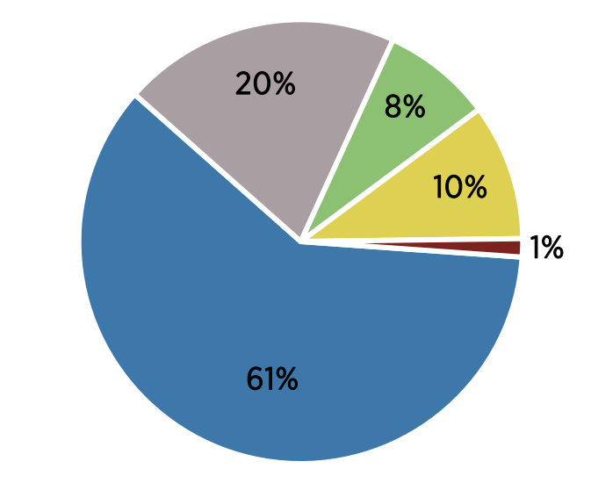
Renewable electricity generation by energy source
Total electricity generated from renewables in 2019
In 2019, the total amount of electricity generated from renewables was 6 963 TWh.
Renewable hydro accounted for about 61% of this (4,207 TWh), followed by wind energy (1 412 TWh), solar energy (693 TWh), bioenergy (558 TWh), geothermal energy (92 TWh) and marine energy (1 TWh).
Notes:
In 2019, the total amount of electricity generated from renewables was 6 963 TWh. Renewable hydro accounted for about 61% of this (4 207 TWh), followed by wind energy (1 412 TWh), solar energy (693 TWh), bioenergy (558 TWh), geothermal energy (92 TWh) and marine energy (1 TWh).
Bioenergy generation was divided as follows: 389 TWh (69%) from solid biofuels; 92 TWh (20%) from biogas; 69 TWh (10%) from renewable municipal waste; and 8 TWh (1%) from liquid biofuels

Slide 3
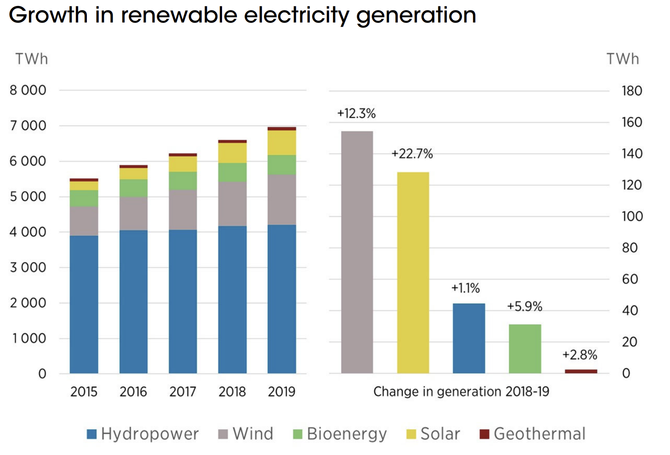
Growth in renewable electricity generation
Renewable electricity generation in 2019 was 361 TWh higher than in 2018 (+5.5%)
Solar and wind generation continued to grow strongly in 2019 (+23% and 12% respectively)
Bioenergy generation also increased by a lot more than in previous years (+31 TWh).
Solar and wind energy continue to dominate growth in renewable generation,
accounting for 71% of growth since 2015.
Notes:
In 2019, the total amount of electricity generated from renewables was 6 963 TWh. Renewable hydro accounted for about 61% of this (4 207 TWh), followed by wind energy (1 412 TWh), solar energy (693 TWh), bioenergy (558 TWh), geothermal energy (92 TWh) and marine energy (1 TWh).
Bioenergy generation was divided as follows: 389 TWh (69%) from solid biofuels; 92 TWh (20%) from biogas; 69 TWh (10%) from renewable municipal waste; and 8 TWh (1%) from liquid biofuels

Slide 4
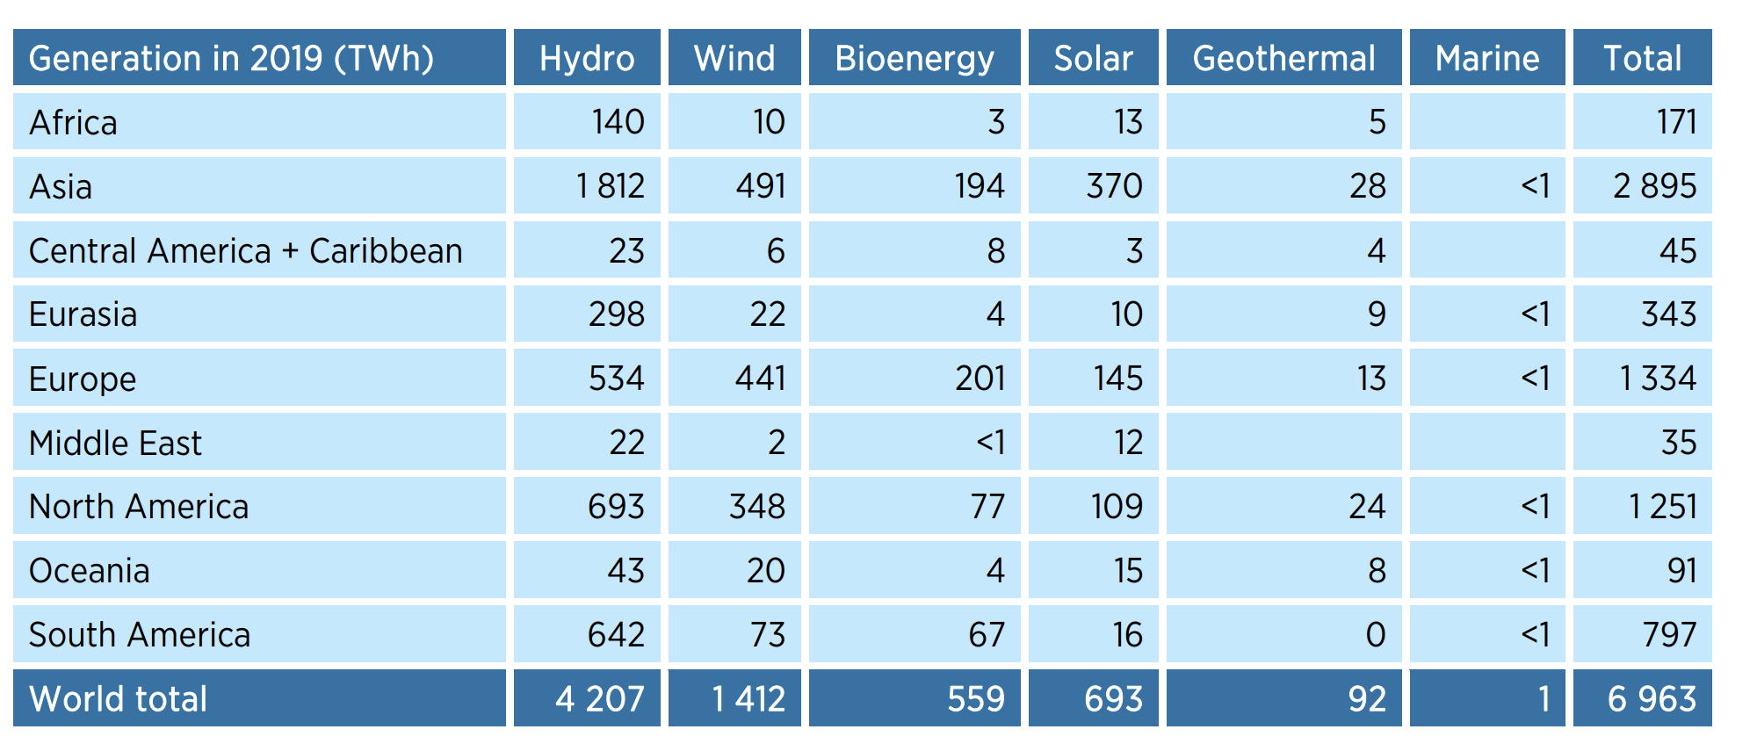
Renewable electricity generation by region
Asia accounted for most growth in renewable electricity generation, with an increase of 245 TWh in 2019. Asia’s share of global renewable generation also continued to increase, reaching 42%. Europe and North America have shares of 19% and 18% respectively, followed by South America (11%) and Eurasia (5%).
Notes:
As in other recent years, Asia accounted for most growth in renewable electricity generation, with an increase of 245 TWh in 2019. Asia’s share of global renewable generation also continued to increase, reaching 42%. Europe and North America have shares of 19% and 18% respectively, followed by South America (11%) and Eurasia (5%). In 2019, renewable hydro generation contracted in most regions, but expanded by almost 90 TWh in Asia, accounting for all of the growth in global generation. Most growth in wind generation occurred in Europe and Asia (+58 TWh and +51 TWh respectively), followed by North America (+25 TWh). Asia also accounted for most of the increase in solar generation (+77 TWh out of the global increase of +128 TWh)

Slide 5
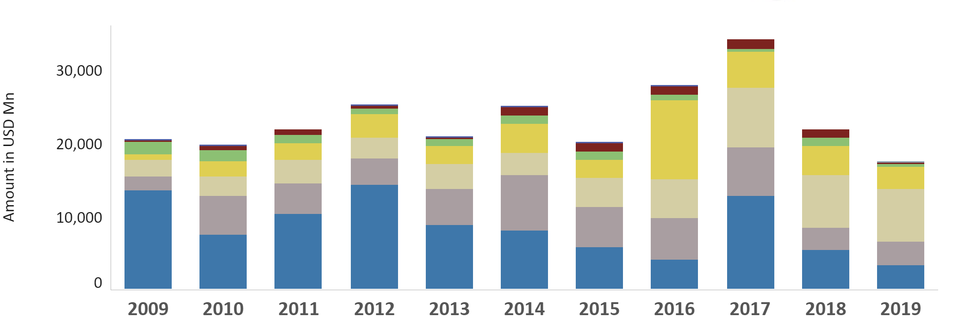
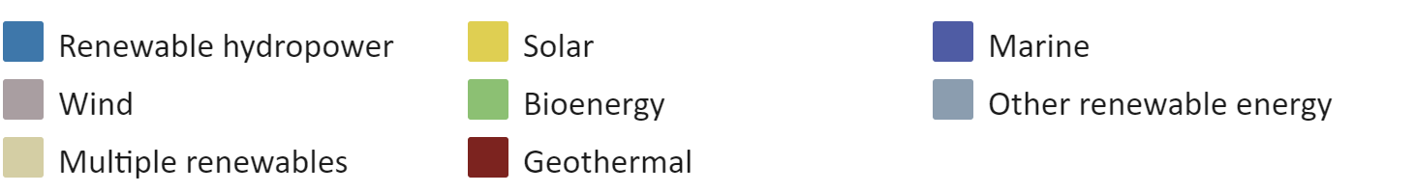
Public investments in renewables
Public investment trends in renewables 2009-2019 (at 2019 prices and exchange rates)
Public investment in renewable energy continued to decline in 2019, with a total investment of USD 17 billion (at 2019 prices and exchange rates), compared to figures of USD 22 billion and USD 34 billion in 2018 and 2017 respectively. This decline has occurred across all technologies.

Slide 6
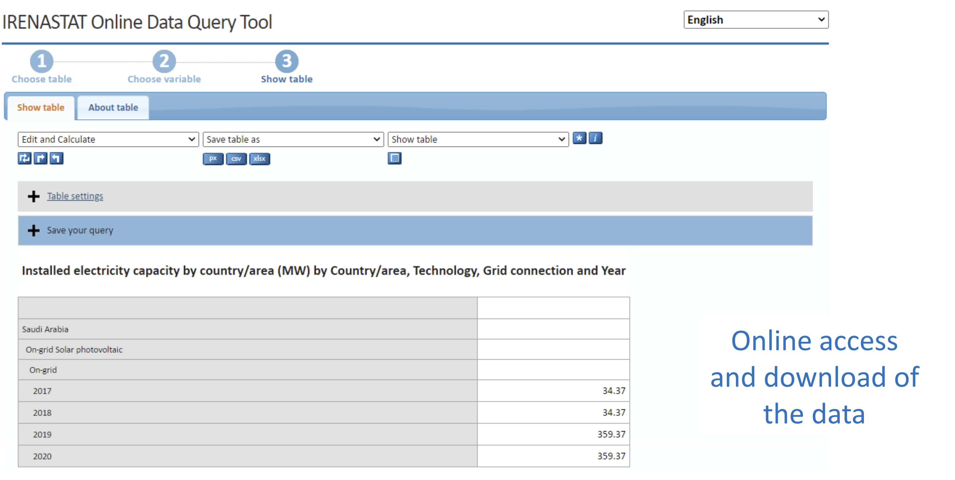
IRENA analysis & data is freely available online
http://pxweb.irena.org/pxweb/en/IRENASTAT

Slide 7
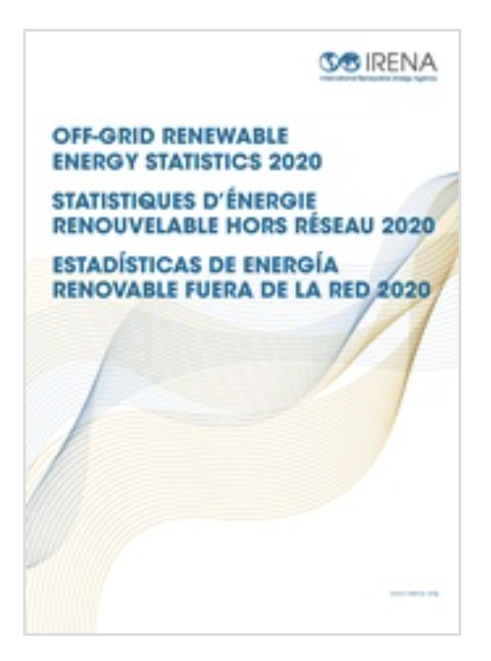
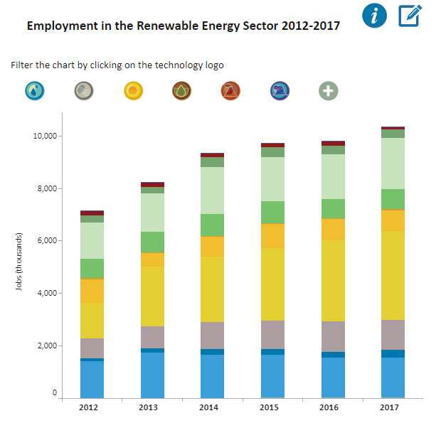
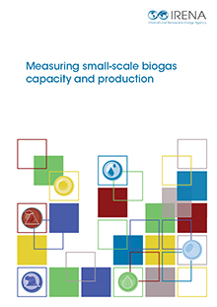
Interactive charts and more on Statistics page
Includes statistics, data query tools, manuals, pilot studies and methodological notes covering various topics and other data:
www.irena.org/statistics
7

