Slide 1
The Geopolitics of the Energy Transformation:
The Hydrogen Factor

Slide 2
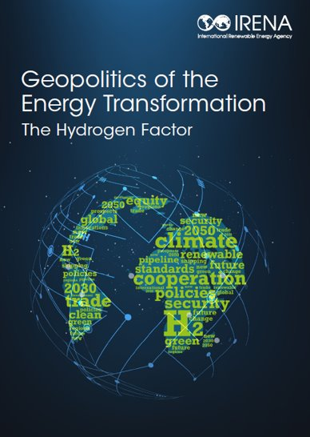
Geopolitics of the Energy Transformation: The Hydrogen Factor

Slide 3
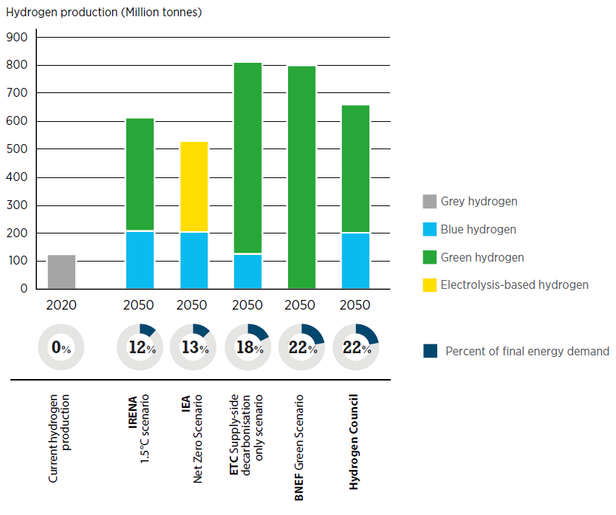
Estimates for global hydrogen demand in 2050

Slide 4
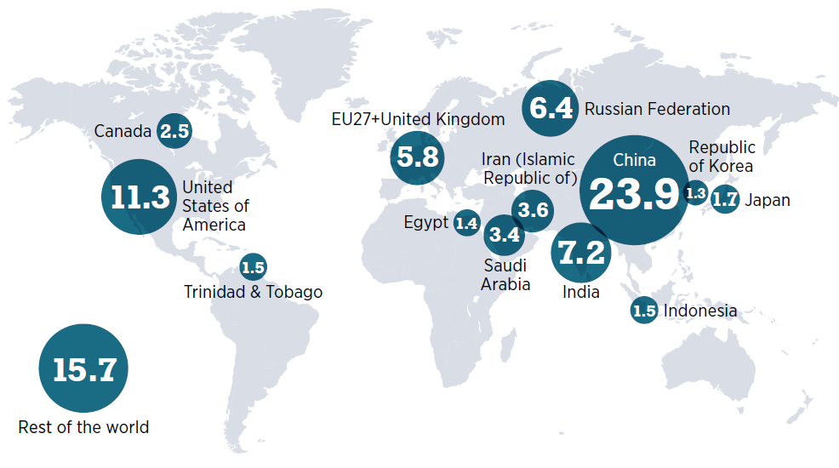
Hydrogen consumption in 2020 (million tonnes per year)

Slide 5
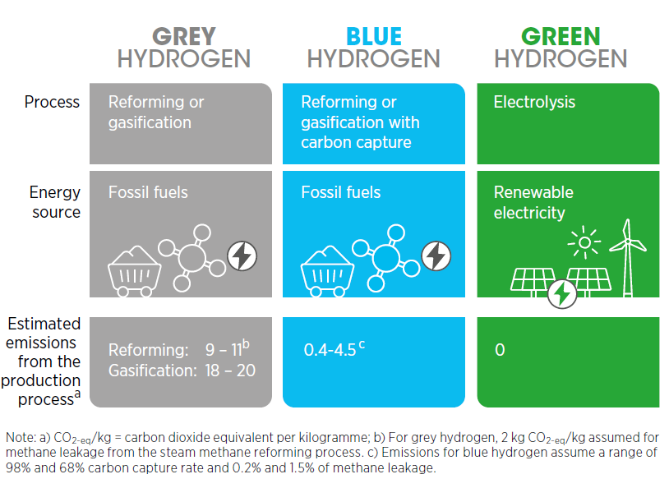
Selected colour-code typology of hydrogen production

Slide 6
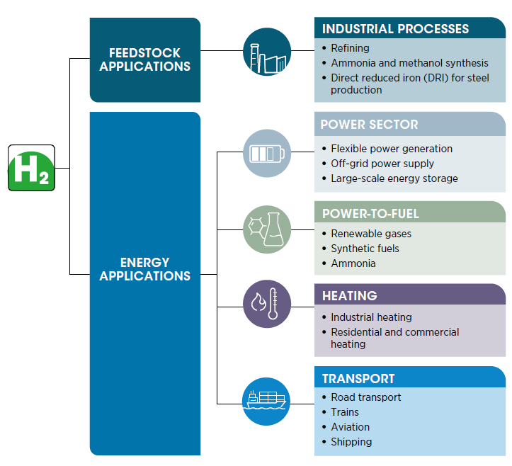
Potential uses for clean hydrogen

Slide 7
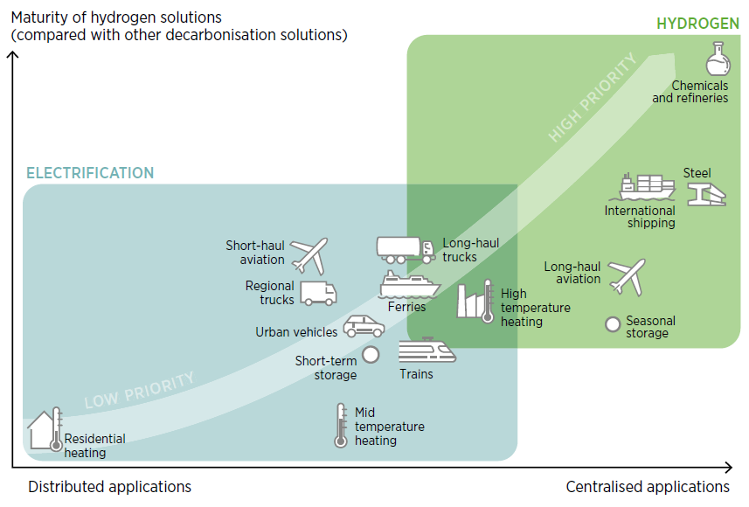
Clean hydrogen policy priorities

Slide 8
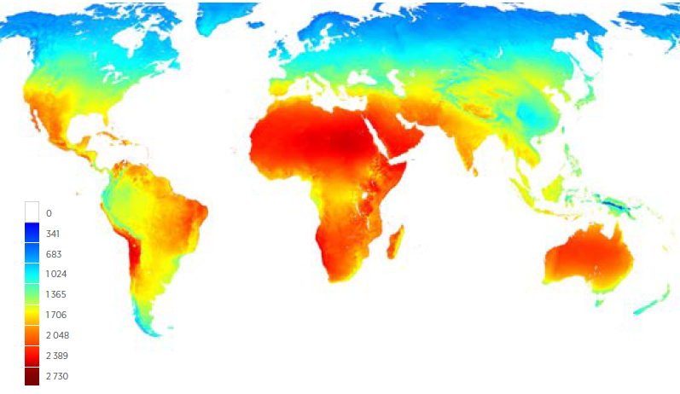

World renewable technical potential
Annual average global horizontal irradiation (kWh/m2)
Annual average wind speed at 100 metres (m/s).

Slide 9
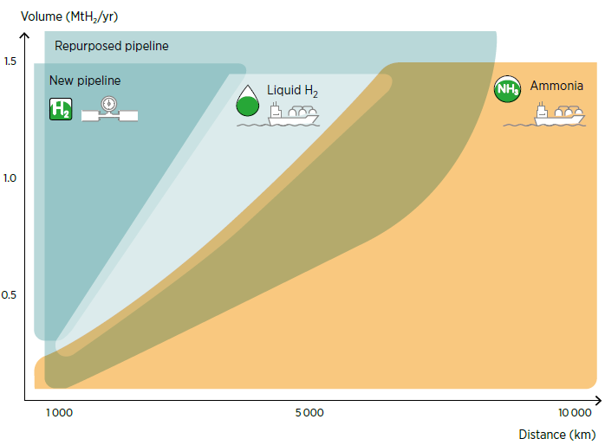
Cost efficiency of transport options when considering volume and distance

Slide 10
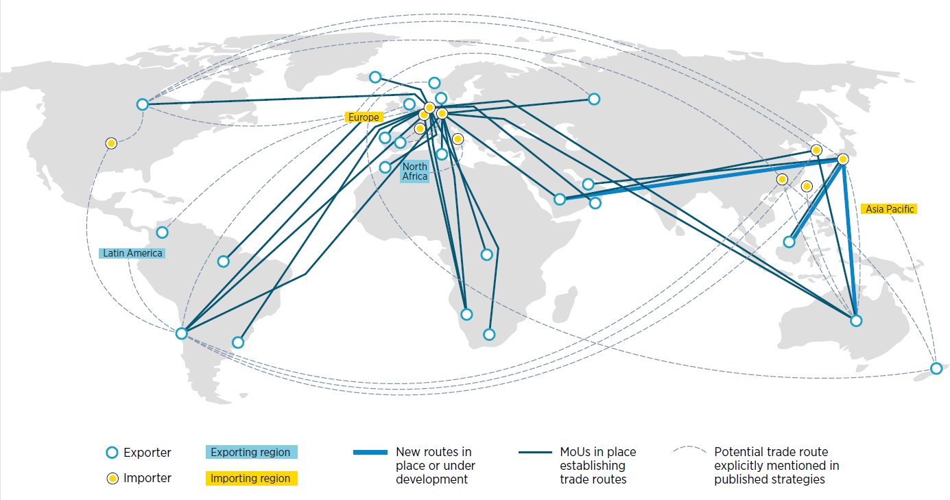
An expanding network of hydrogen trade routes, plans and agreements

Slide 11
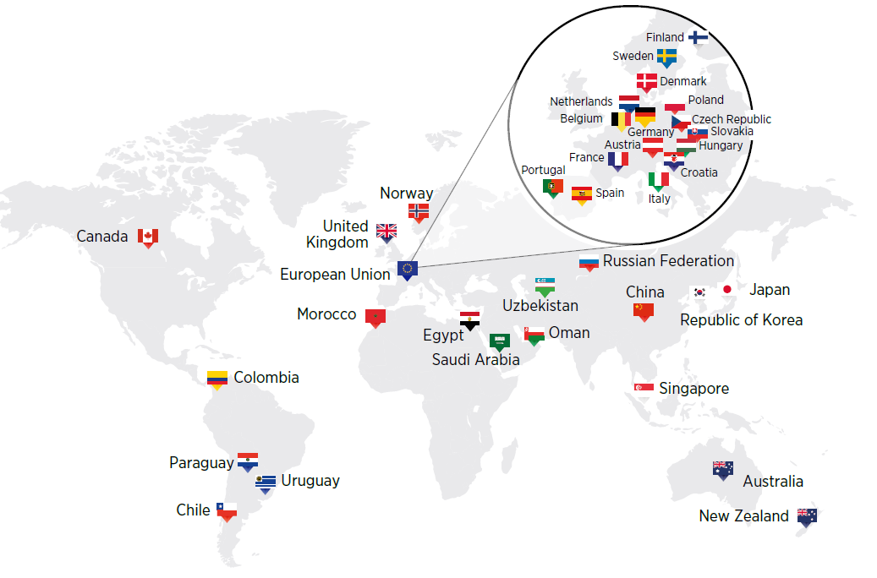
Hydrogen Strategies (October 2021)

Slide 12
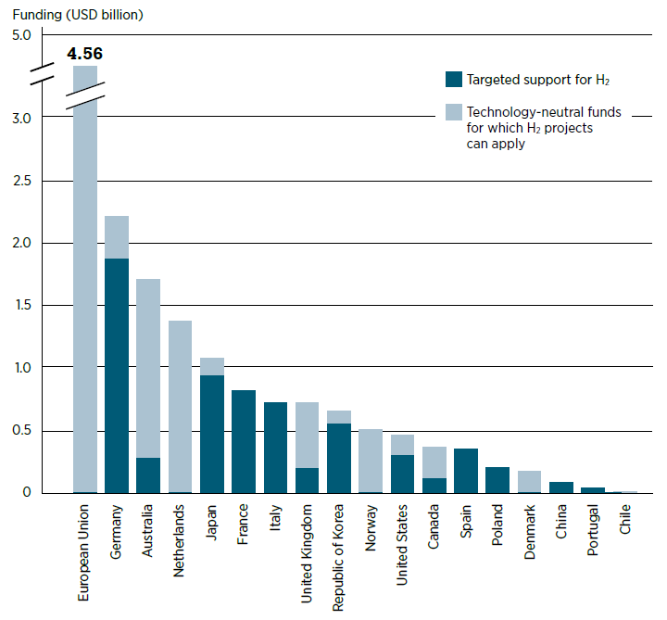
Average annual funding potentially available for hydrogen projects, 2021-2030
As of August 2021

Slide 13
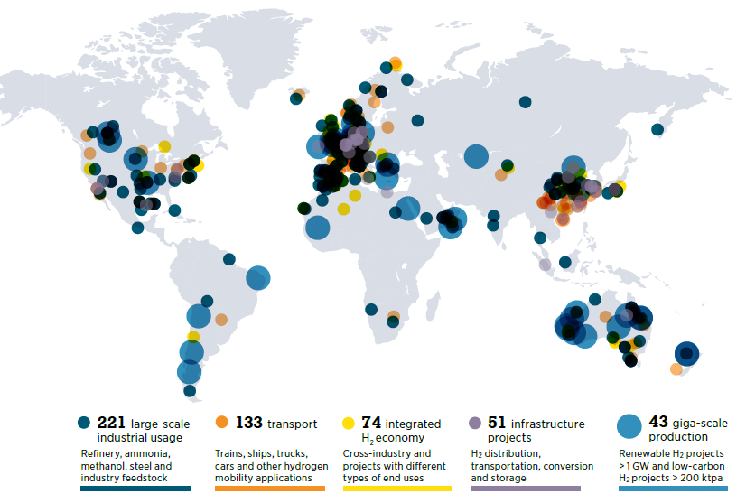
Clean hydrogen projects and investment (November 2021)

Slide 14
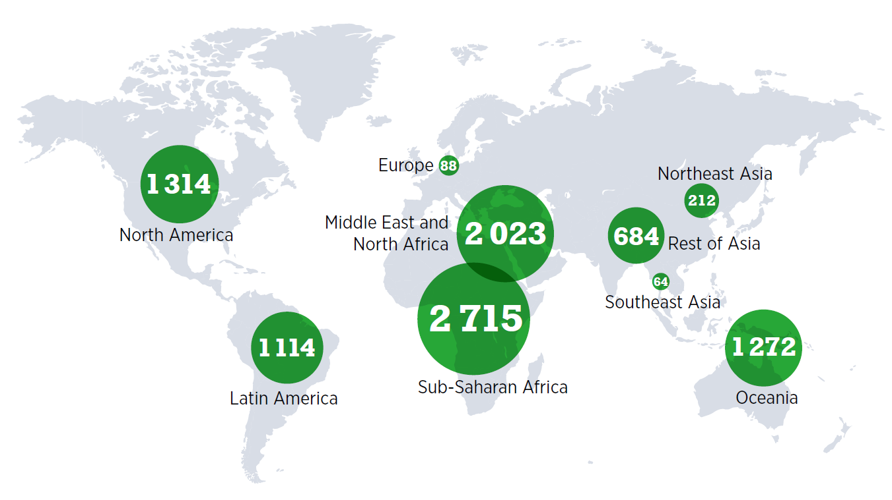
Technical potential for producing green hydrogen under USD 1.5/kg by 2050, in EJ

Slide 15
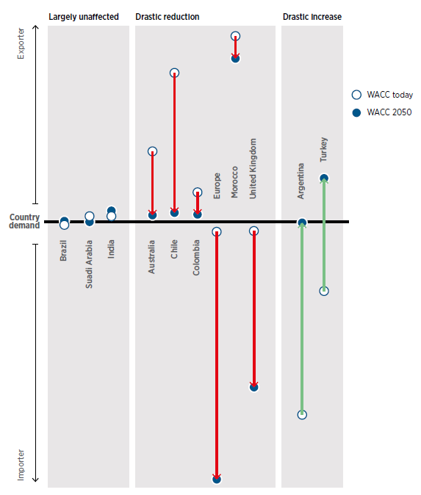
Impact of cost assumptions on hydrogen production of selected countries

Slide 16
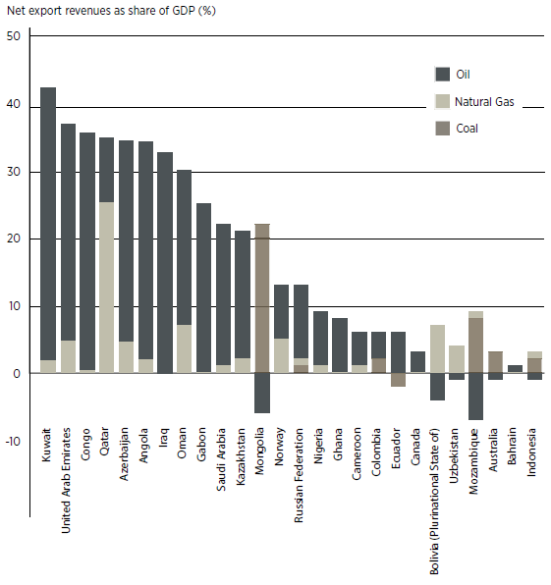
Stranded asset risk for major net fossil fuel exporters, 2019

Slide 17
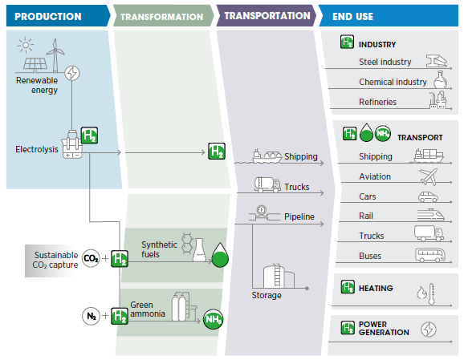
Technology leadership opportunities in green hydrogen value chains

Slide 18
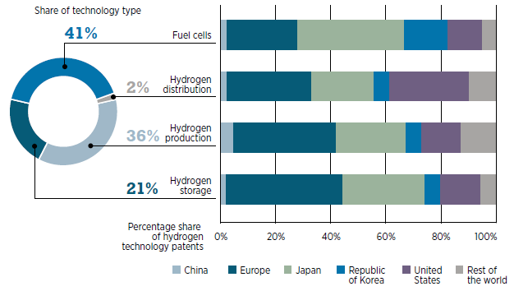
Geographic distribution of hydrogen-related patent families, 2010-2020

Slide 19
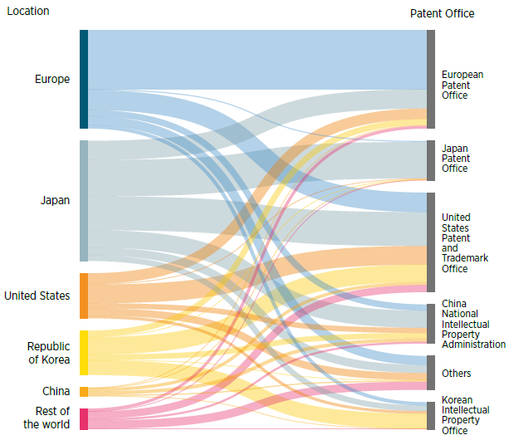
Flow of inventions in hydrogen technology, 2010-2020

Slide 20
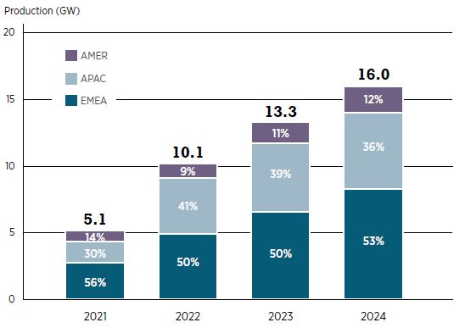
Estimated global electrolyser manufacturing capacity 2021-2024
based on investment plans

Slide 21
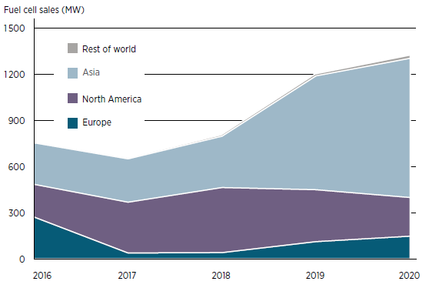
Fuel cell sales, by region of adoption, 2016-2020

Slide 22
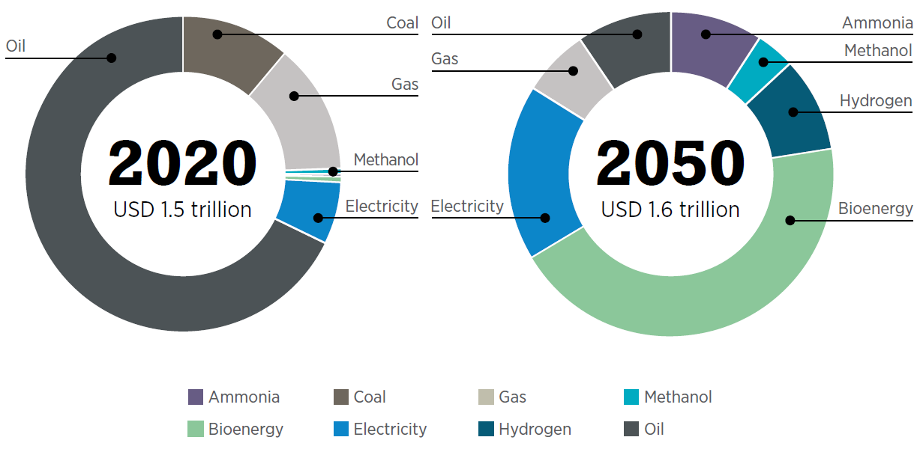
Shifts in the value of trade in energy commodities, 2020 to 2050

Slide 23

Global map of natural gas transmission pipelines

Slide 24
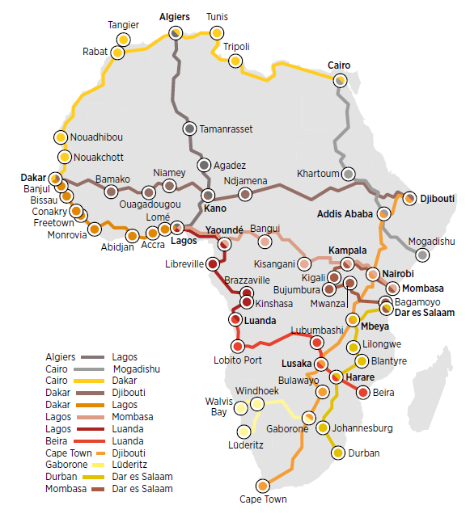
Possible hydrogen routes across Africa

Slide 25
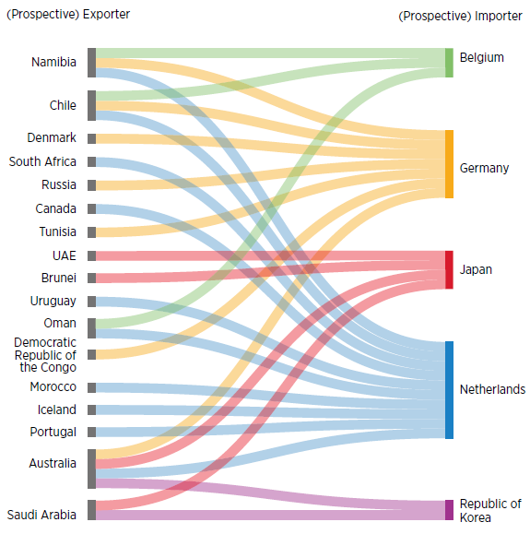
Selected country bilateral trade agreements and MOUs (November 2021)

Slide 26
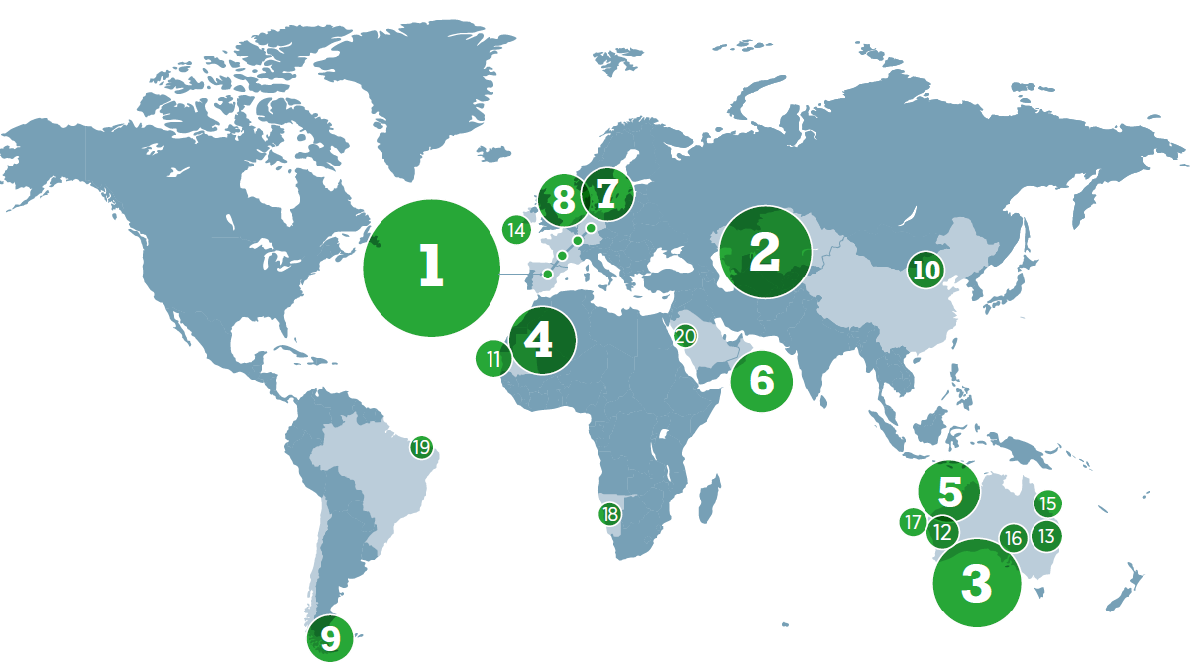
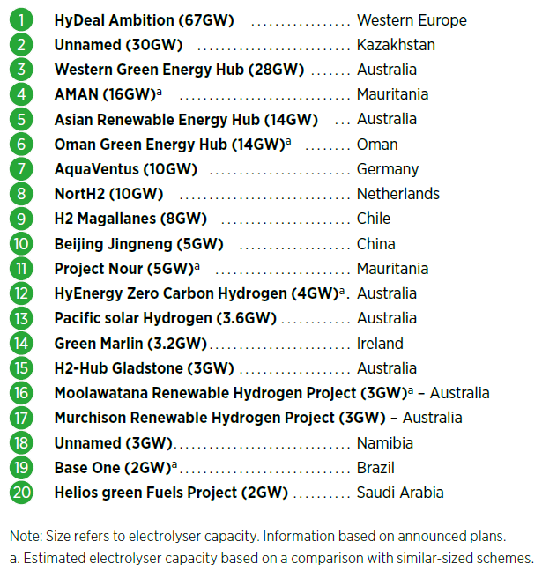
Largest green hydrogen projects, 2021

Slide 27
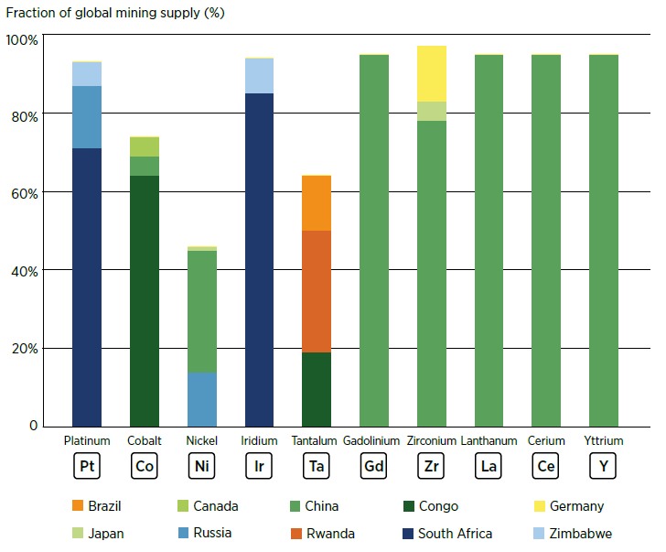
Top producers of critical materials in electrolysers

Slide 28
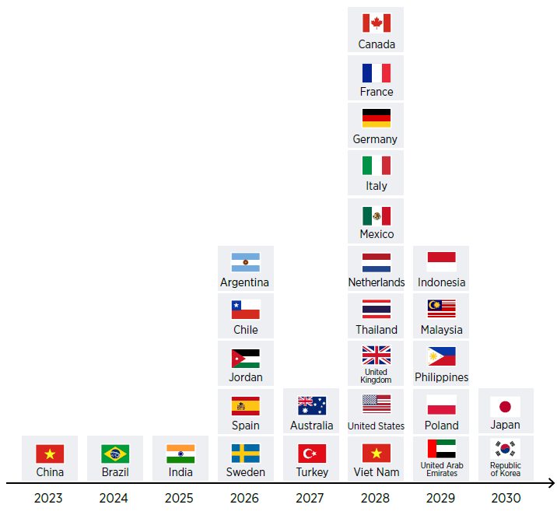
Countries where green hydrogen could become cheaper than blue hydrogen

Slide 29
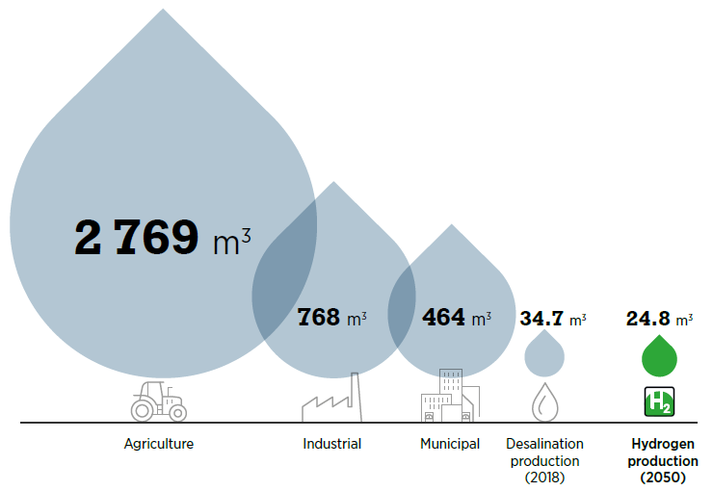
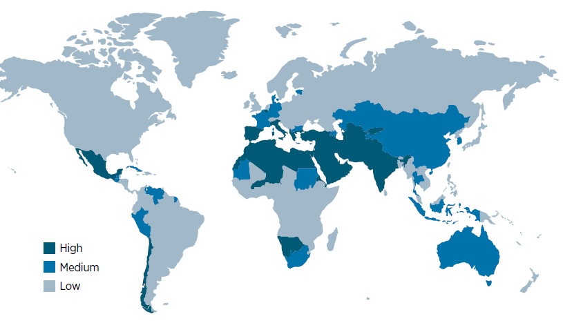
Water
Heat map of water stress levels
Water consumption of hydrogen in 2050
compared with selected sectors today (bn m³)

Slide 30
Policy Considerations
Hydrogen is part of a much bigger energy transition picture, and its development and deployment strategies should not be pursued in isolation.
Setting the right priorities for hydrogen use will be essential for its rapid scale-up and long-term contribution to decarbonisation efforts.
International co-operation will be necessary to devise a transparent hydrogen market with coherent standards and norms that contribute to climate change efforts meaningfully.
Supporting the advancement of renewable energy and green hydrogen in developing countries is critical for decarbonising the energy system and can contribute to global equity and stability.
Geopolitical risks can be mitigated by reducing unnecessary energy consumption across many final uses.
Policy makers should consider broader impacts of hydrogen development on sustainable development to ensure positive, long-lasting outcomes.

