Slide 1
Delivering on the UAE Consensus
TRACKING PROGRESS
Francesco La Camera
IRENA Director-General
Friday, 11 October 2024 • PRE-COP29 • Baku, Azerbaijan

Slide 2
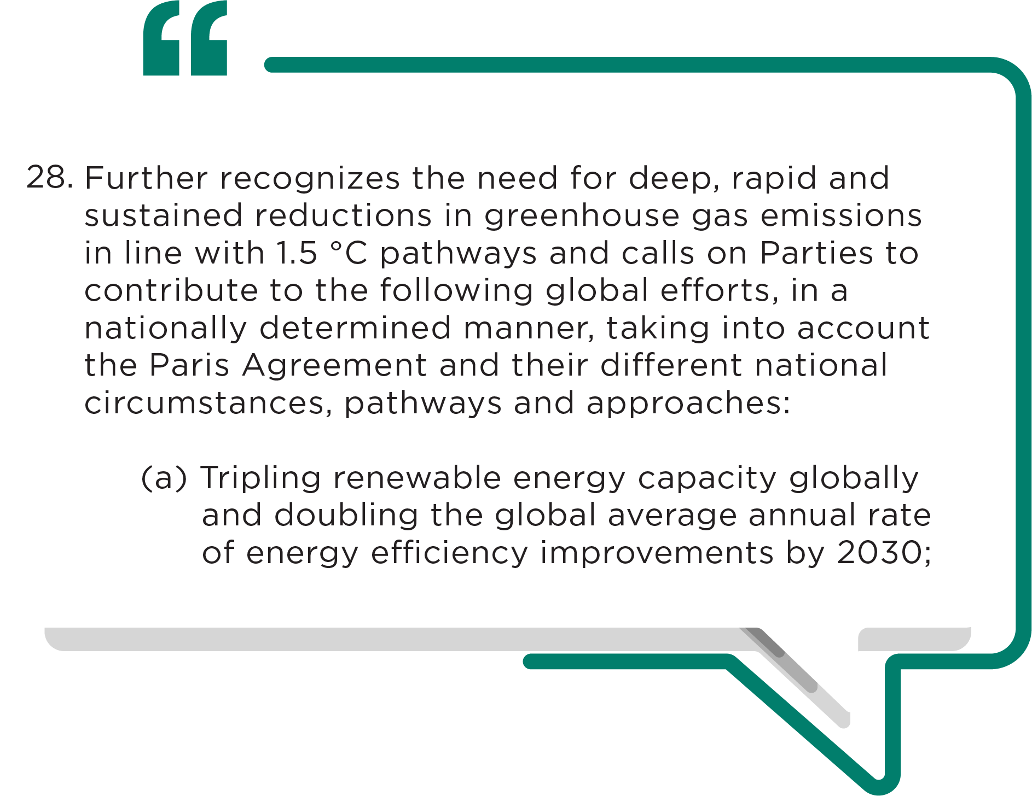


Outcome of the First Global Stocktake at COP28
2

Slide 3
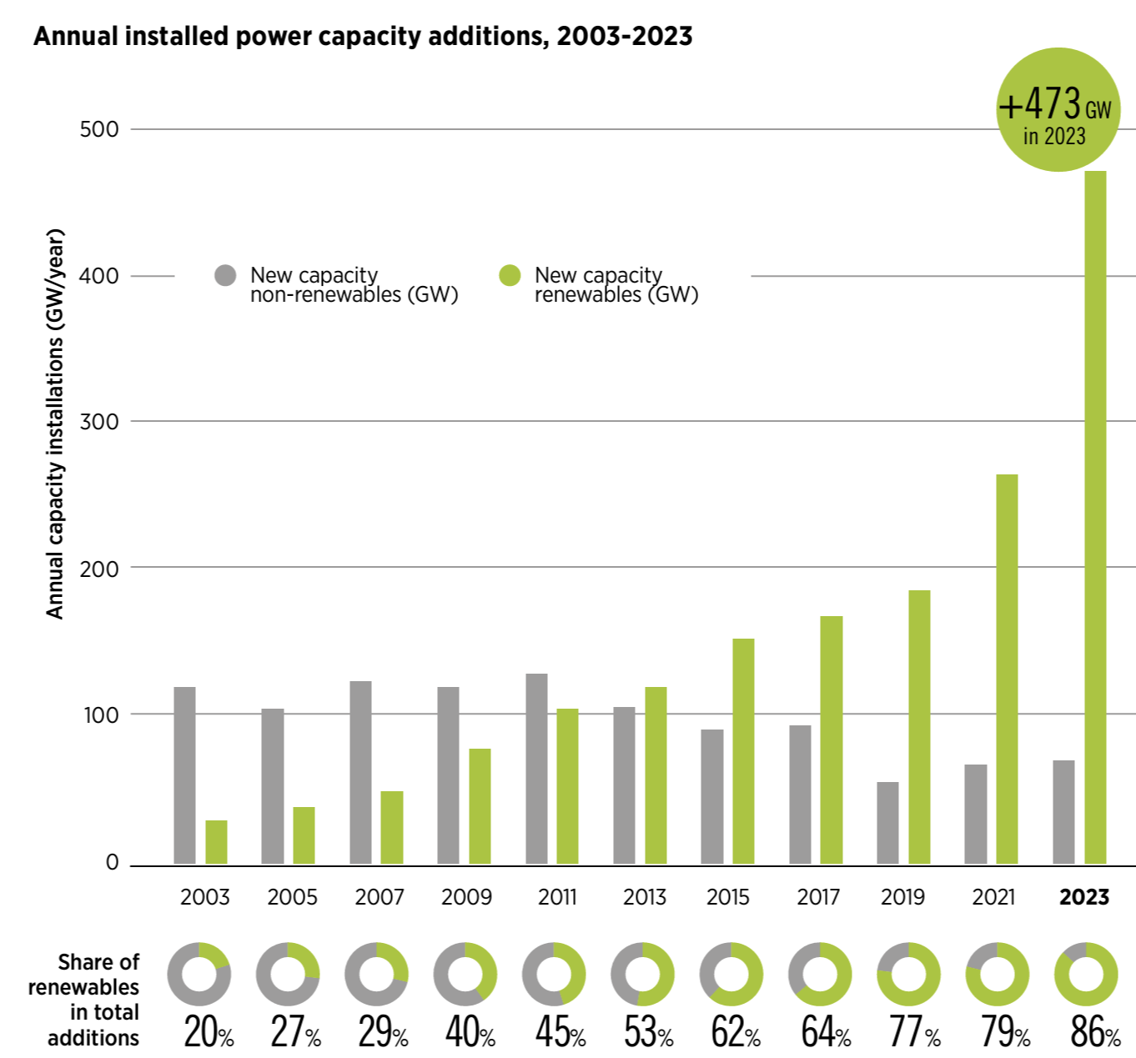
Renewable power additions saw unprecedented growth in 2023
Annual installed power capacity additions, 2003-2023.
Conducive policies, geopolitical developments and falling costs, have driven renewable energy growth.
Renewable capacity of 473 GW added in 2023, accounting for 87% of newly installed capacity.
Solar energy accounted for 73% of this growth.
New capacity was concentrated in China, the EU and the US, which collectively accounted for 83% of additions.
3

Slide 4
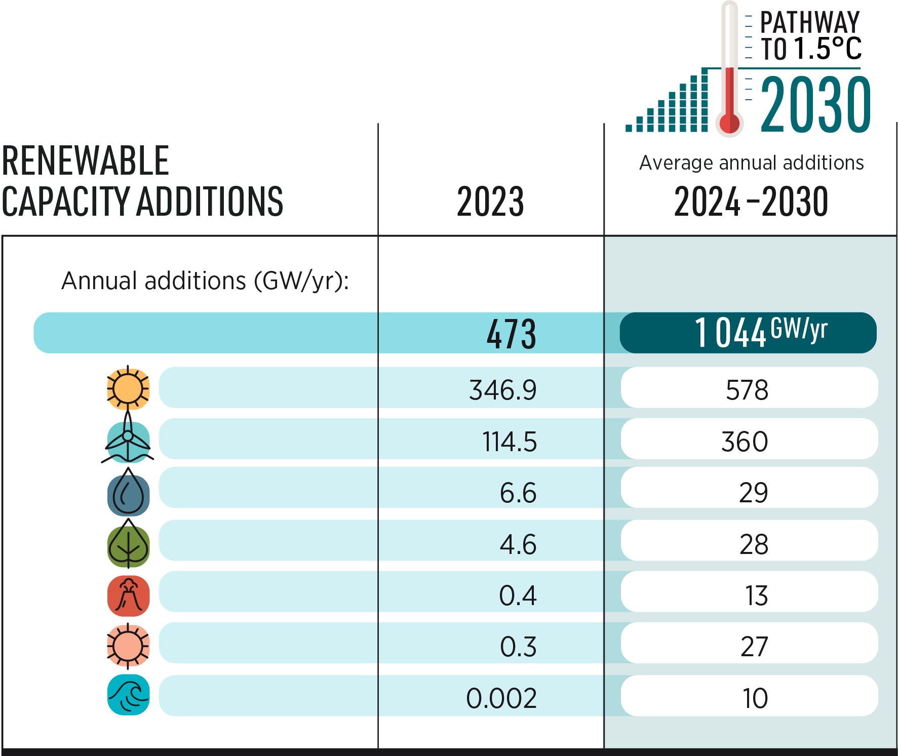
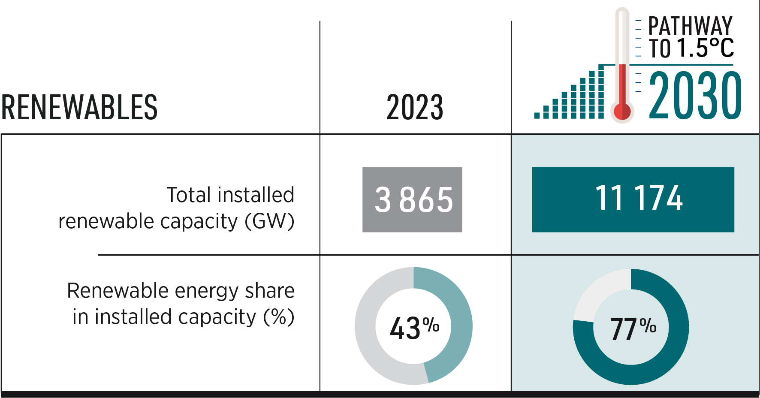
Gaps to the tripling goal
Tracking COP28 outcomes: Tripling renewable power by 2030.
4

Slide 5
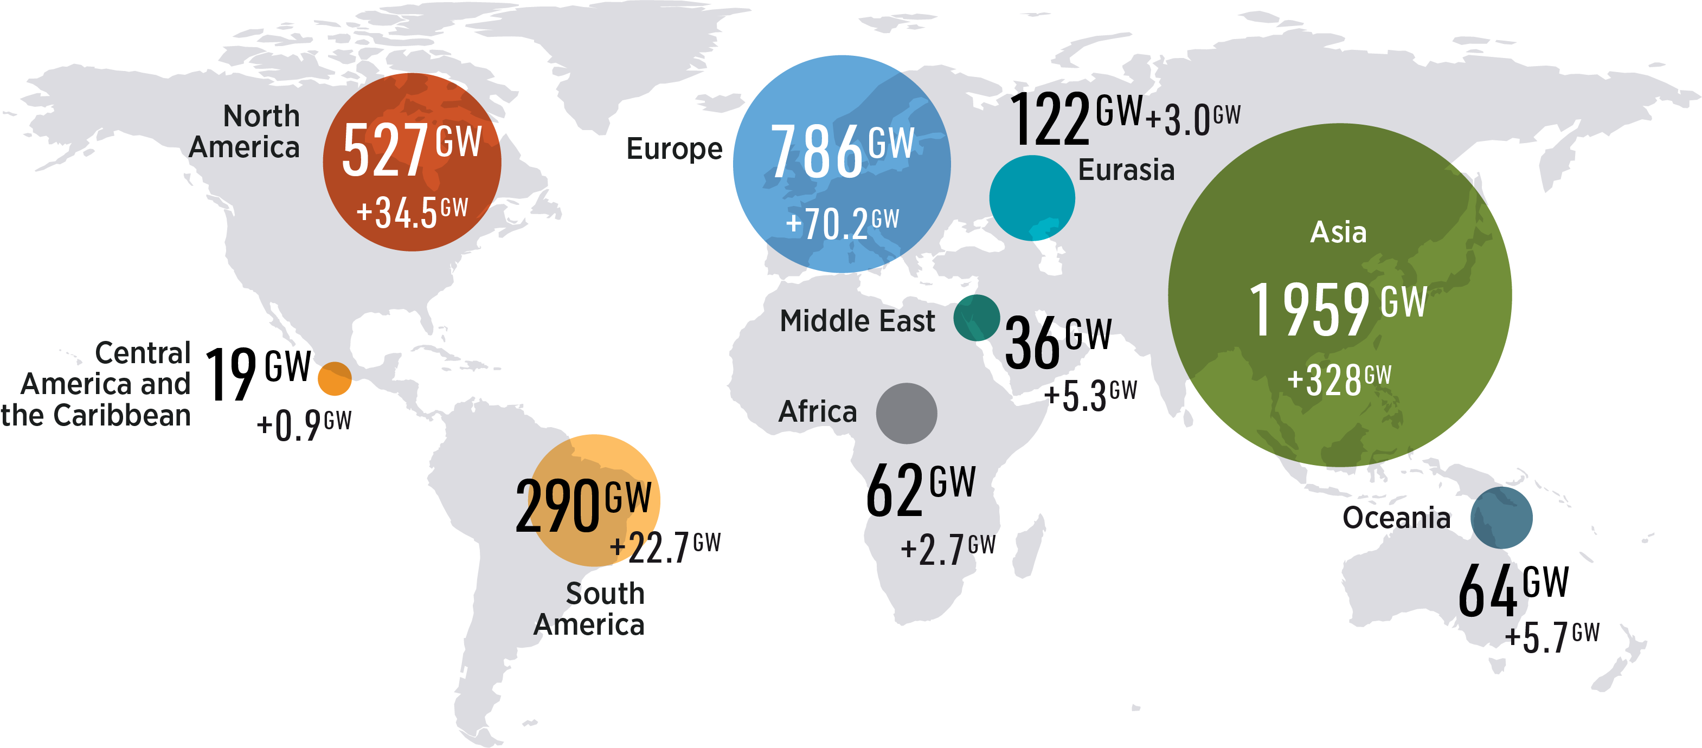
Uneven geographical deployment
Renewable power capacity by region and additions in 2023.
5

Slide 6
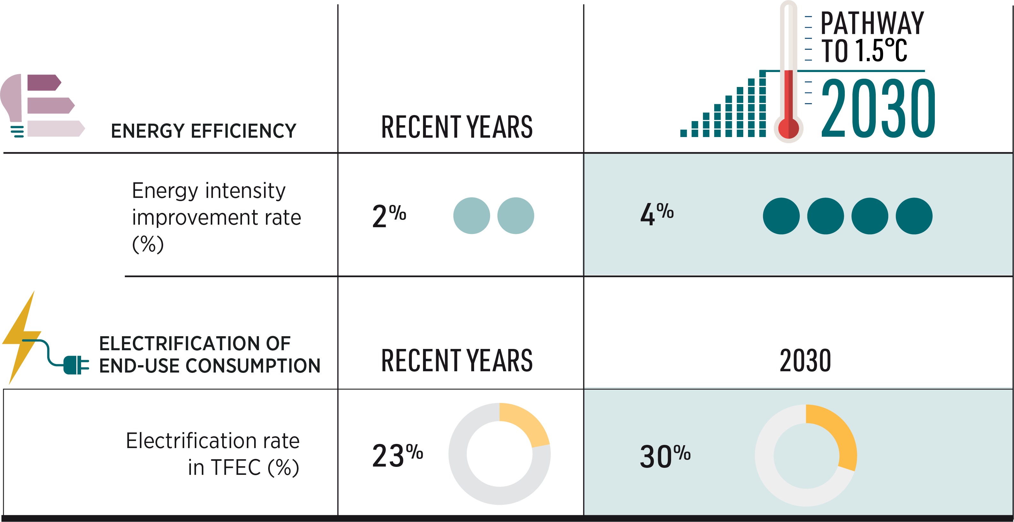
Urgent need to accelerate energy efficiency and electrification
6

Slide 7
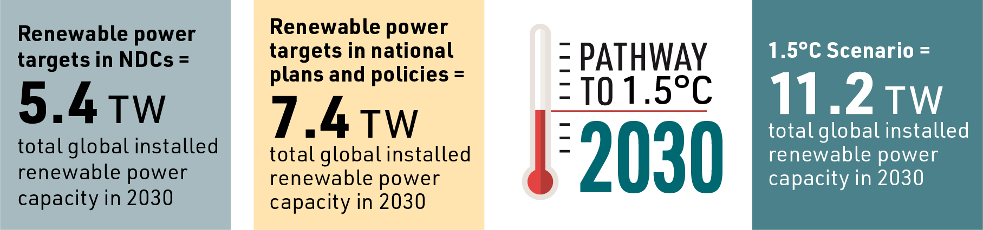
Enhanced NDCs are needed
7

Slide 8
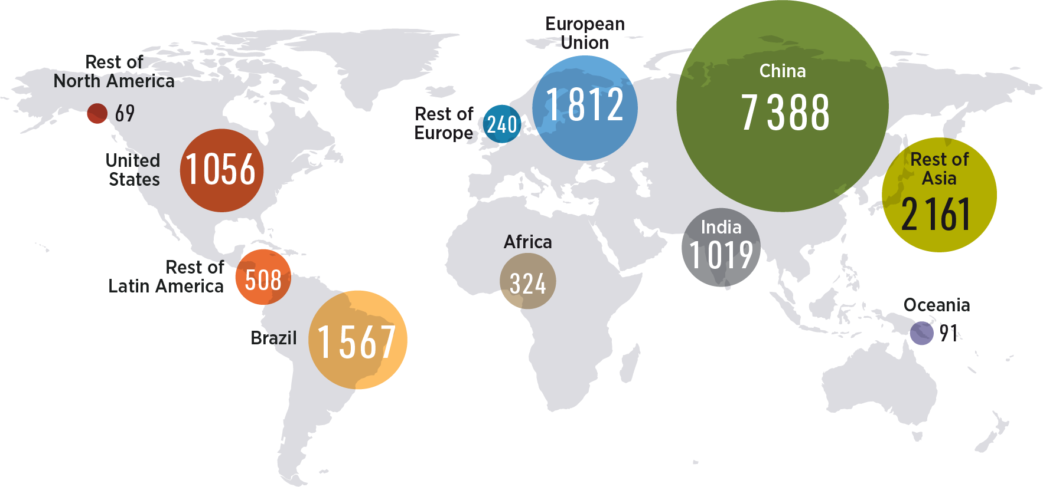
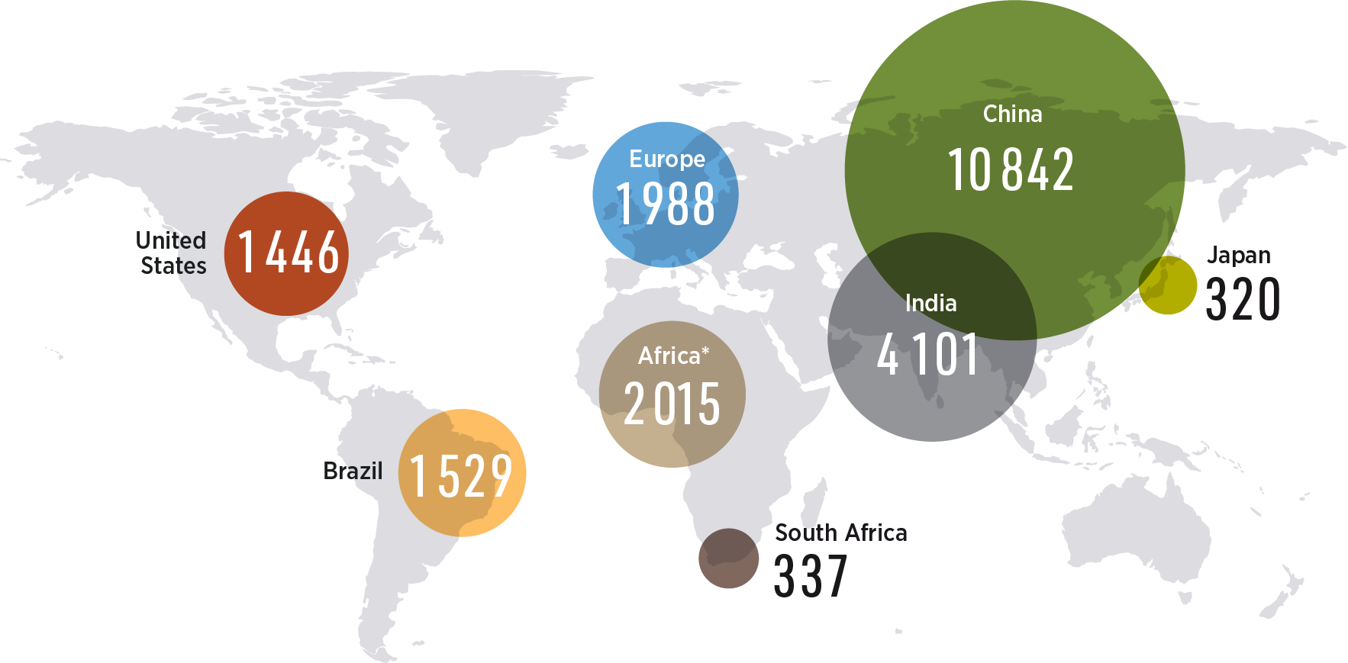

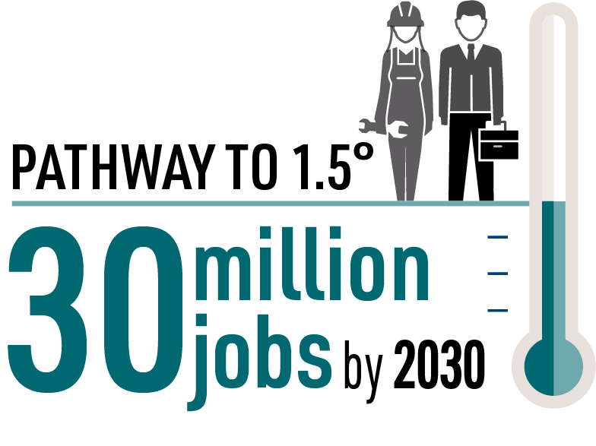
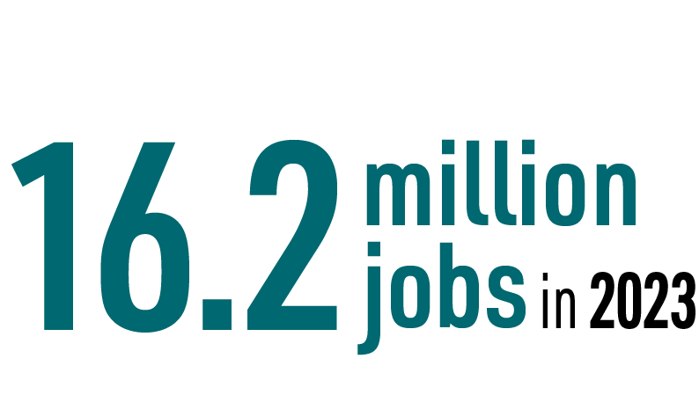
Benefits of tripling on job creation
Jobs in 2023 (in thousands)
Expected jobs under the 1.5°C scenario in 2030
(in thousands)
8

Slide 9
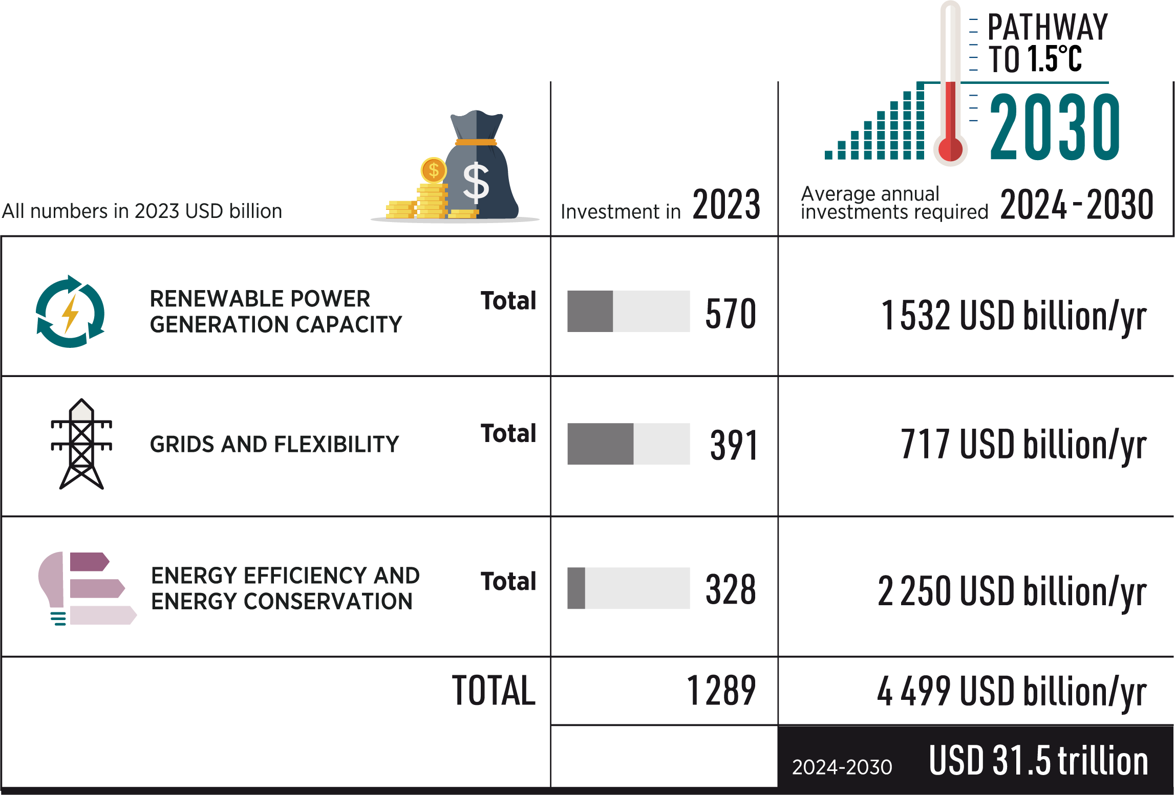
Investments are key
9

Slide 10

Key barriers to the global energy transition
10

Slide 11
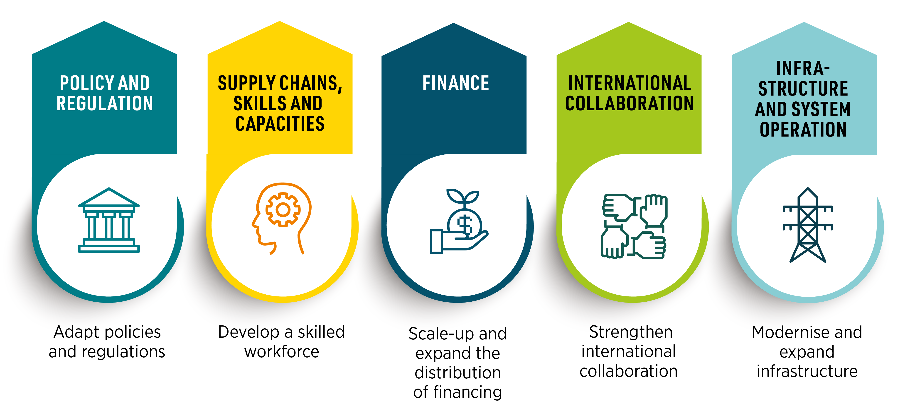
Enablers and urgent actions for policy makers ahead of COP29
11

Slide 12

READ THE REPORT

