Slide 1
Side event:
Best Practices in Energy Planning for Social Inclusion and Mobilizing Finance
Abu Dhabi, UAE. June 14, 2024.
IRENA Innovation and Technology Centre

Slide 2
Event Overview
Session 1: Participatory process – cross government cooperation and social inclusion | 35 min
Session 2: Strategic energy planning for finance mobilization | 35 min
Floor interventions | 10 min
Closing remarks | 05 min

Slide 3

Session 1:
Scene-setting:
Robust energy planning and participatory process. Experiences from the Global LTES Network
(Global Network of Energy Scenario Practitioners)
Juan Jose Garcia
Programme Officer
Clean Energy Transition Scenarios

Slide 4
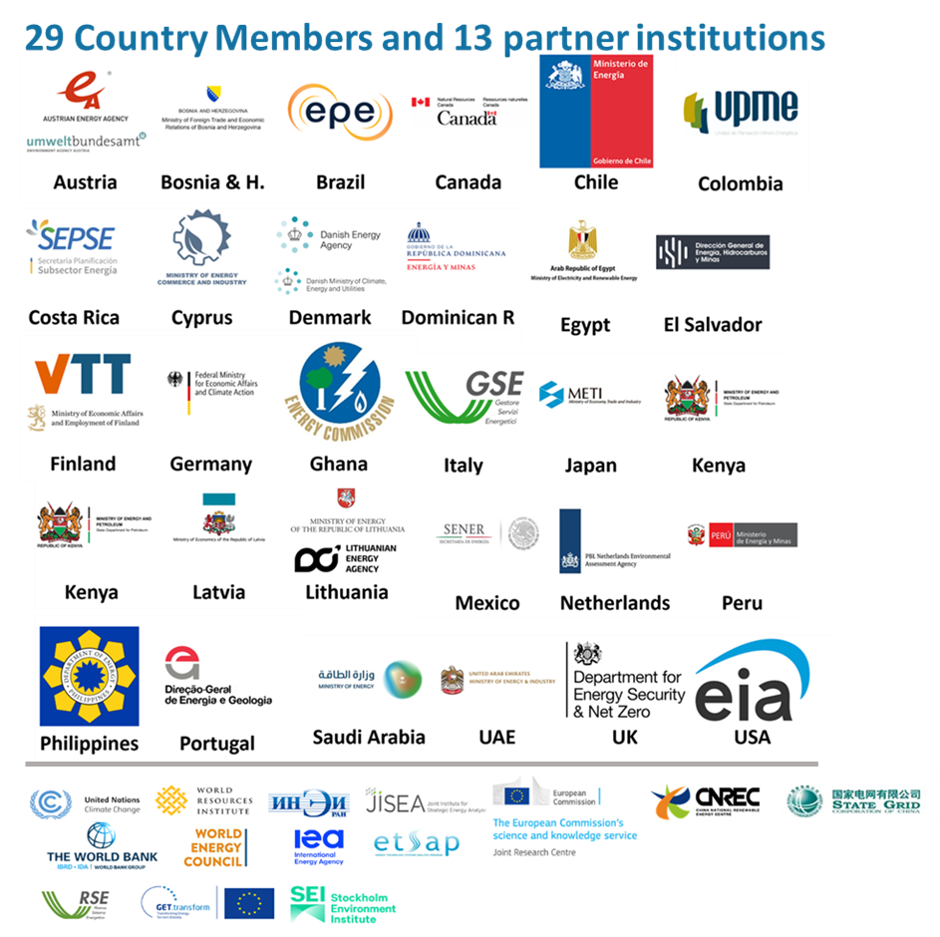

Global LTES Network
Network of energy scenario practitioners from governments
Countries with exemplary planning practices
Platform for peer-to-peer exchange
Set the agenda for the community
Notes:
What is it? Key Points:
Global Reach and Membership: Mention the 29 countries and 13 technical partners.
Experience and Engagement: Highlight over 70 international and regional dialogue sessions, attracting 6000 participants and featuring more than 400 scenario experts.
Why do countries use LTES? Key Points:
Countries are using energy scenarios as strategic tools for navigating the complexities of the clean energy transition.
Scenarios provide critical insights into future energy systems, policy impacts, and strategic planning.
Specific uses of Scenarios include:
Forecast energy demand
Assess renewable energy potential
Risk management and uncertainty exploration
Stakeholder engagement and consensus building
Align energy plans with climate goals.
Identify and prioritize infrastructure investments
After all, the underlaying purpose of using scenarios is to make informed decisions and policy frameworks.
Examples of use of Scenarios (can mention 2 or 3):
Denmark: : Grounding energy planning in economic viability and technological feasibility.
Brazil: Aligning the energy transition with economic and environmental goals and enhancing stakeholder engagement.
Germany: understanding of potential pathways to achieve energy transition and decarbonization goals.
United Arab Emirates (UAE): Balancing economic needs and environmental goals
Chile: Reducing uncertainty and risk in decision-making for carbon neutrality by 2050.
Nigeria: Exploring decarbonization trajectories and planning infrastructure development.
South Africa: Supporting the development of the Integrated Resource Plan (IRP).
The Philippines: Use of scenarios: Facilitating continuous stakeholder participation and leveraging international technical assistance for scenario development.
Practical Impacts Key Points:
Members, such as Ghana, Chile, Brazil, Cyprus, Costa Rica, Kenya, have cited the importance of the Network in allowing them to learn and update their planning frameworks to be more participatory and to apply good practices to shared problems. The Network has enabled members to incorporate different elements into their energy plans, communicate their scenarios more effectively, and feel supported in facing common challenges.

Slide 5
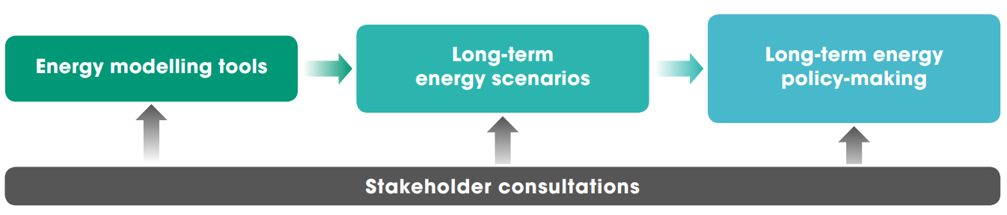
Energy planning mental model – original
How are scenarios developed and used in the energy planning process for government decision-making?
Notes:
The LTES network has operated with a clear focus on scenario use within the government sector. We tend to use this mental model for the Network to illustrate the energy planning process within the general decision-making framework,
in a simplified model, long-term scenarios are used within ministries and similar institutions, which are often produced with energy modelling tools. This in turn informs policymaking within the legislative and executive branches.
Stakeholder consultations form an essential part of this process in each step, especially with the increasing complexity a and diversity of stakeholders that is necessitated by the clean energy transition
Members of the LTES network have highlighted the importance of the topic of communication with stakeholder and participatory processes, and in a survey we conducted to explore the priorities of the network, members expressed their keen interest in further exploring this topic within this Network, which was our main driver for holding this session

Slide 6
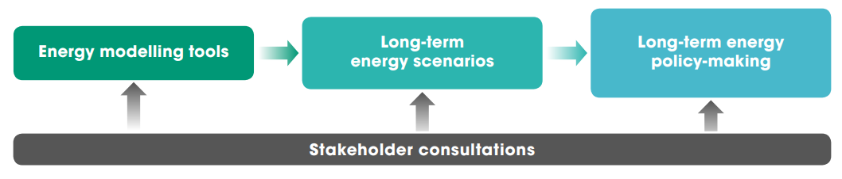
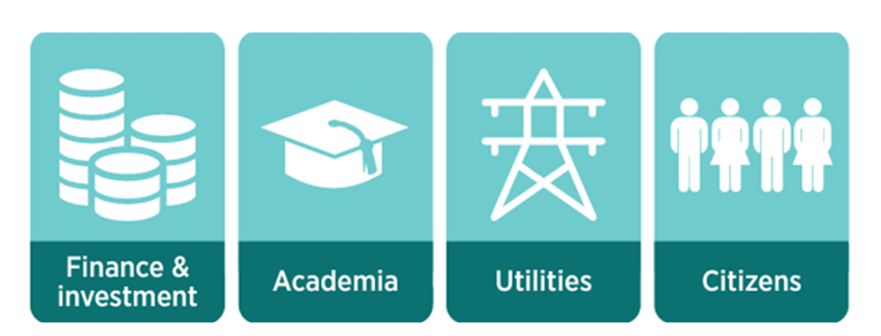
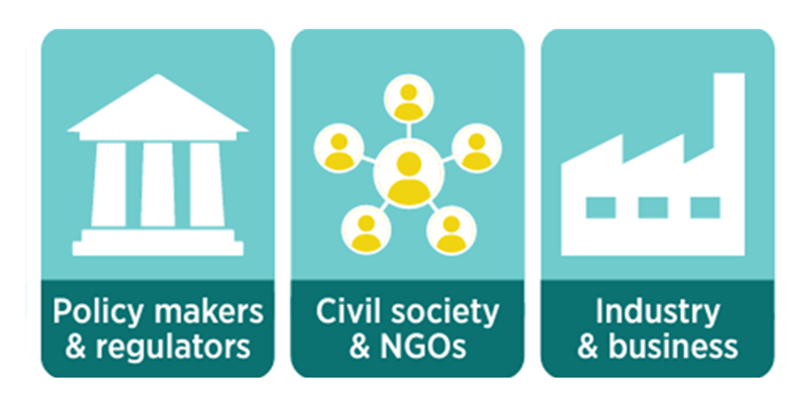
Participation and communication
Modified energy planning mental model
Notes:
And they are indeed different processes, but they are linked as participatory processes can sometimes be a great way to communicate scenarios to different stakeholders, and this is something that was stressed both by members and during talks with scientists and experts.
And this is how we see them becoming part of one process, where communication becomes a key outcome of the participatory process, where participatory process is expanded to encompass all the relevant stakeholders for the clean energy transition, and communication can be done efficiently through learning from experience and actual hands on engagement
As I mentioned, this is a topic that has been considered essential by our members and we think this can be a valuable setting in which we can gather your input to refine this model and reflect it to these government institutions, as this can be an appropriate way to link this scientific community and scenario practitioners in the public space

Slide 7









Why participation and communication
Participatory energy planning is crucial for a sustainable, inclusive energy future due to its ability to:
Build trust among stakeholders and increase legitimacy of plans.
Ensure policies are equitable and mindful of all stakeholders' needs.
Communicate clear insights about the assumptions, outcomes, and compromises in policy decisions.
Featured case studies
Notes:
Important:
Based on the Global Network’s member experiences it's recognized the crucial role of participatory planning processes.
Key points on building trust:
how it build trust?
By opening up the development process, making it inclusive, and adopting a multi-institutional approach, participatory processes create trustworthy scenarios.
Examples:
Finland: The government is coordinating multidisciplinary research projects with workshops and consumer surveys.
Denmark: Conducting iterative consultations with stakeholders.
Brazil: Including public consultations in the National Energy Plan development.
United Kingdom: Engaging with nearly 600 stakeholders for the Future Energy Scenarios.
South Africa: Extensive consultation with academia, government, and industry for the Integrated Resource Plan.
Key points on equitable policies:
How energy planning ensures policies are equitable?
by involving diverse groups in the planning process, reflecting a broad consensus, and being mindful of different perspectives.
Examples:
Denmark: Involving experts from various fields in developing Technology Catalogues.
Brazil: Stimulating debate and building consensus through public consultations for the PNE 2050.
Chile: Embedding citizen participation in long-term energy and transmission planning.
Tunisia: Aligning energy scenarios with socio-economic plans and involving specialized stakeholders.
Nigeria: Involving ministries, departments, agencies, private sector, and civil society in LTES development.
Key points on insights from communication and assumptions:
How?
Using transparent and publicly available information, interactive tools, and accessible formats to ensure clarity and understanding among stakeholders.
Examples:
United Kingdom: Uses online interactive tools such as the Carbon Calculator to providing clear insights into energy production and consumption trends.
United Arab Emirates: Educates officials through the Future Lab game.
African power pools: Validate results in workshops and publishing on platforms to ensuring transparency and clear communication of insights.
South Africa: cross-checks simulations with reality in Integrated Resources Assessment Plan to ensure clear communication of inputs, outputs, and outcomes.
Brazil: Transparent communication during scenario development to build consensus and aligning plans with the long-term vision.
Colombia: Uses a diverse communication strategy for the National Energy Plan 2020-2050 to ensuring transparency and effective interaction with a broad audience.
Costa Rica: Uses public consultations and feedback on the National Energy Plan to foster clear communication of assumptions, outcomes, and compromises to all stakeholders.

Slide 8
Panel discussion 1
Ms. Elfriede-Anna More. Head of Department of International Climate, Environment and Energy Affairs. Federal Ministry for Climate Action, Environment, Energy, Mobility, Innovation and Technology. Austria.
Mr. Jean-Philippe Bernier. Deputy Director Renewable Energy. Natural Resources Canada.

Slide 9
Session 2
Scene-setting:
Mobilizing finances with strategic, cross-governmental energy planning processes
Juan Jose Garcia
Programme Officer
Clean Energy Transition Scenarios

Slide 10
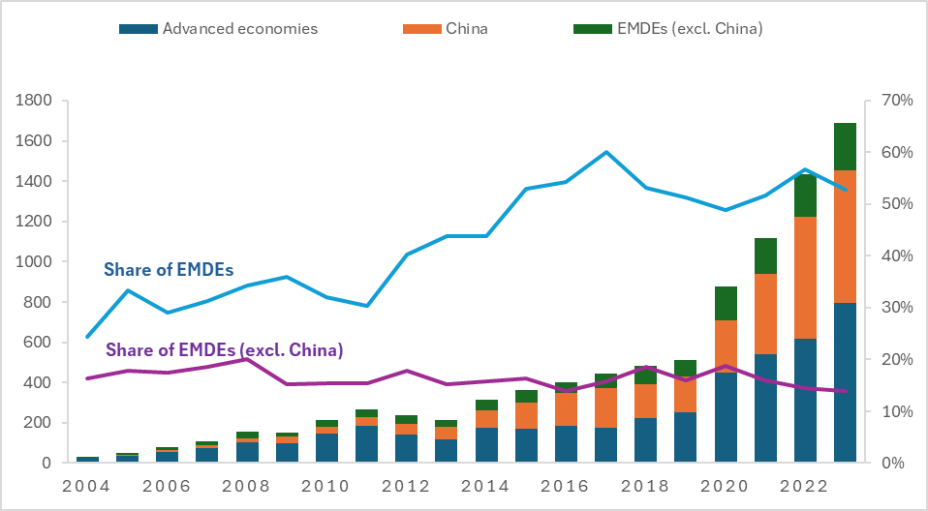
Financing landscapes in EMDEs
Share of EMDEs excl. China in the investments in energy transition-related technologies excluding energy efficiency remain largely stagnant over 2004-2022
A key challenge: higher financing costs in EMDEs
Need stronger public-private partnership (incl. DFIs) to address this challenge

Slide 11
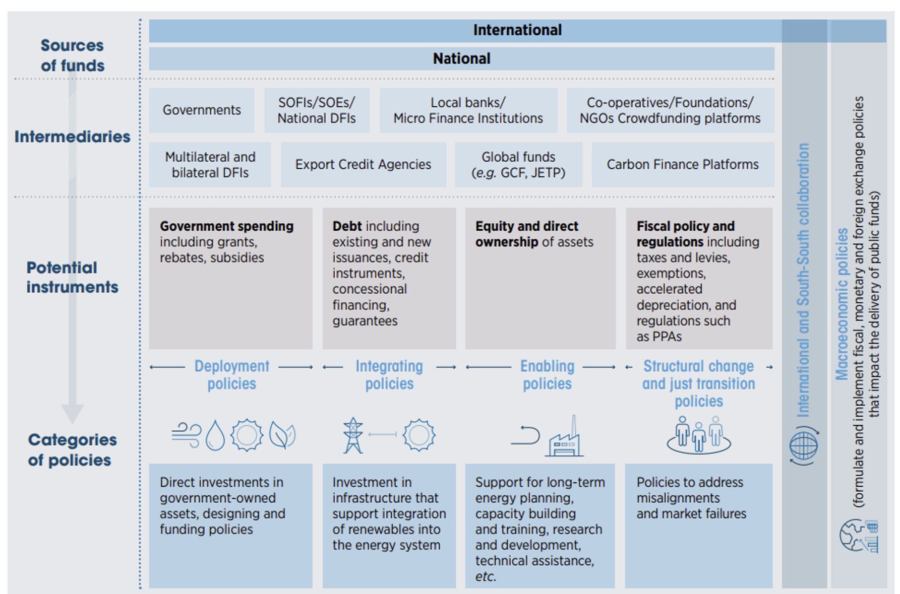
The role of public and private stakeholders
The public sector plays a critical catalyzing role by providing a predictable enabling environment for long-term investment decisions of the private sector
Coordinated and transparent energy planning processes is key to mitigate perceived investment risks and boost investors’ confidence, thereby contributing to lowered cost of capital

Slide 12
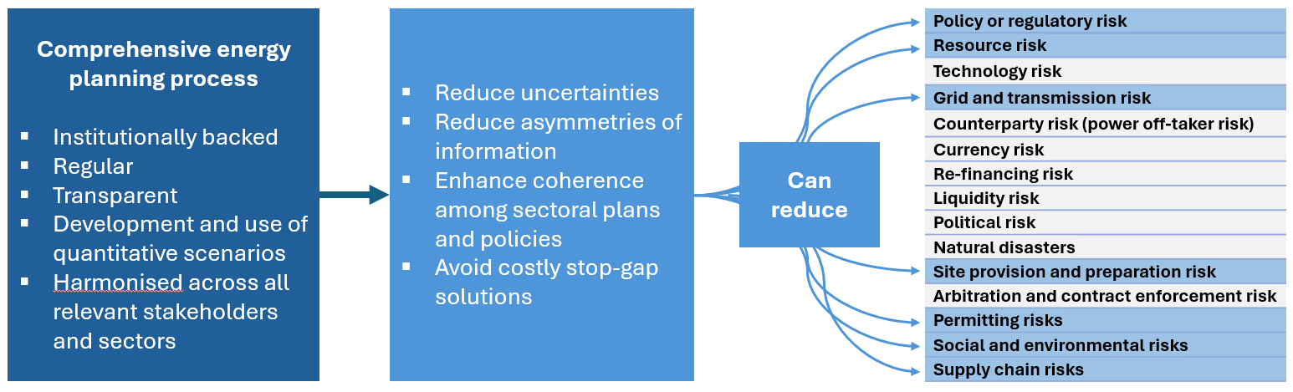
Energy planning to drive investment
A comprehensive energy planning process can act as a foundation to reduce many risks and boost investor confidence to develop bankable projects for the energy transition.

Slide 13
Brazil Case: key success factors
Jointly roles of domestic energy planning and finance institution acting together to mitigate investment risks. Well-defined roles and responsibilities.
Critical role of domestic expertise in energy planning and financing.
Market design and PPA customized to mitigate specific investment risk through collaborative process (energy planning and BNDES).
Collaborative and adaptative process to develop bankable renewable projects with validation by domestic energy planning and finance institutions (enabling project finance structure).
Secure availability of long-term funds in local currency at low cost for renewable projects.

Slide 14
Panel discussion 2
Mr. George Partasides. Energy and Commercial Counsellor, Ministry of Energy, Commerce and Industry. Cyprus.
Ms. Nawal Alhanaee. Director of the Future Energy Department, Ministry of Energy and Infrastructure. UAE
Mr. Edward Neri. Supervising Science Research Specialist. Renewable Energy Management Bureau. Department of Energy. Philippines.

Slide 15
Floor Interventions

Slide 16
Closing Remarks

Slide 17






^{www.irena.org}
^{www.twitter.com/irena}
^{www.facebook.com/irena.org}
^{www.instagram.com/irenaimages}
www.flickr.com/photos/irenaimages
^{www.youtube.com/user/irenaorg}

