Slide 1
IRENA’s programmes in Africa
SADC Renewable Energy Entrepreneurship Support Facility
Tijana Radojicic – Associate Programme Officer
27 April 2017
Maseru, Lesotho

Slide 2
About IRENA
Headquarters in Abu Dhabi, UAE
  Country Support and Partnerships
  Knowledge Policy and Finance Centre
  Innovation & Technology Centre (in Bonn, Germany)
Established in April 2011
150 member countries
Mission: Accelerating deployment of all forms of renewable energy

Slide 3

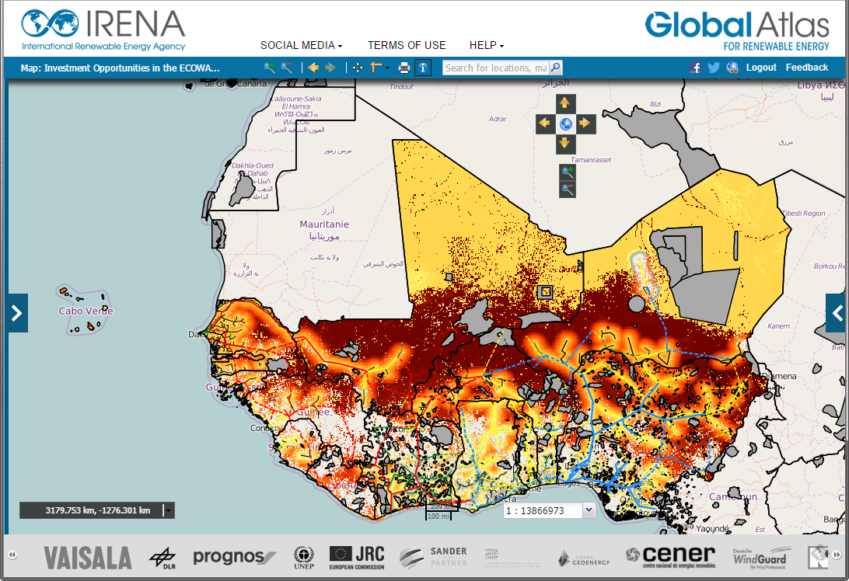
Site appraisal service
Reduce the risks in resource assessment in the
process of developing bankable renewable energy
projects
Support local authorities and potentially, financial
institutions with a method for qualifying and
screening renewable energy sites earmarked for
development
Appraisals completed so far…
Two (2) wind sites in Cape Verde with a combined
capacity of 4.8 MW
Four (4) wind sites in Comoros Island, with each one
of them being explored for a potential 2MW farm

Slide 4
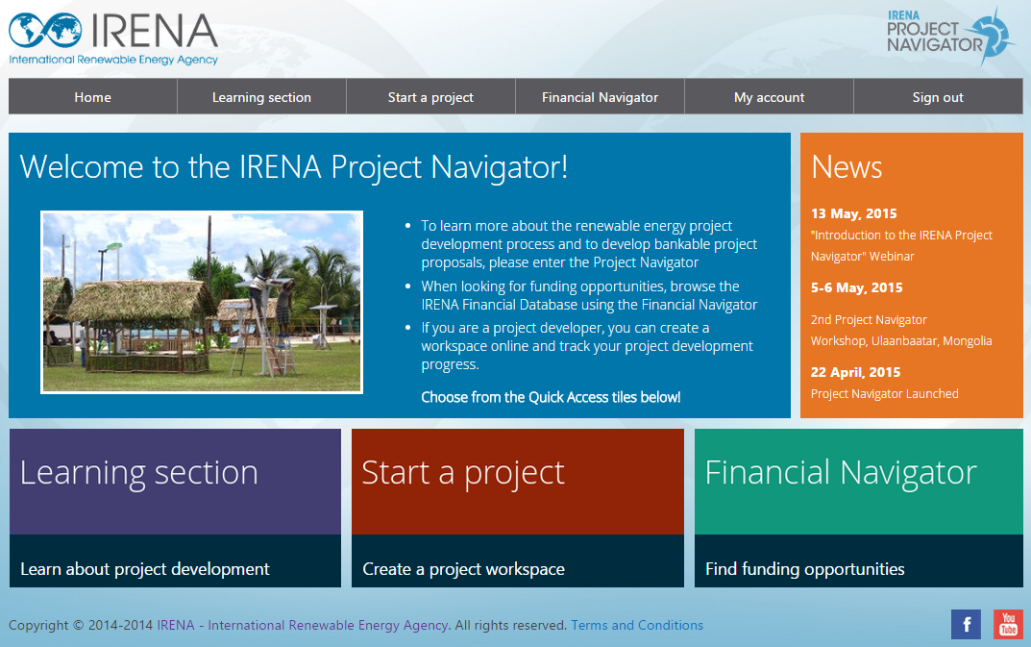
The Project Navigator Platform
www.irena.org/navigator
Notes:
This is what the Navigator looks like. In order to gain access to the content, users will need to register by filling-in their details.
The Navigator is divided in three main parts:
The Learning Section, which is a large repository of knowledge, tools, templates, examples and best-practices which are aimed at strengthening the users’ project development skills.
The Start a Project Section, where users can access a personal workspace where they can start developing and tracking their own project by using provided tools and following a step-by-step process.
The last part is the Financial Navigator, which contains a database of relevant funding options which can be filtered depending on project-specific conditions.

Slide 5

To scale up renewable energy and energy efficiency investments a virtual market place is created with the objective to support:
initiation,
development and
financing
of sustainable energy projects
By:
Improving the transparency of the market
Offering relevant tools and databases for market players
Supporting and facilitating projects in the development stage

Slide 6

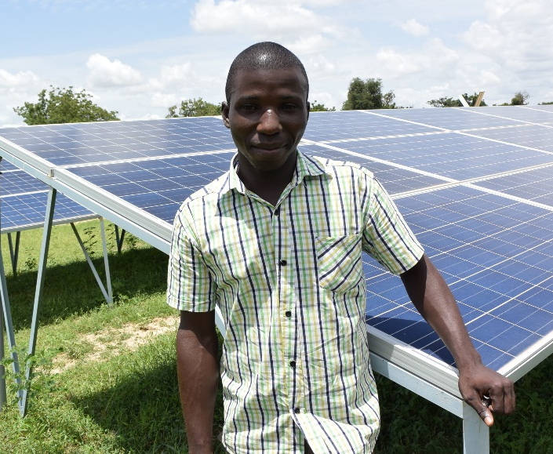
The IRENA/ADFD Project Facility is a joint collaborative facility between IRENA and the Abu Dhabi Fund for Development (ADFD), now in its 5th Cycle.
Funding offer:
USD 50 million in each annual cycle
USD 5-15 million ADFD loans for each project, covering up to 50% of the project costs. Remainder must be co-financed
1-2% interest rate on loans.
20 years loan period including 5 years of a grace period
3.6 MW solar mini-grid project in Burkina Faso
www.irena.org/adfd
Notes:
The Project Facility
The IRENA/ADFD Project Facility is a joint collaborative facility between IRENA and Abu Dhabi Fund for Development (ADFD).
The Facility is now in its 5th cycle (deadline to receive summary applications 15th February 2017). Shortlisted projects are announced in May of each year and final selection occurs in December.
ADFD will cover up to 50% of the project cost with the concessional loan. The other 50% must be leveraged from other institutions such as governments, international development banks and private partners. IRENA helps countries and project proponents with this process.
Each project must have the full support of, and be prioritized by the government of the country where the project is to be implemented. All applicants must be able to provide a government guarantee letter (see website for templates).
Evaluation process
IRENA carries out its project screening and recommendation process through two bodies. The first stage is an evaluation by the Panel of Experts. The second is the Advisory Committee, appointed by the IRENA Assembly annually.
IRENA then recommends projects for funding to the ADFD for final selection.

Slide 7


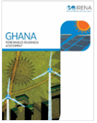
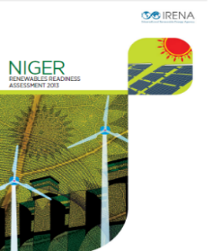
IRENA’s Approach in the regions
Renewables Readiness Assessment
Capacity Building
Support
Regional
Engagement
Notes:
In the frame of its regional work, IRENA aims to support members of the Economic Community of West African States (ECOWAS) in their aspirations to tap the huge renewable energy resources in the region, thereby increasing access to energy, improving livelihoods, generating economic opportunities, and improving energy security and sustainability of supply. To this effect, IRENA has partnered with the ECOWAS Regional Centre for Renewable Energy and Energy Efficiency (ECREEE) for the development and implementation of the ProSPER initiative.

Slide 8
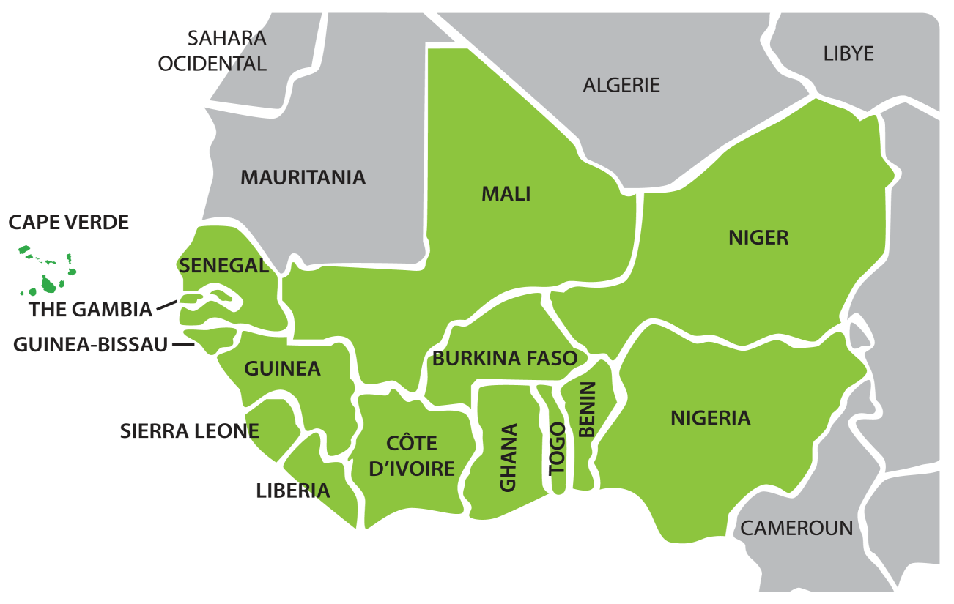
Africa Clean Energy Corridor
Develop RE resources and integrate renewable power into grid
Promote cross-border trade of renewable power
Build on regional initiatives

Slide 9
ProSPER: Promoting a Solar PV Market in West Africa

Slide 10
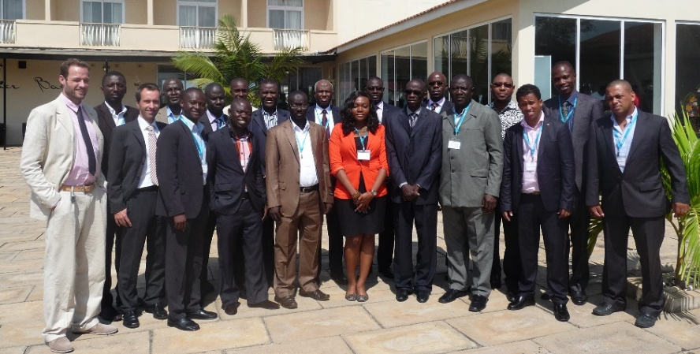
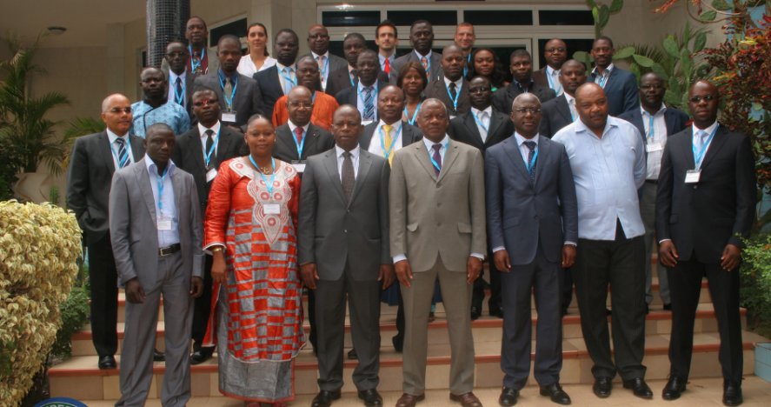
ProSPER
ProSPER: Promoting a Solar PV Market in West Africa
Strengthening and developing local capacities of policymakers, regulators and utilities, financial institutions and renewable energy entrepreneurs.
National Renewable Energy Policies and Incentive Schemes
Reinforcing the capacities on policies, regulatory frameworks and incentive schemes to promote renewable energies at the national level.
  September 2013, Accra, Ghana

Slide 11
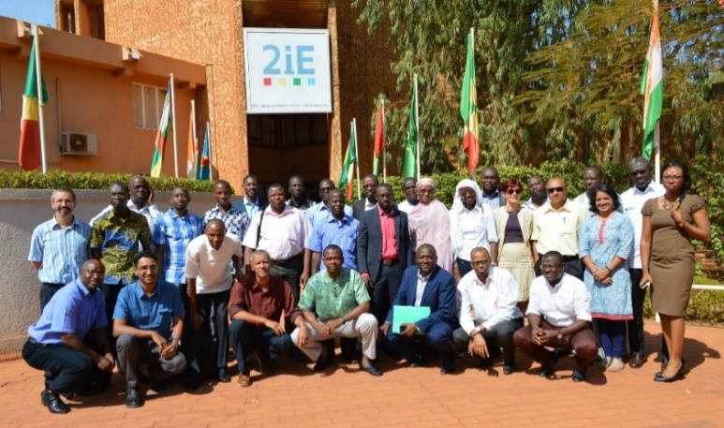
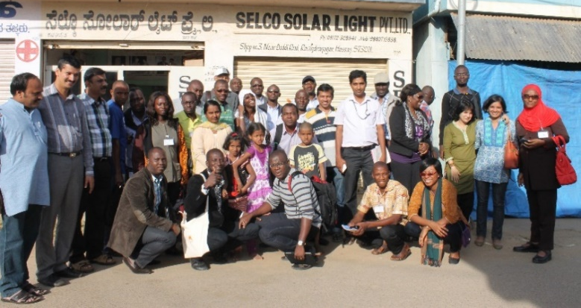


ProSPER
Supporting Entrepreneurship and Project Financing
Sharing innovative processes across different countries and the potentials of decentralized PV business models within the ECOWAS region;
Enabling SMEs to assess the business potentials of PV projects, develop business plans and loan requests;
Increasing confidence of financial institutions in RET as they enhance their understanding of the technologies, improving the sustainability of RE projects and investments;
Sharing of experiences between an international incubation centre and an ECOWAS based incubation centre.

Slide 12
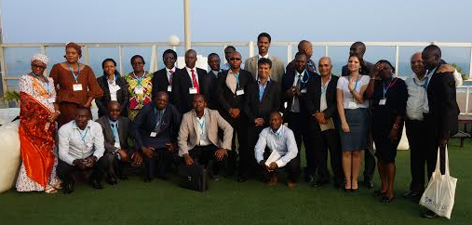
ProSPER
Financing of Solar Energy Technology Projects
Raise awareness on RE financing opportunities, associated risks and share best practices;
Increase FI’s confidence in financing RE projects;
Raise awareness for the benefits of RE, provide broad technology overview;
Enhance the ability to assess business plans and risks of proposed RE projects.
  July 2014, Lomé, Togo

Slide 13
ProSPER
OUTCOMES:
Awareness and understanding on instruments and mechanisms;
Development of regional renewable energy policy supported;
Number of countries with renewable energy targets, promotion policies and incentive schemes increased;
Intensification of contacts
  among regional policy makers to create a network for exchange on policy implementation;
  among entrepreneurs to create a network for exchange;
  among lending institutions and investment promotion agencies.
Awareness and understanding of:
  regulators and utilities for the requirements to increase market participation of IPPs;
  lending institutions for financing of PV projects.

Slide 14

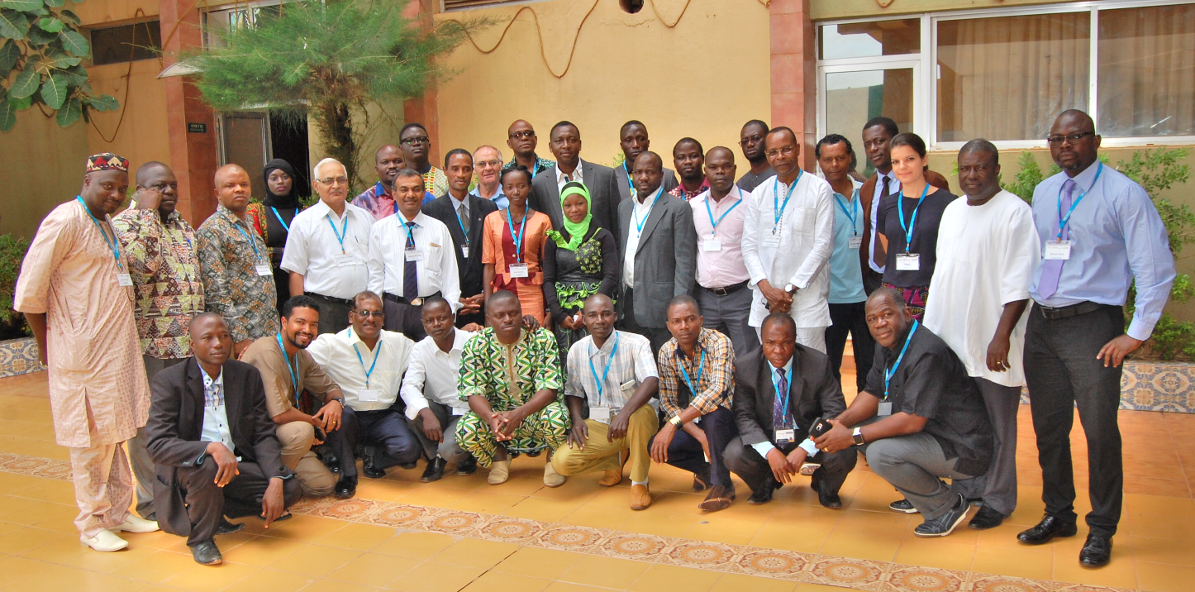
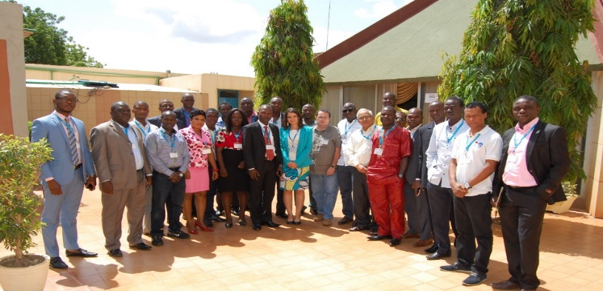
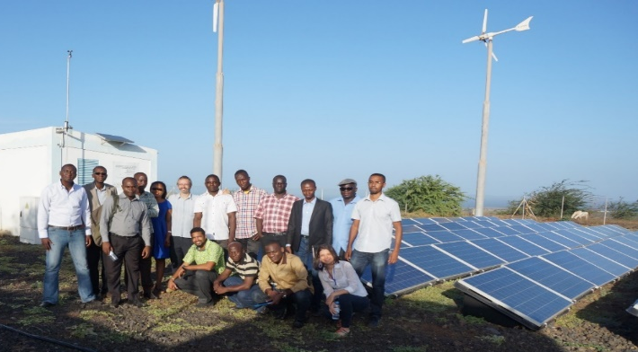
The Entrepreneurship Support
Facility
ECOWAS Renewable Energy Entrepreneurship Support Facility
OBJECTIVES:
Assist entrepreneurs in improving their business operations.
Provide mentorship and technical support to existing entrepreneurs.
Provide advisory services upon request.
Refine entrepreneurs’ solar energy proposals to bankable levels.

Slide 15
Thank you for your attention.

