Slide 1
21 October 2021

Slide 2
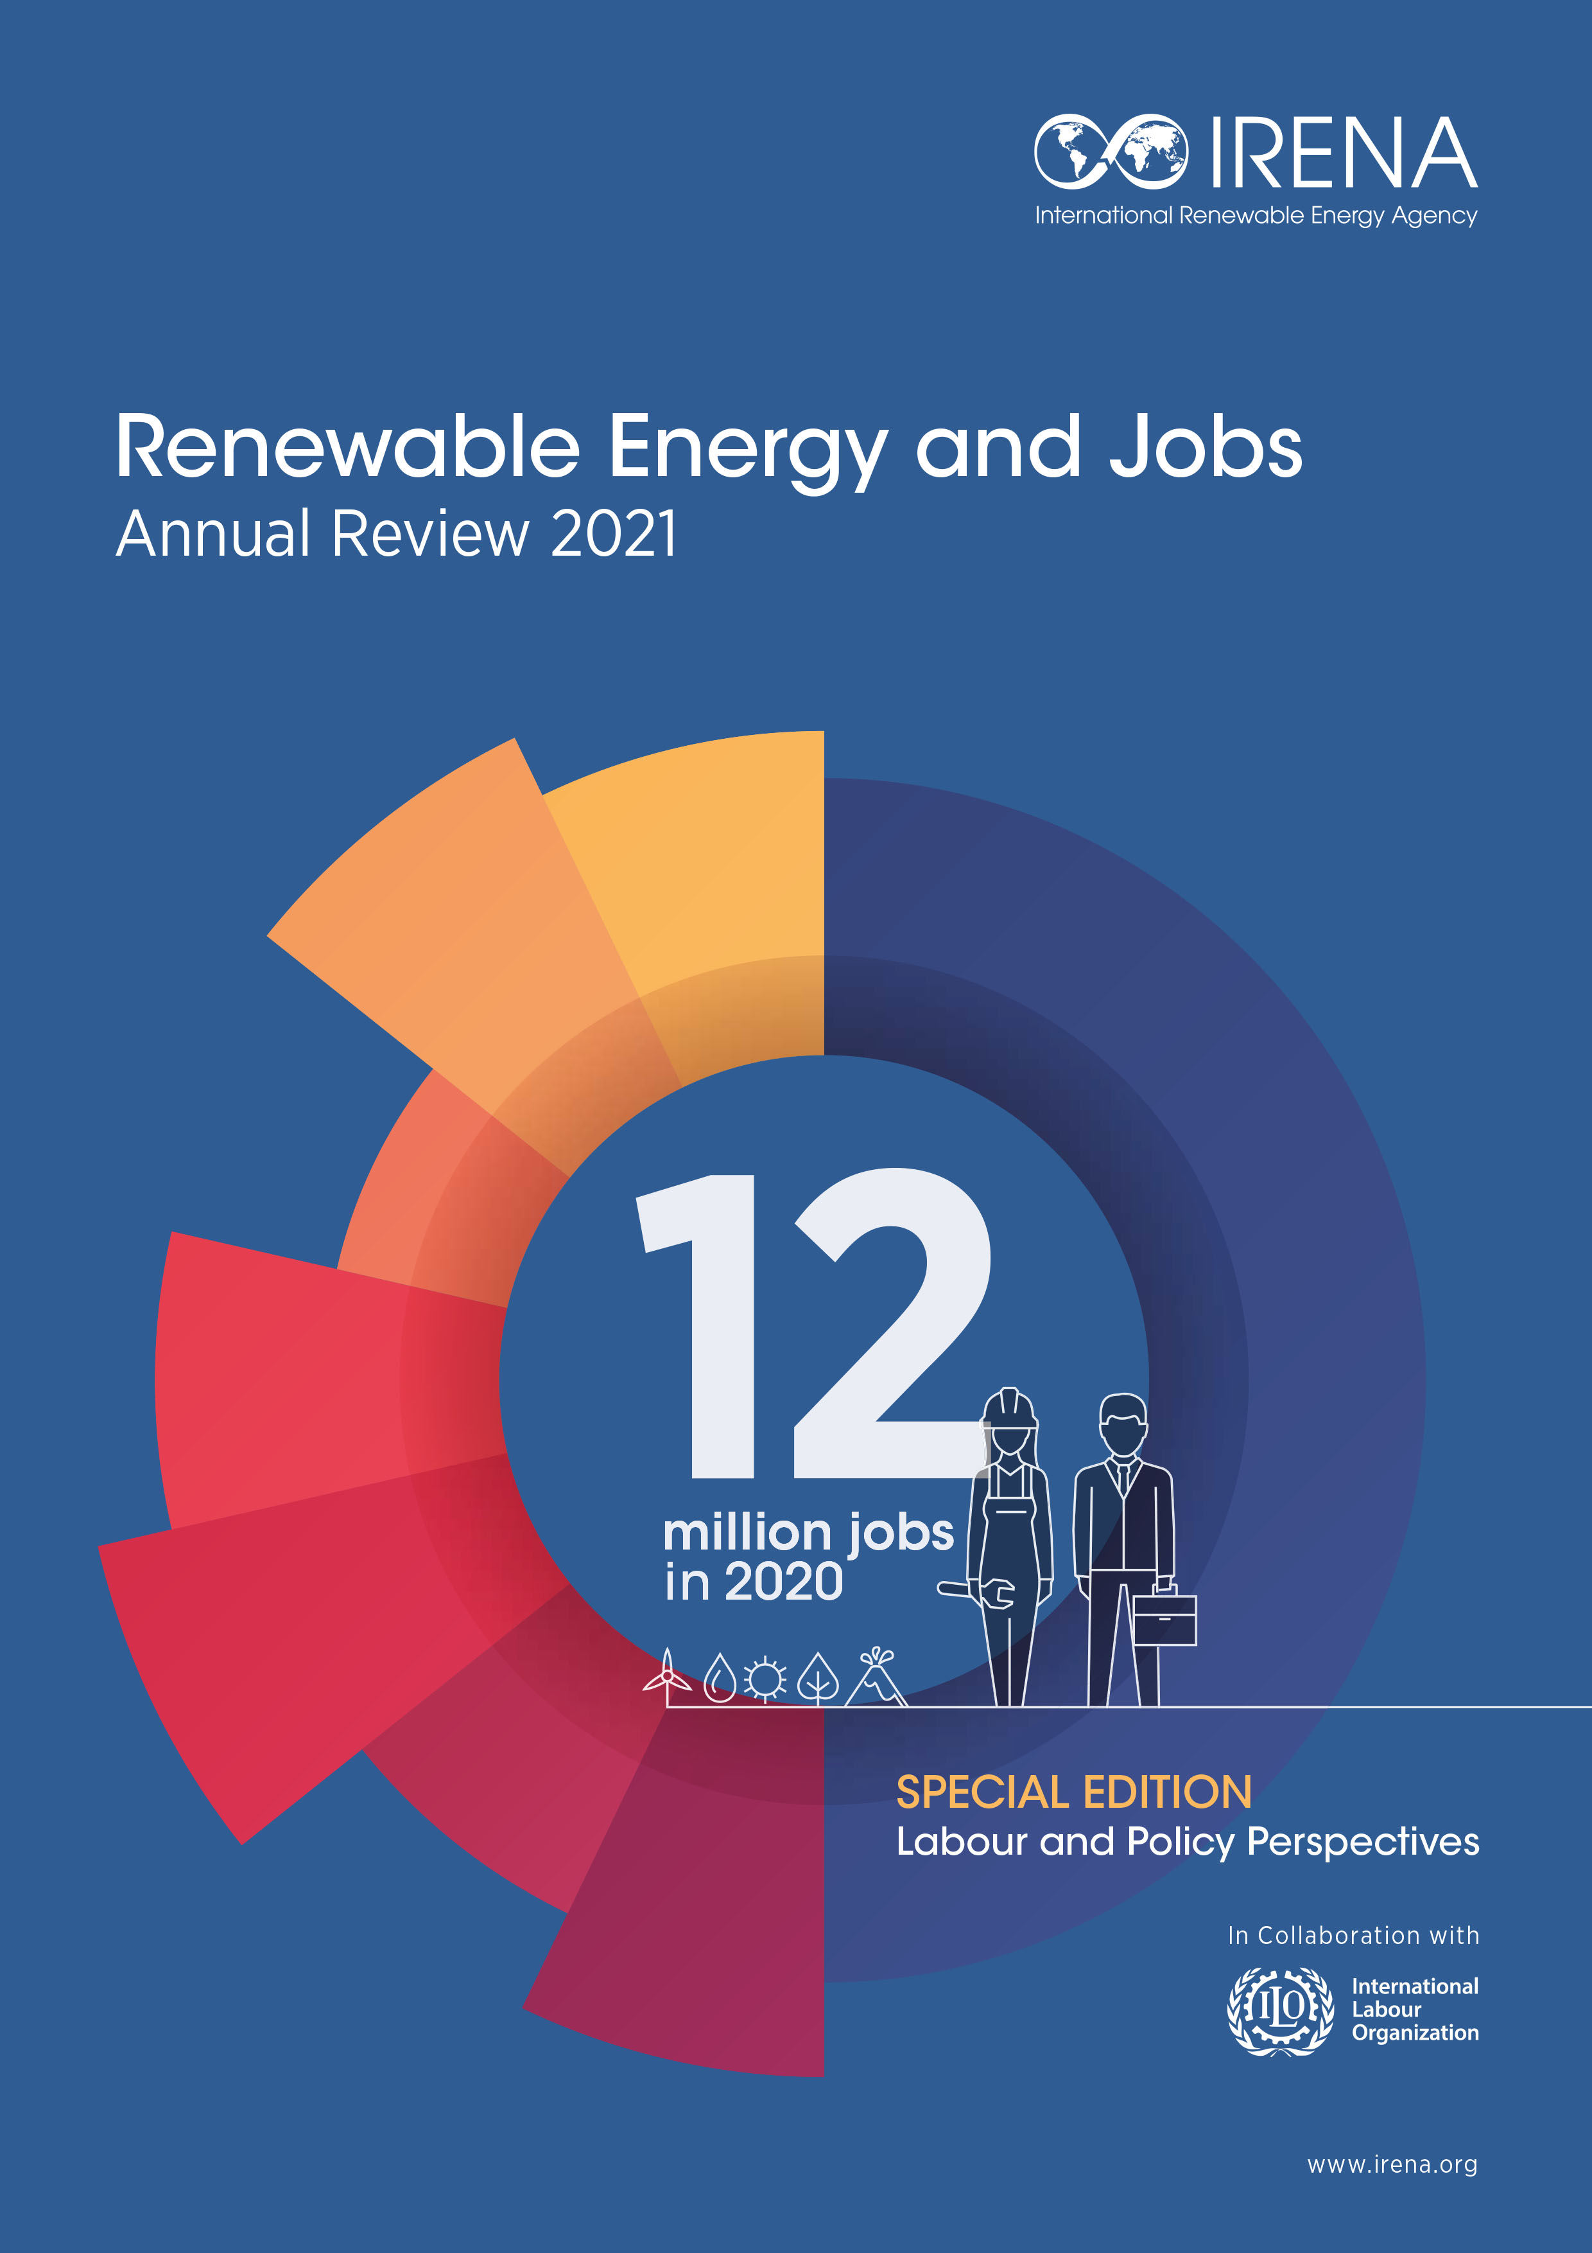







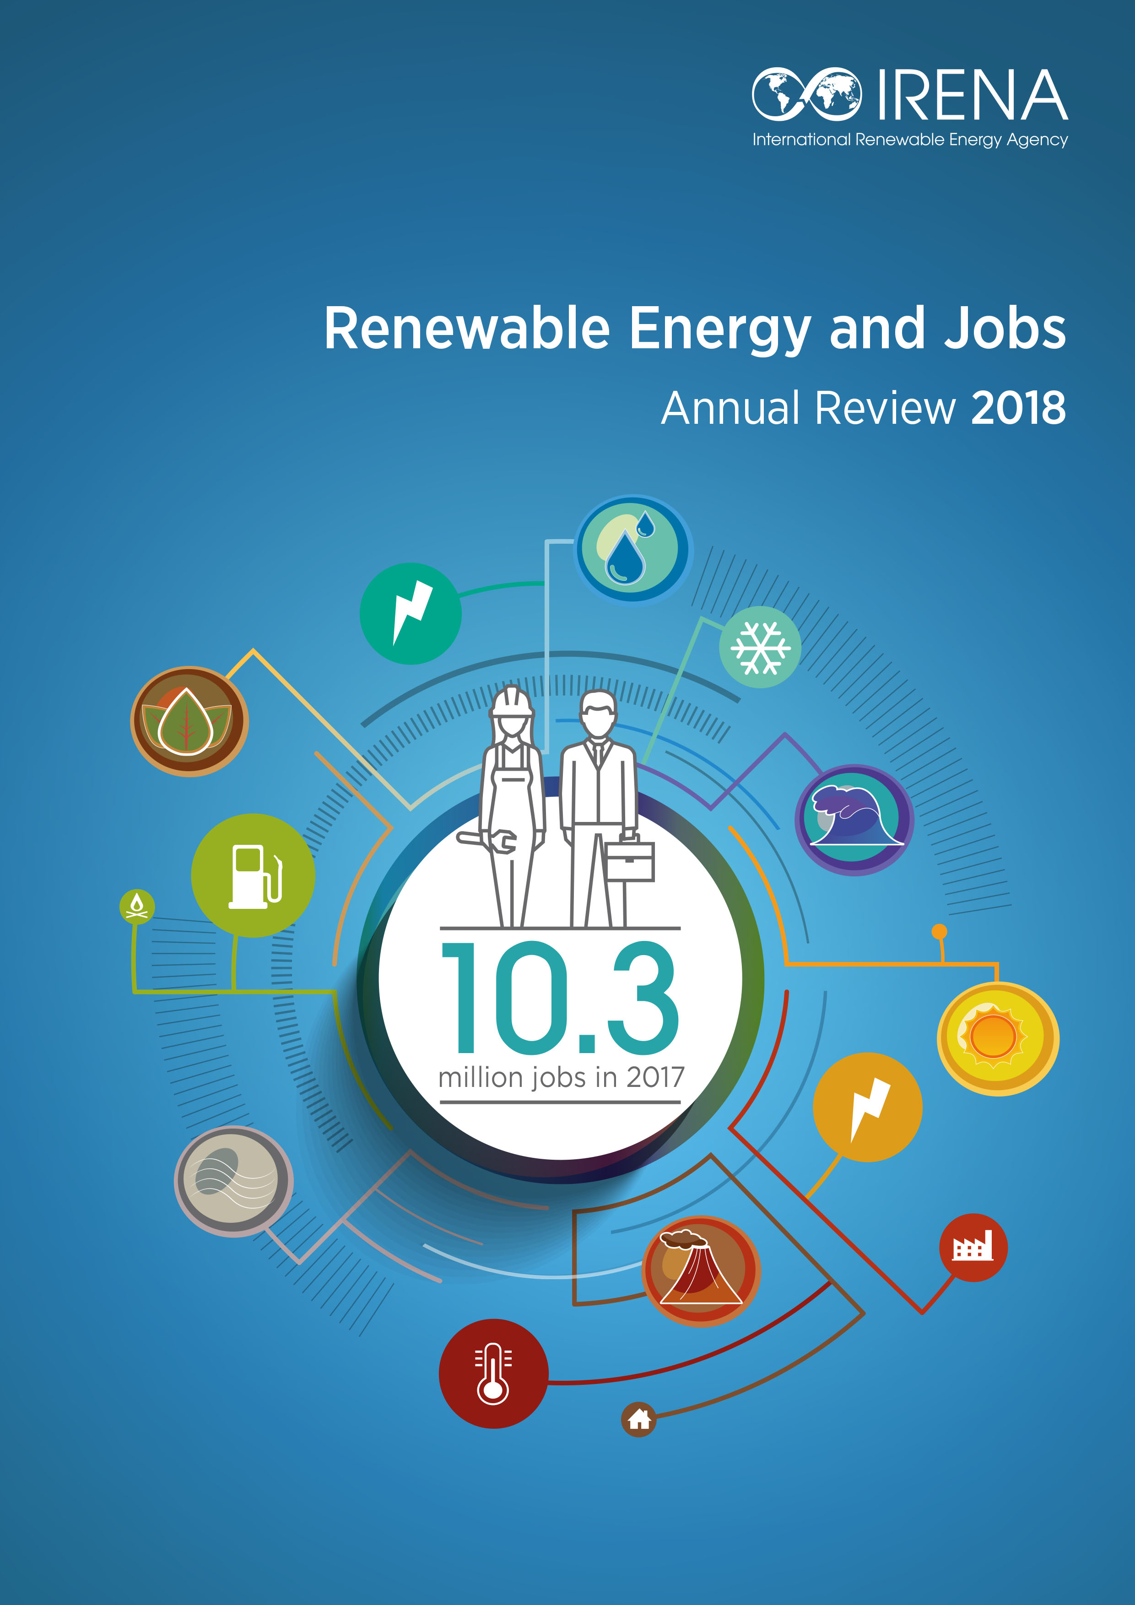


IRENA’s Work on the Socio-economics of Renewables
Annual reviews of employment in renewables
2011-2013
2014
2015
2016
2017
2018
2019
2020

Slide 3
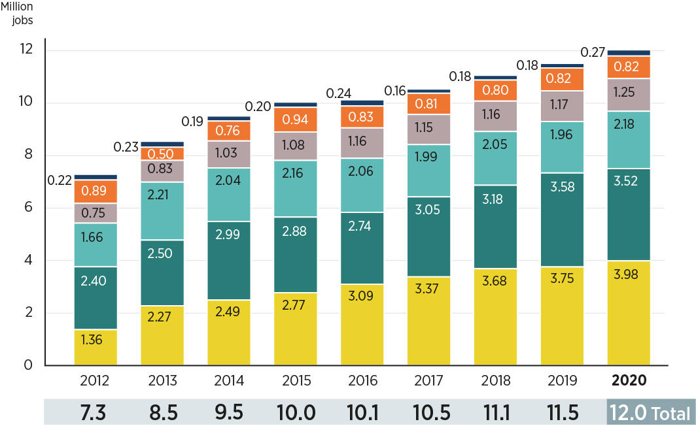
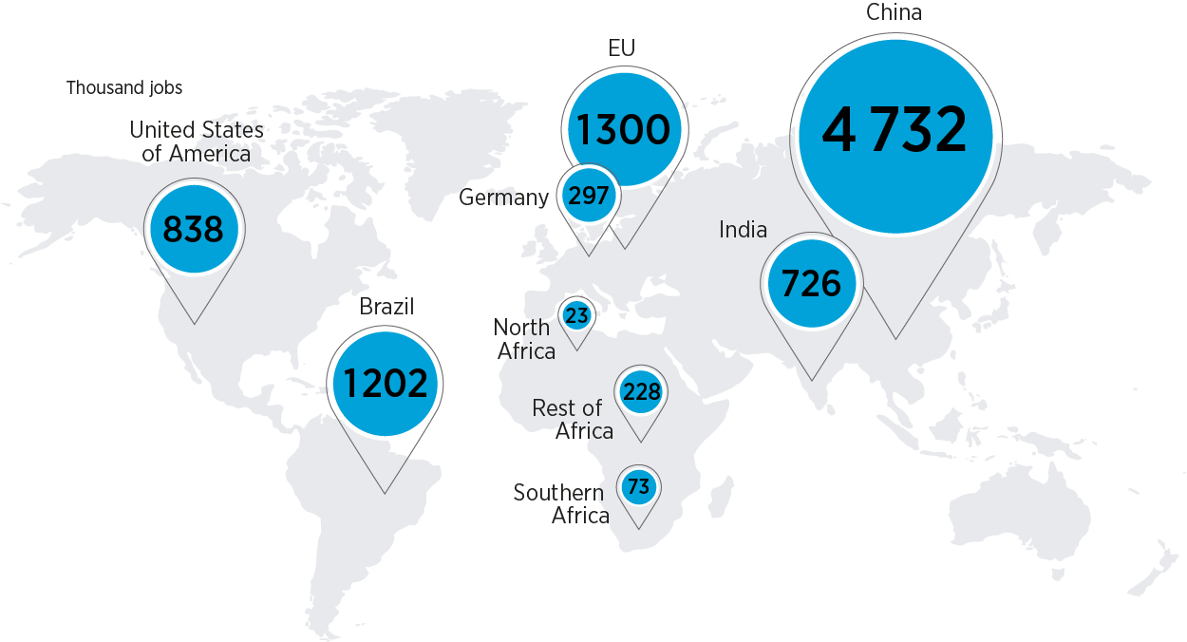
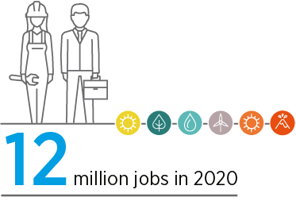
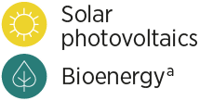
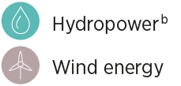
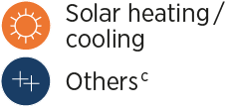
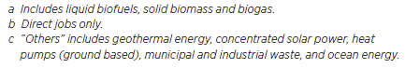
Jobs in Renewable Energy – by Year and Selected Countries

Slide 4
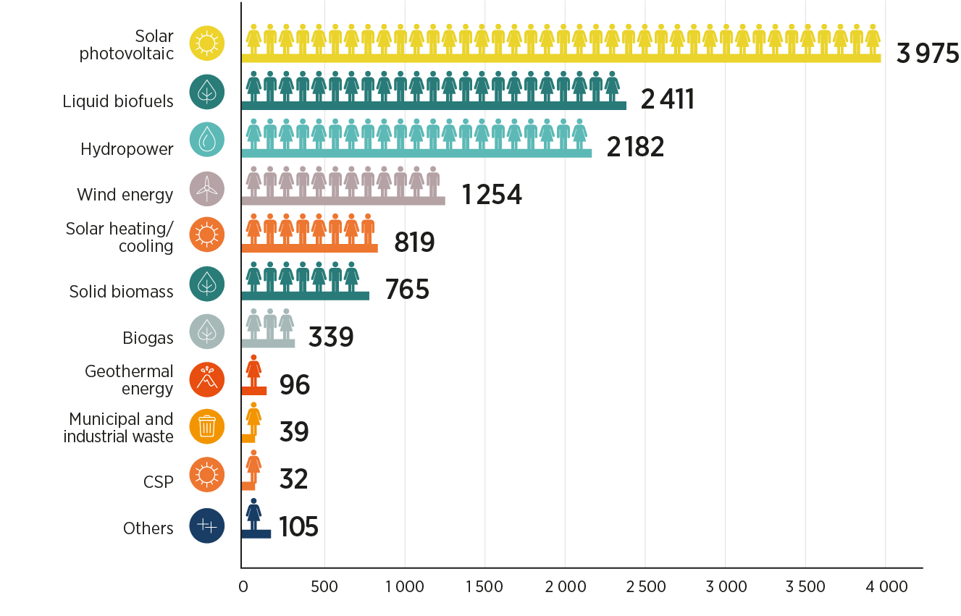
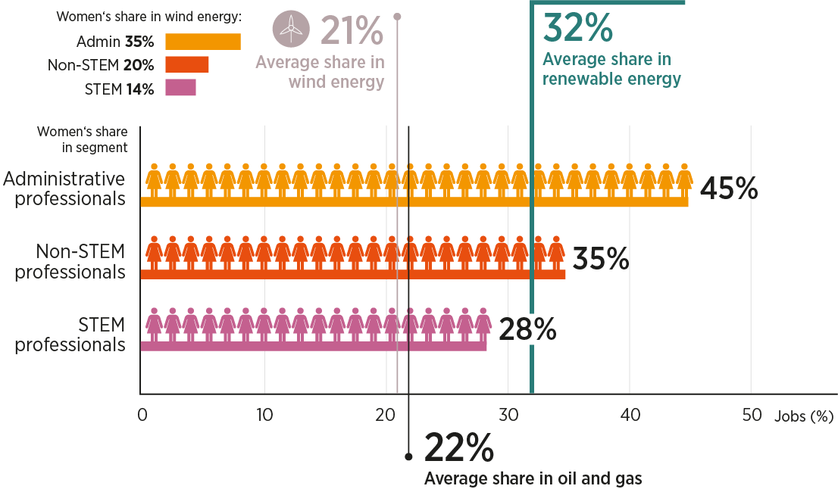

Jobs in Renewable Energy - by Technology and Women’s Share

Slide 5
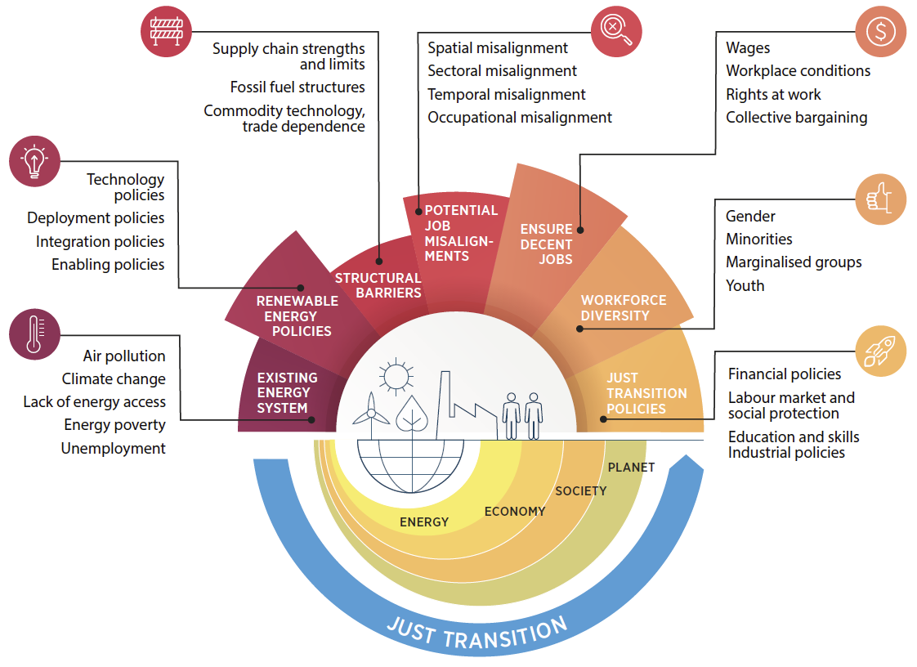
Just Transition - A Comprehensive Policy Framework

Slide 6
Thank you!

