Slide 1
Notes:
1

Slide 2
FIGURES
Notes:
2

Slide 3
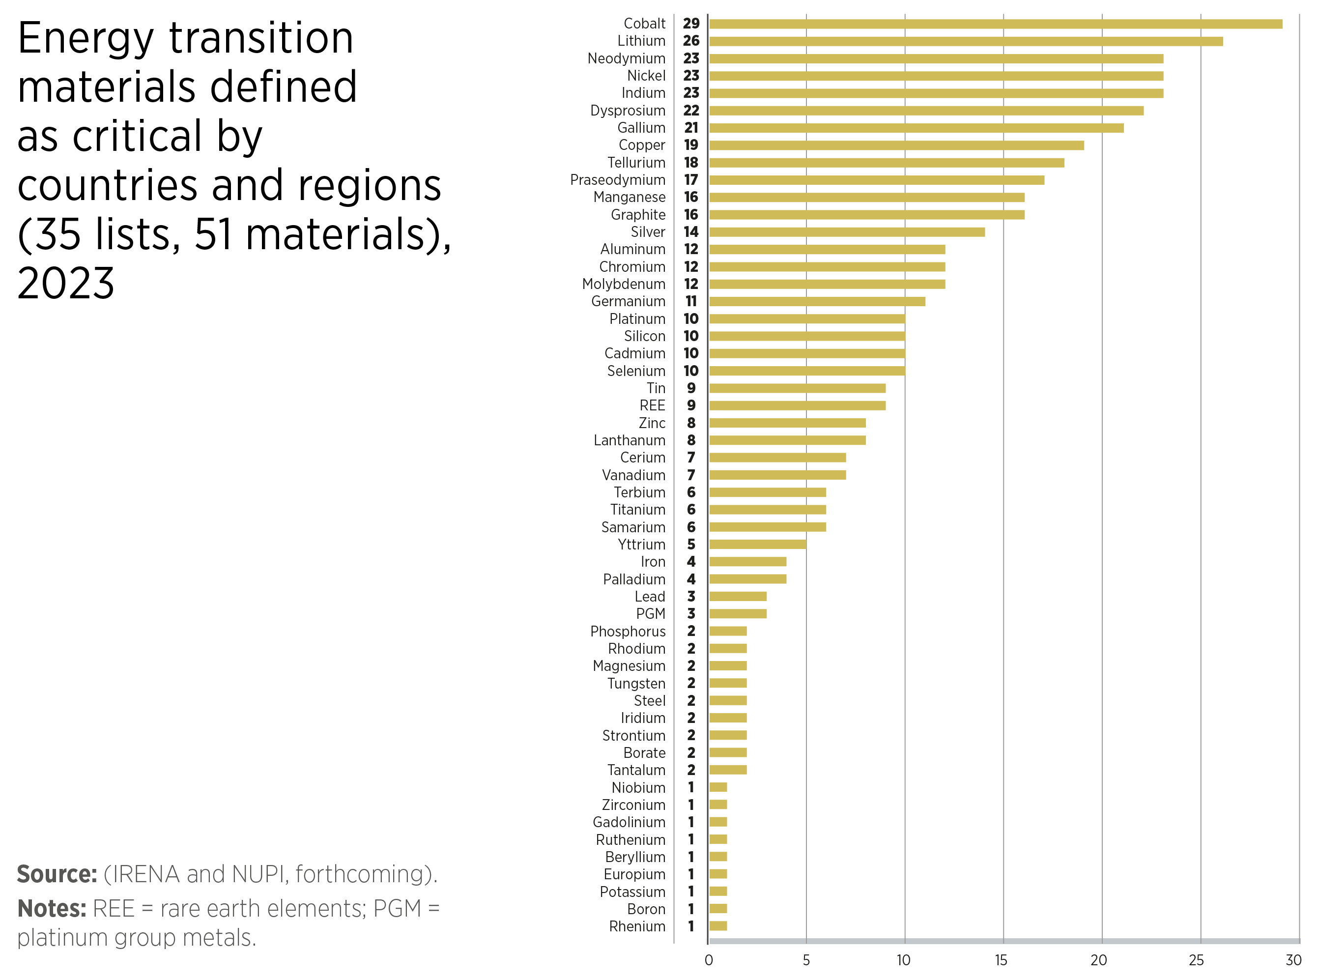
FIGURE 1.1 Energy transition materials defined as critical by countries and regions
3

Slide 4
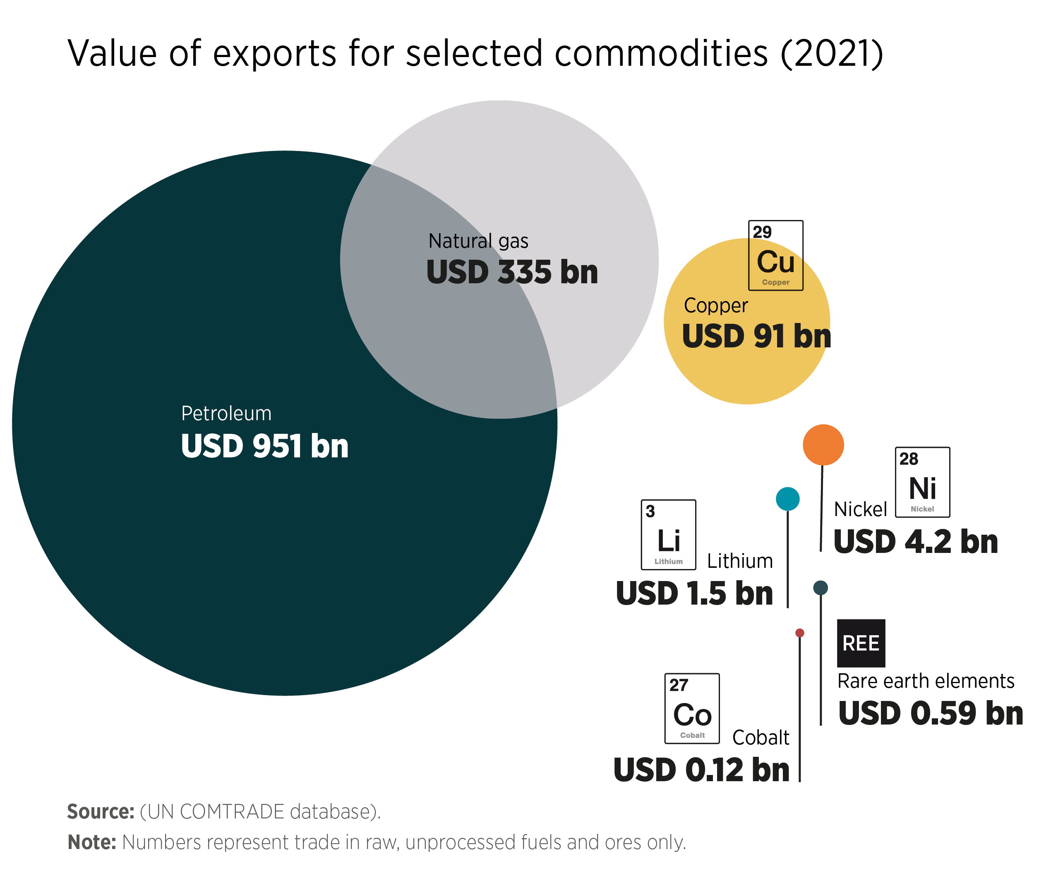
FIGURE 1.2 Value of exports for selected commodities (2021)
4

Slide 5
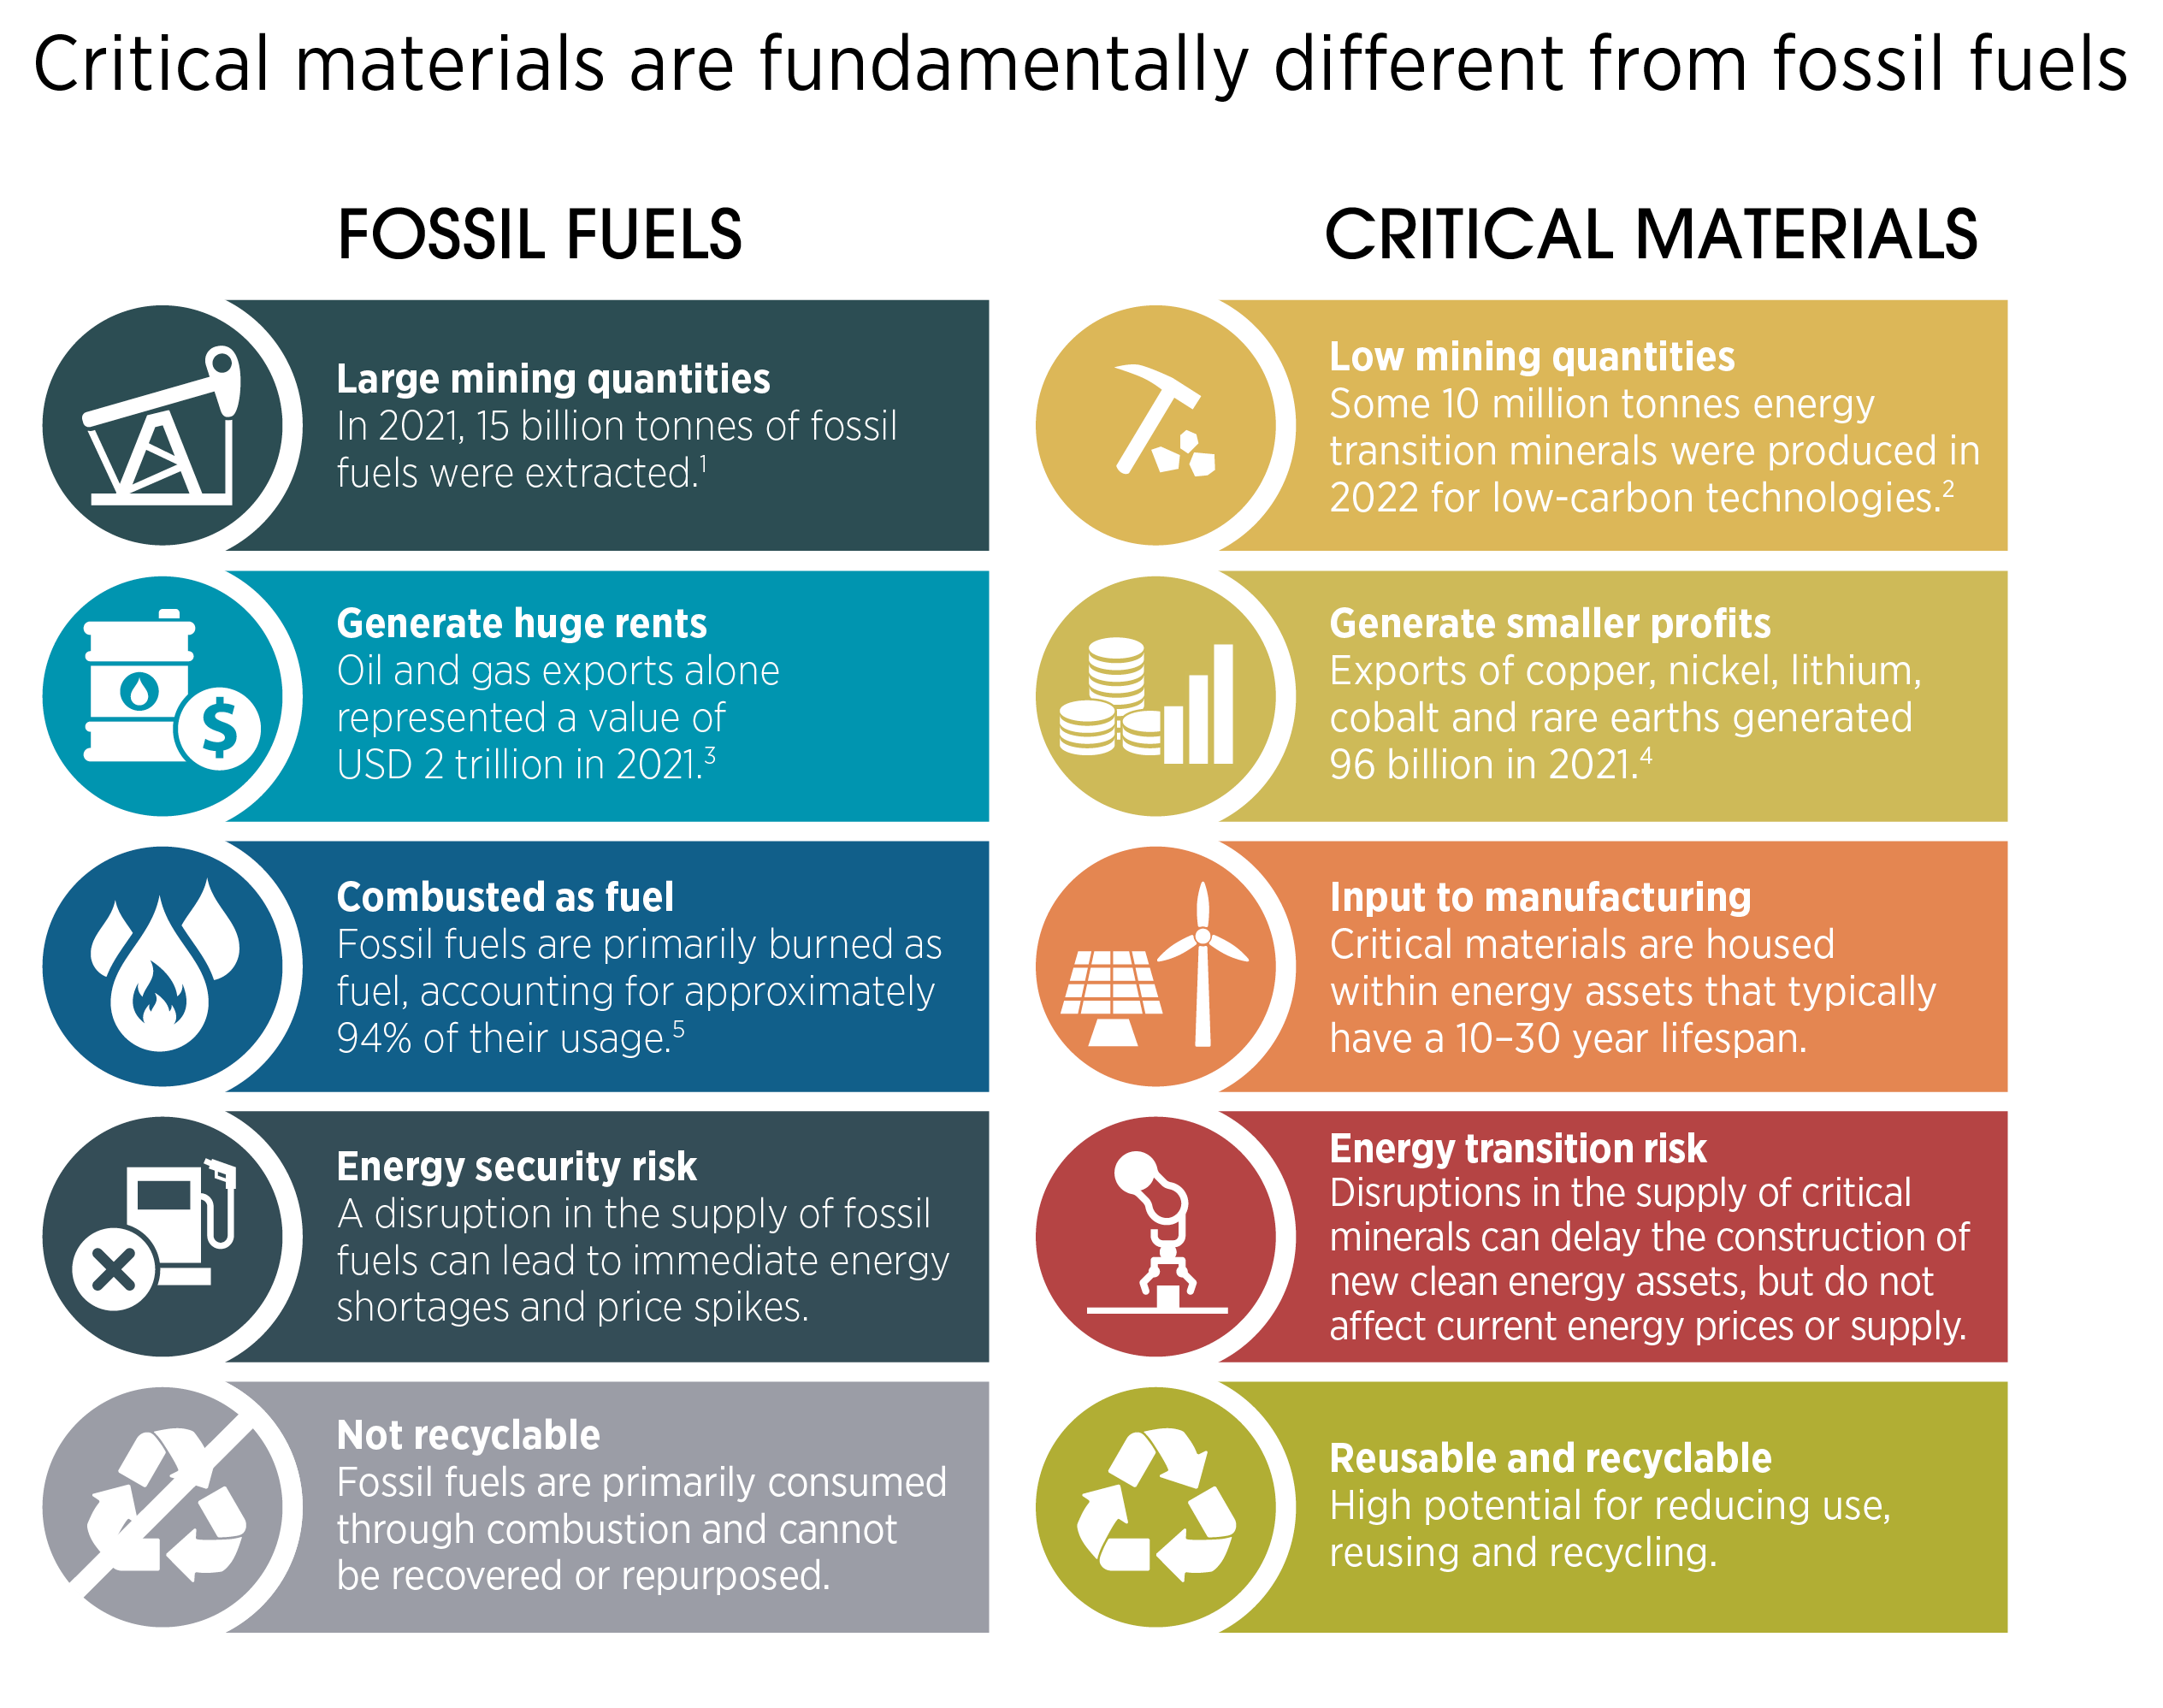
FIGURE 1.3 Critical materials are fundamentally different from fossil fuels
5

Slide 6
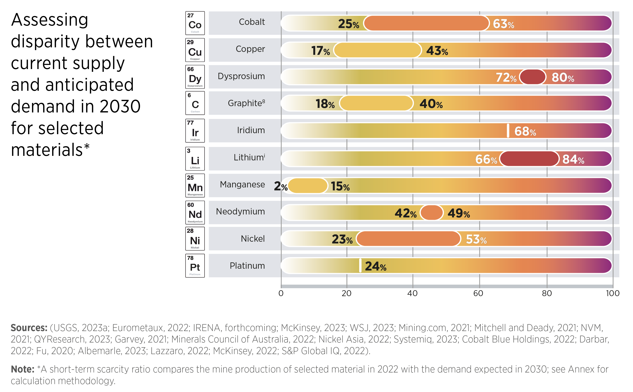
FIGURE 1.5 Assessing disparity between current supply and anticipated demand in 2030 for selected materials
6

Slide 7
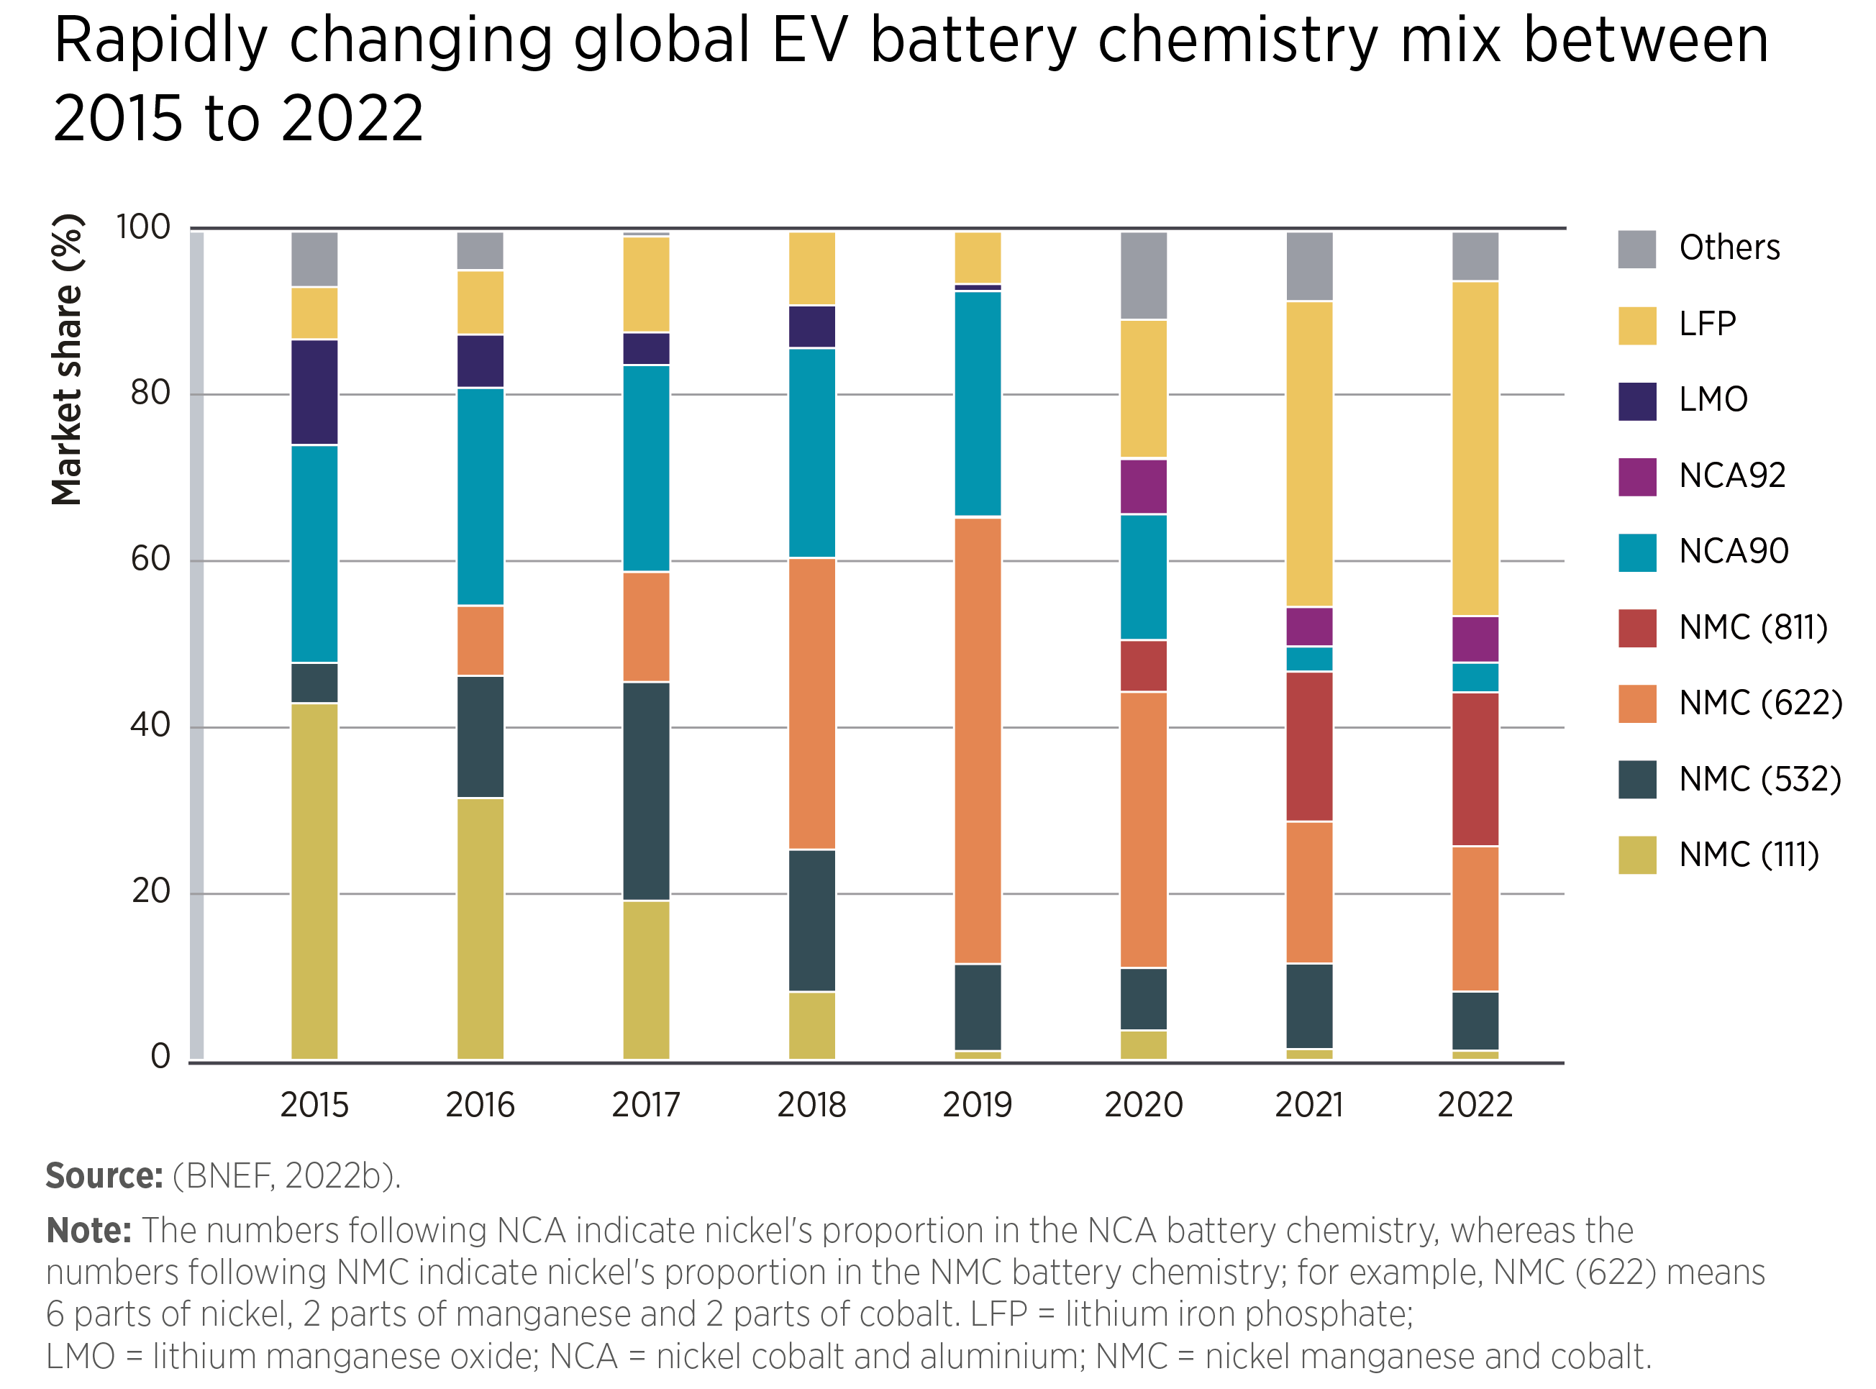
FIGURE 1.6 Rapidly changing global EV battery chemistry mix between 2015 to 2022
7

Slide 8
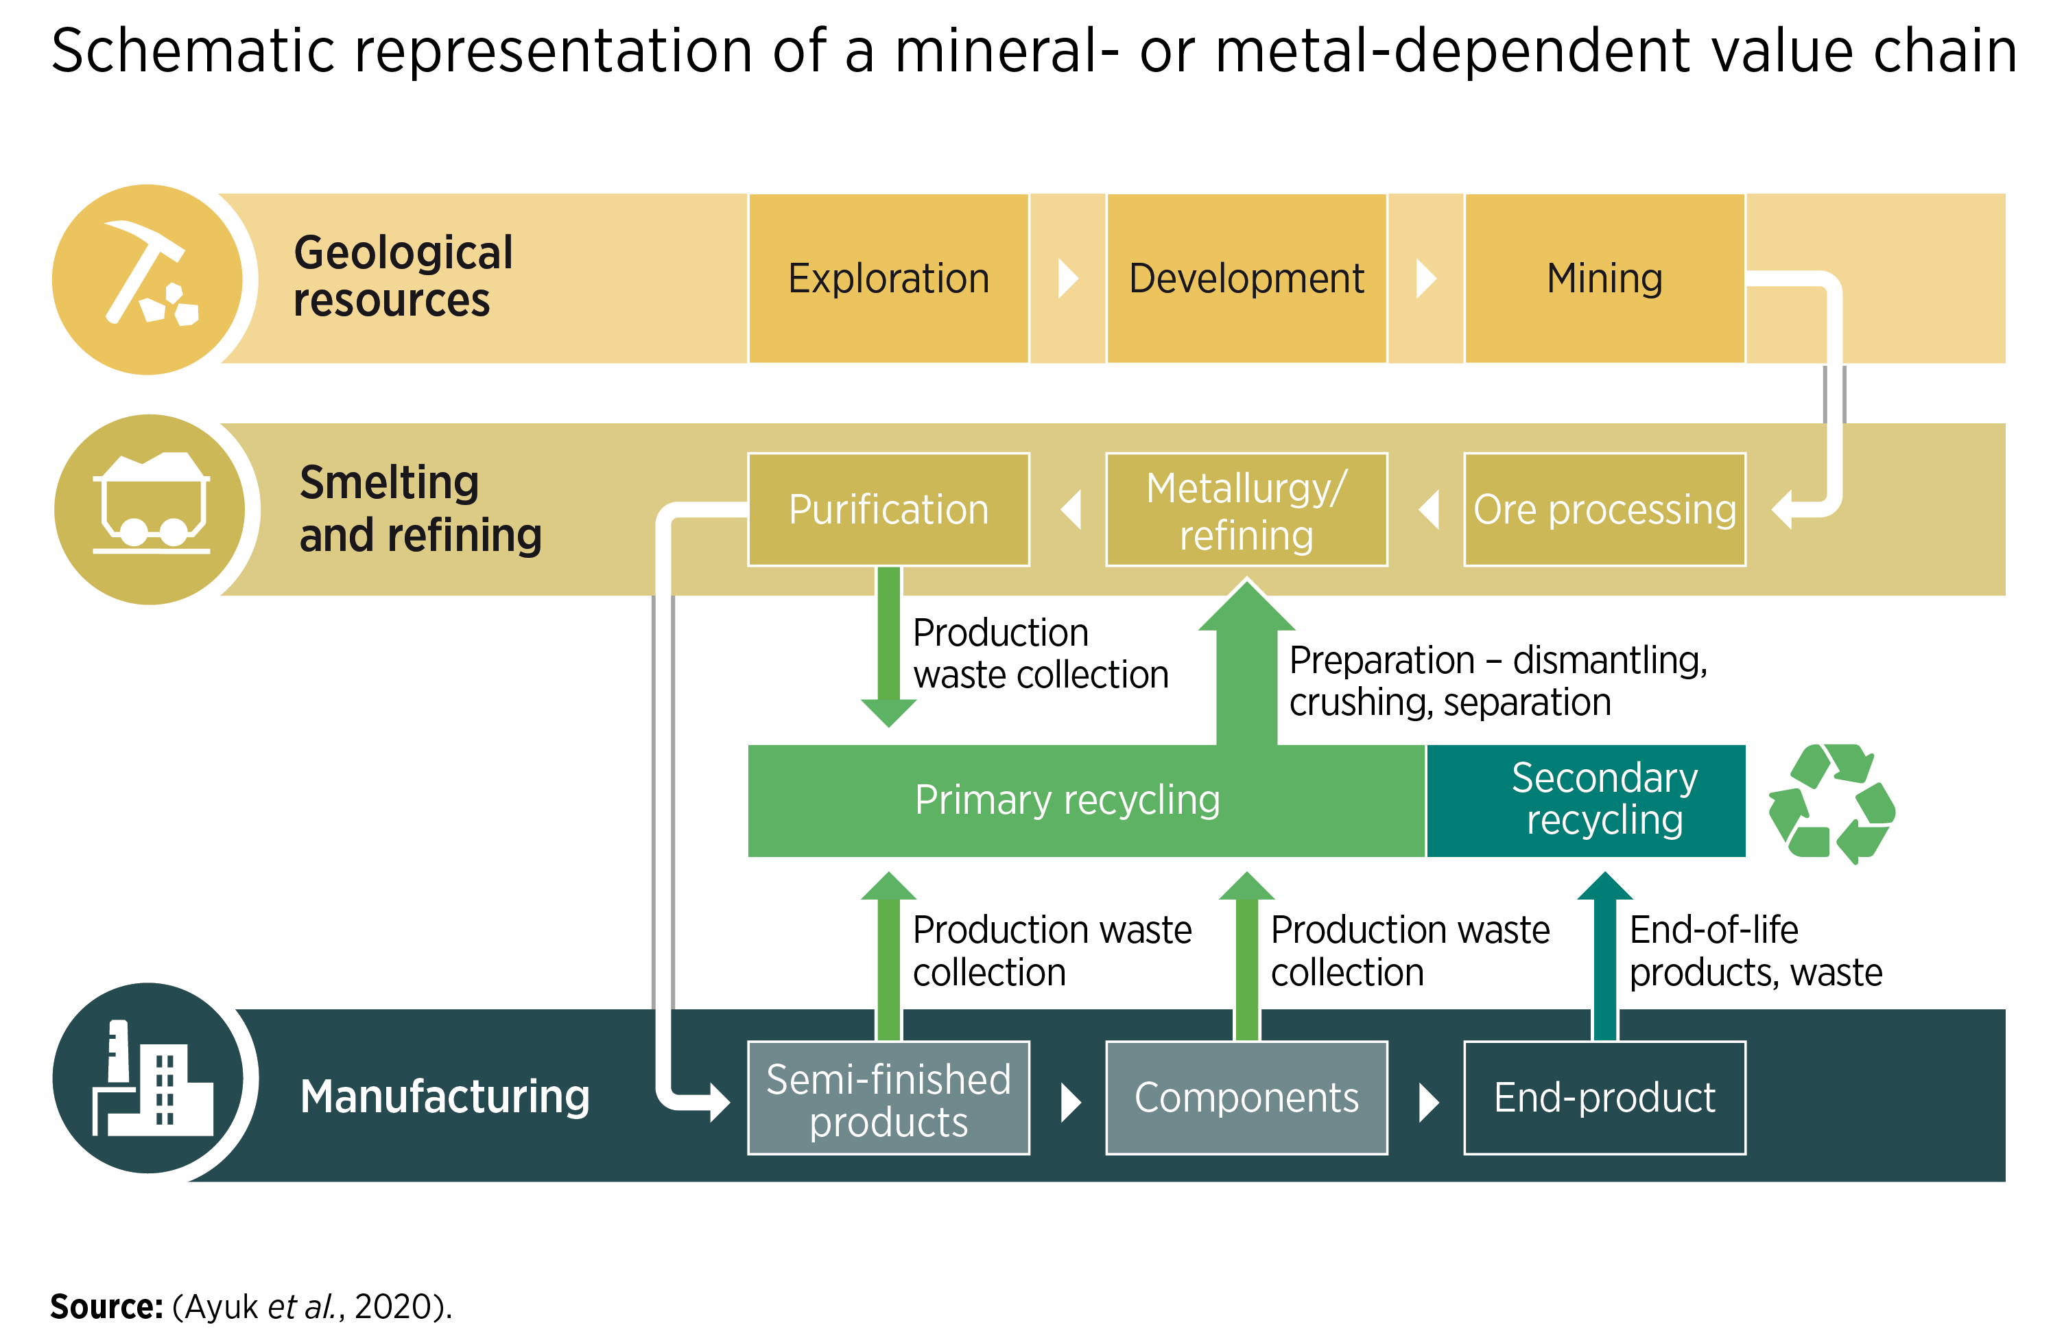
FIGURE 2.1 Schematic representation of a mineral- or metal-dependent value chain
8

Slide 9
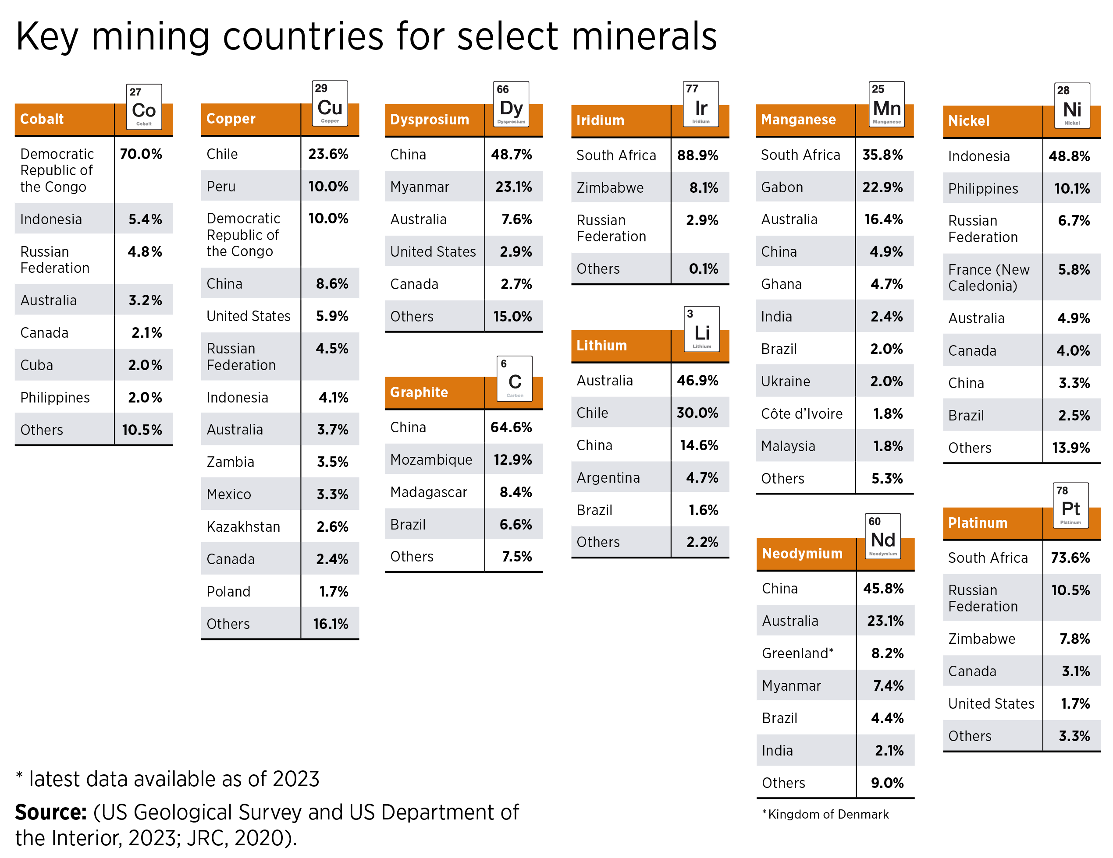
FIGURE 2.2 Key mining countries for select minerals
9

Slide 10
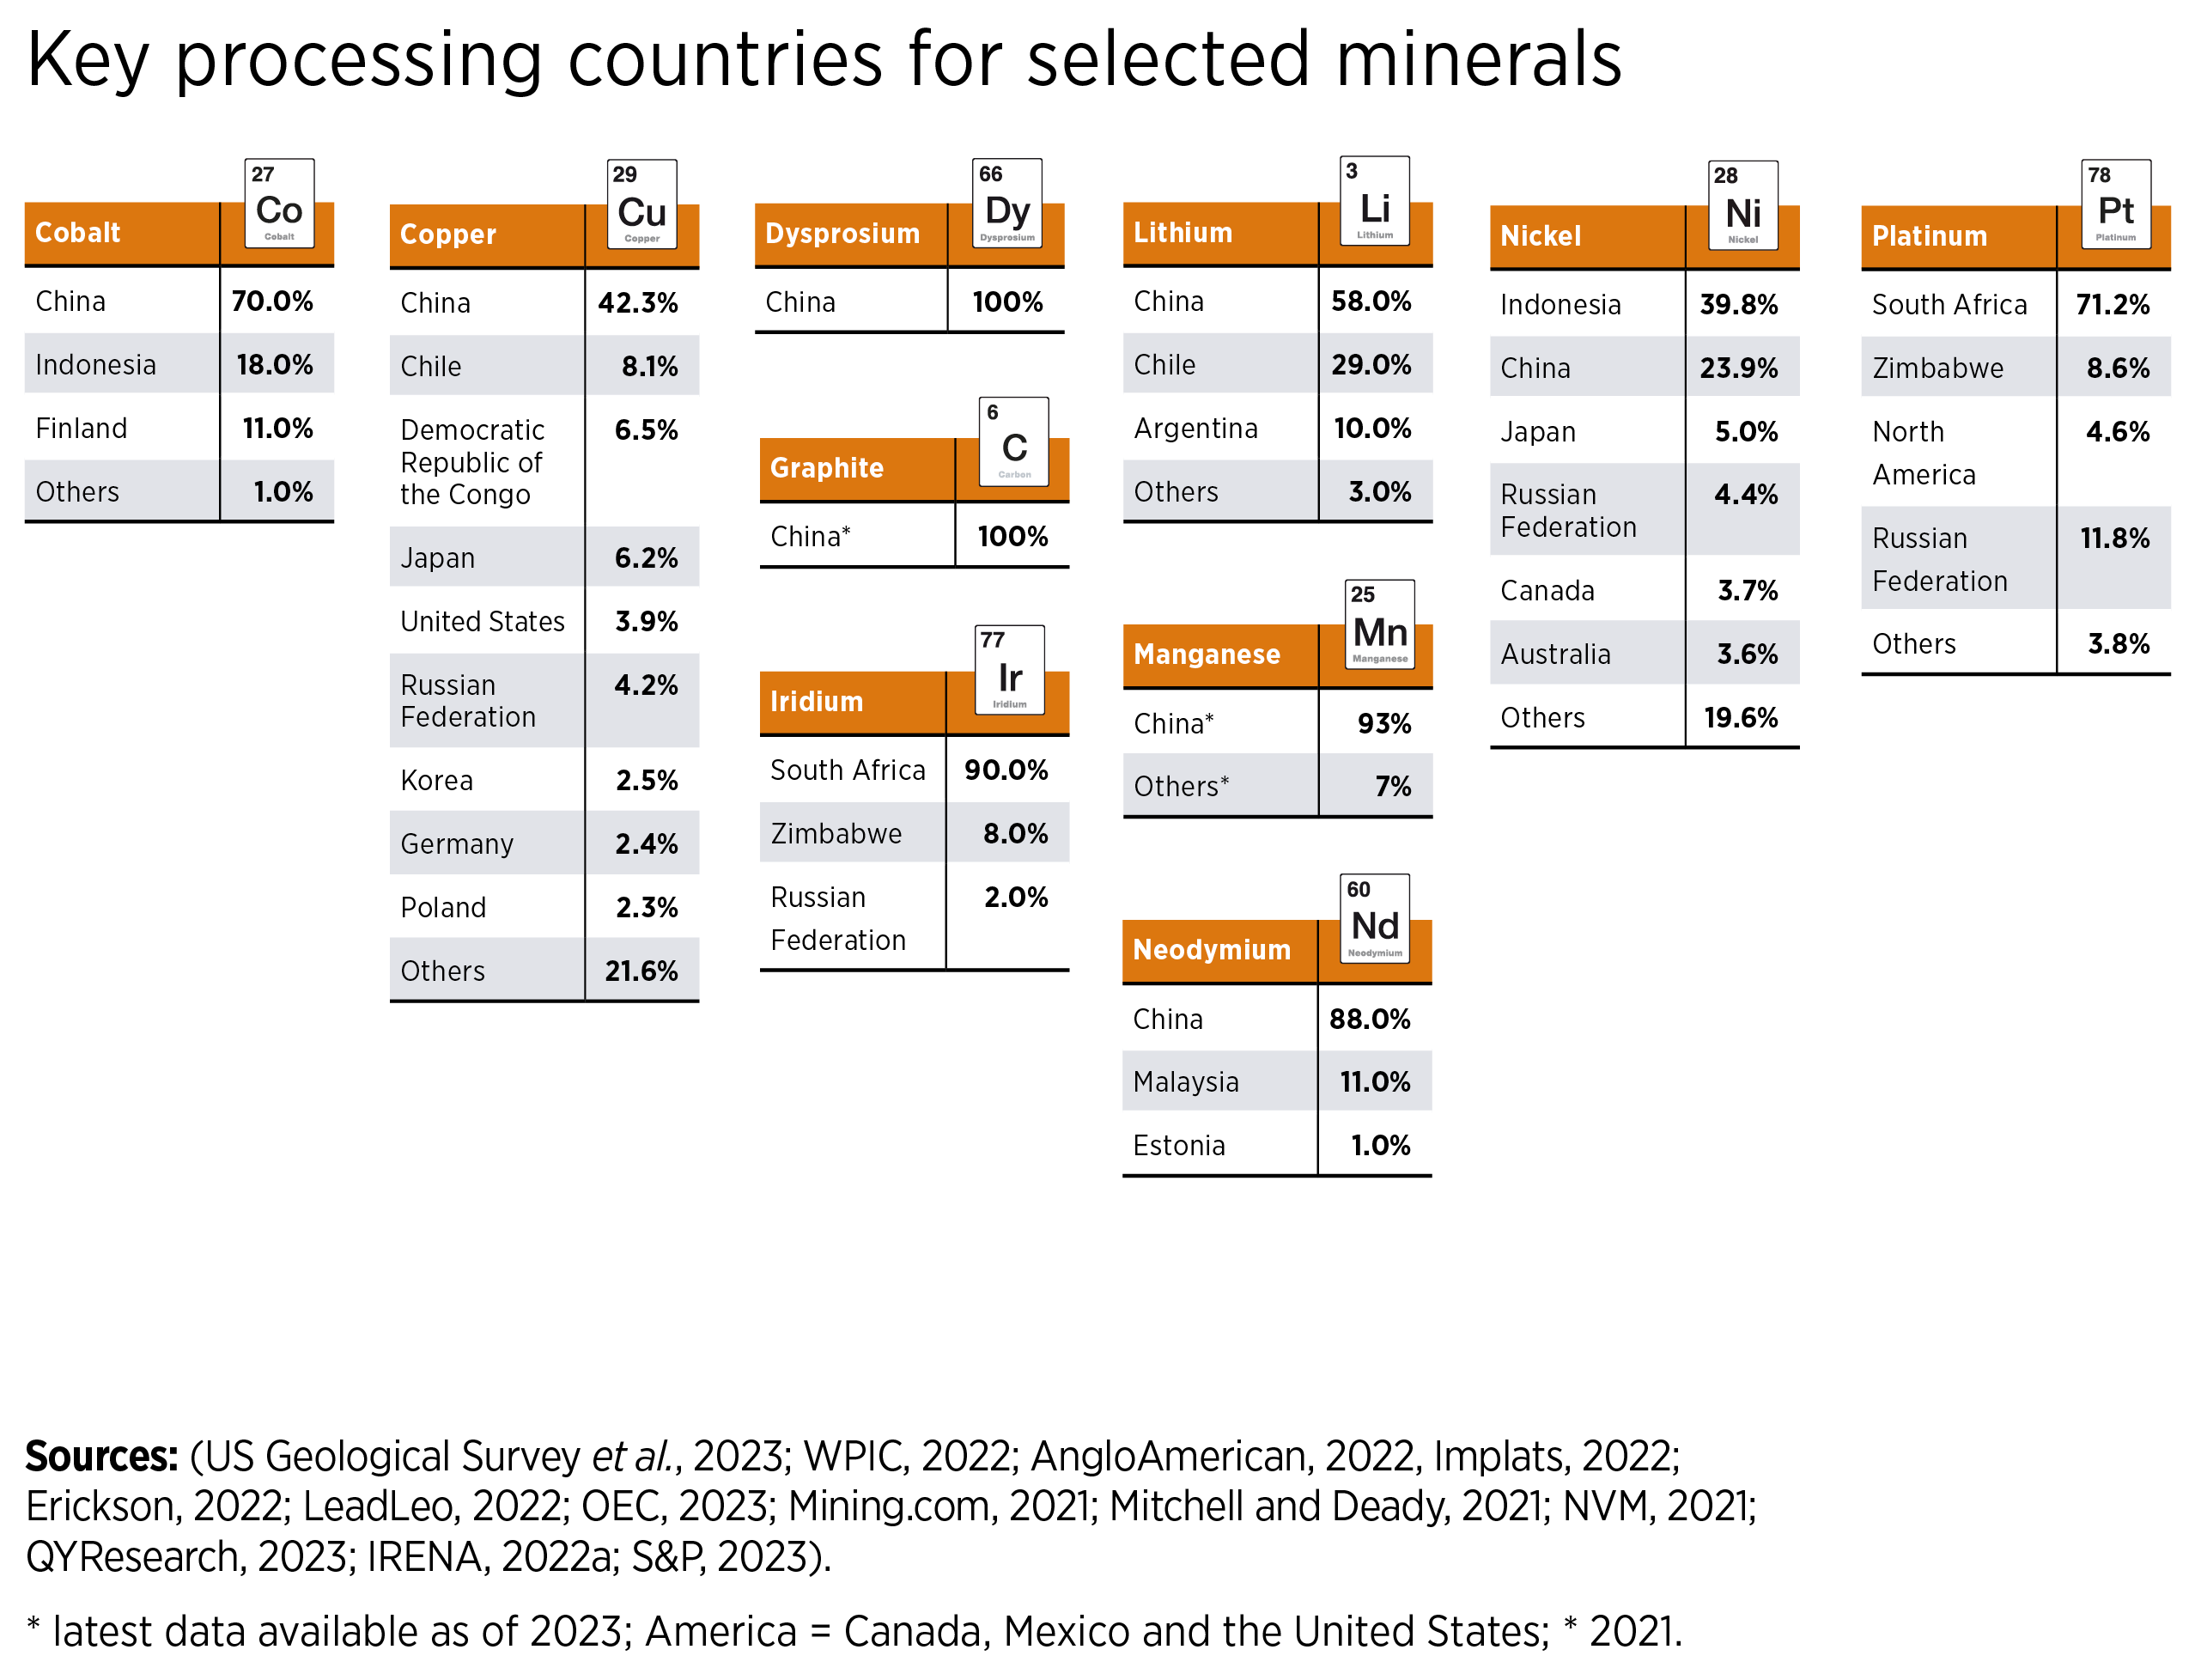
FIGURE 2.3 Key processing countries for selected minerals
10

Slide 11
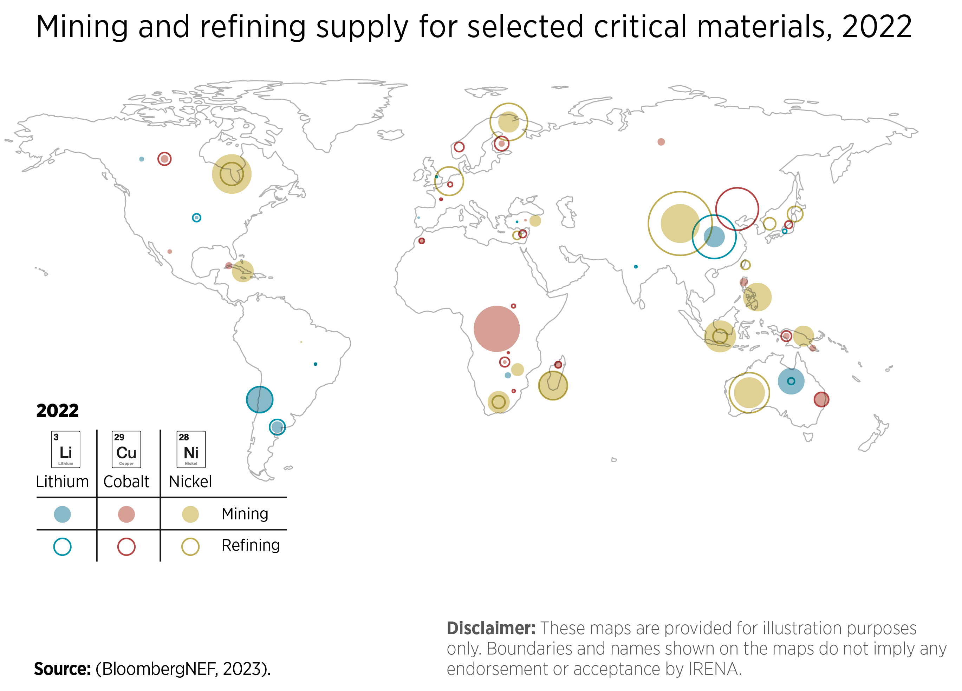
FIGURE 2.4 Mining and refining supply for selected critical materials, 2022
11

Slide 12
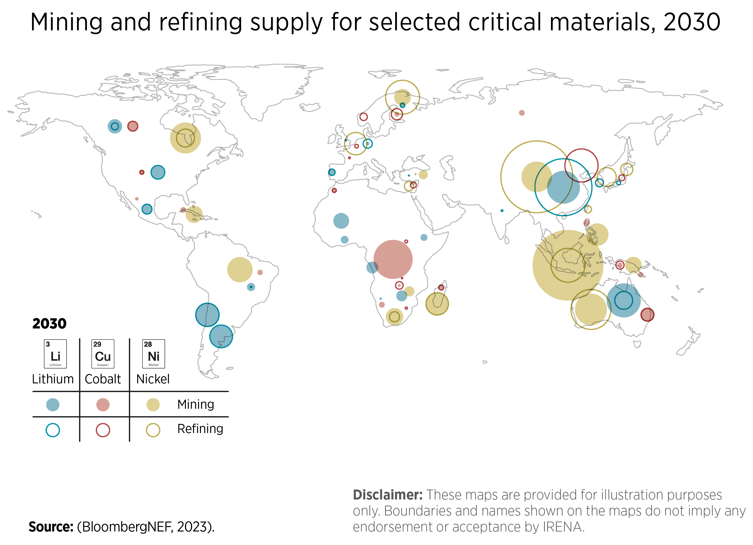
FIGURE 2.5 Mining and refining supply forecasts for selected critical materials, 2030
12

Slide 13
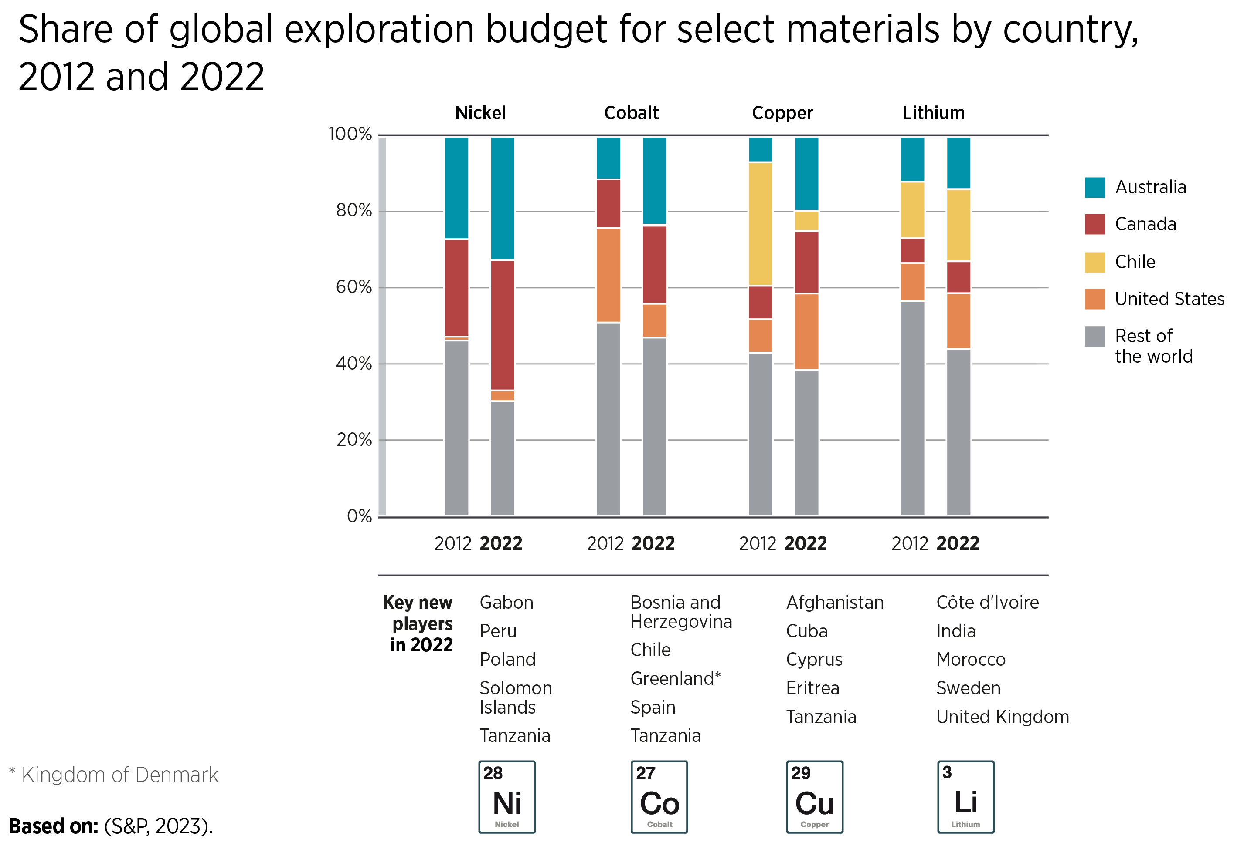
FIGURE 2.6 Share of global exploration budget for select materials by country, 2012 and 2022
13

Slide 14
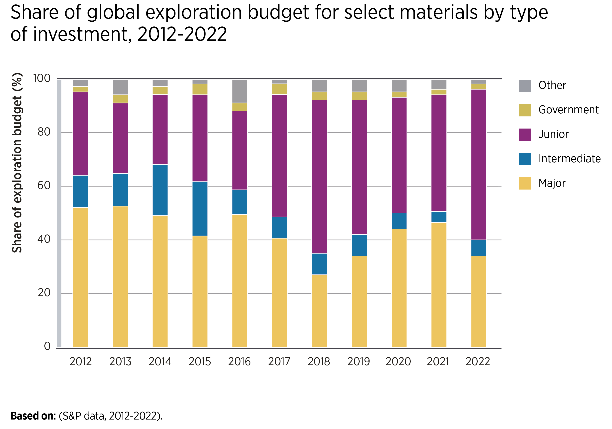
FIGURE 2.7 Share of global exploration budget for select materials by type of investment, 2012 to 2022
14

Slide 15
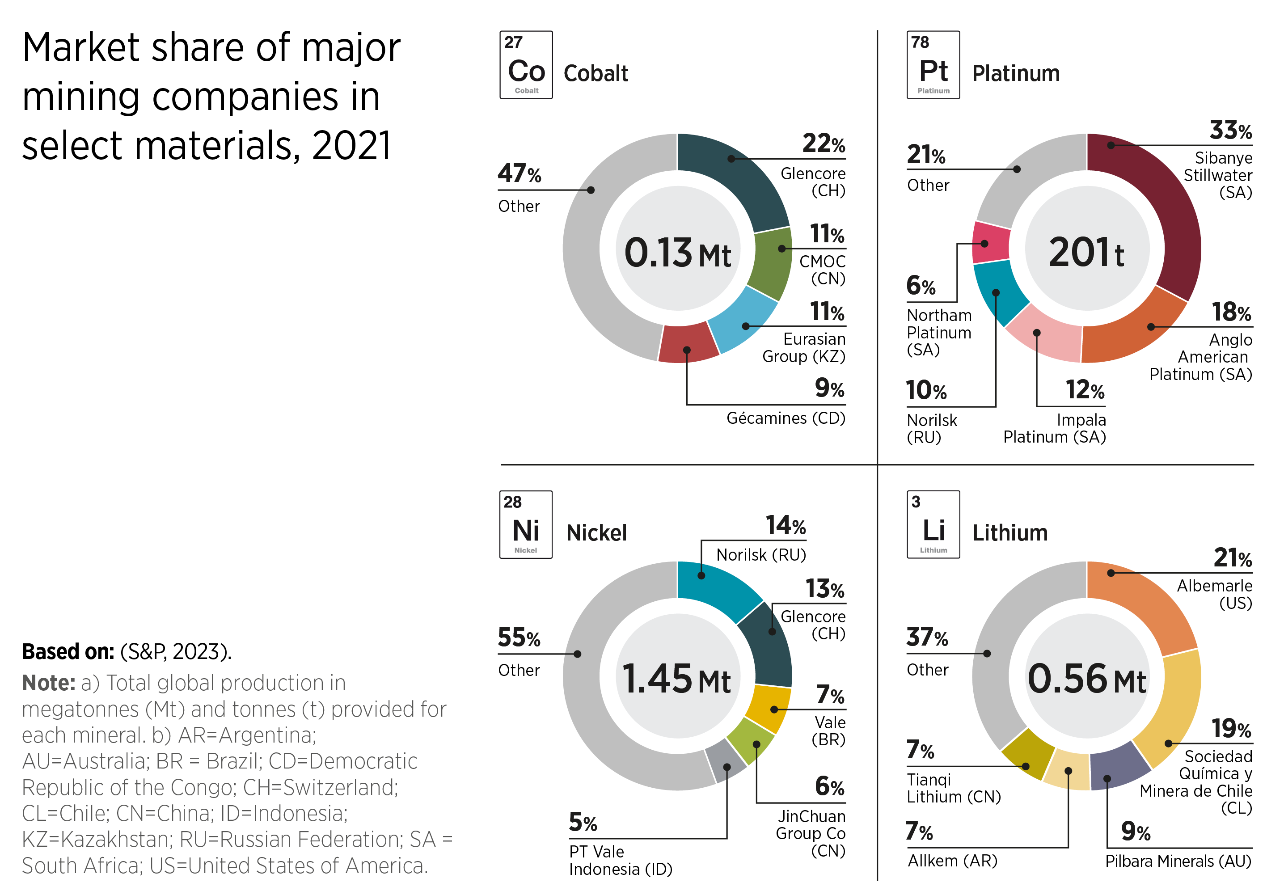
FIGURE 2.8 Market share of major mining companies in select materials, 2021
15

Slide 16
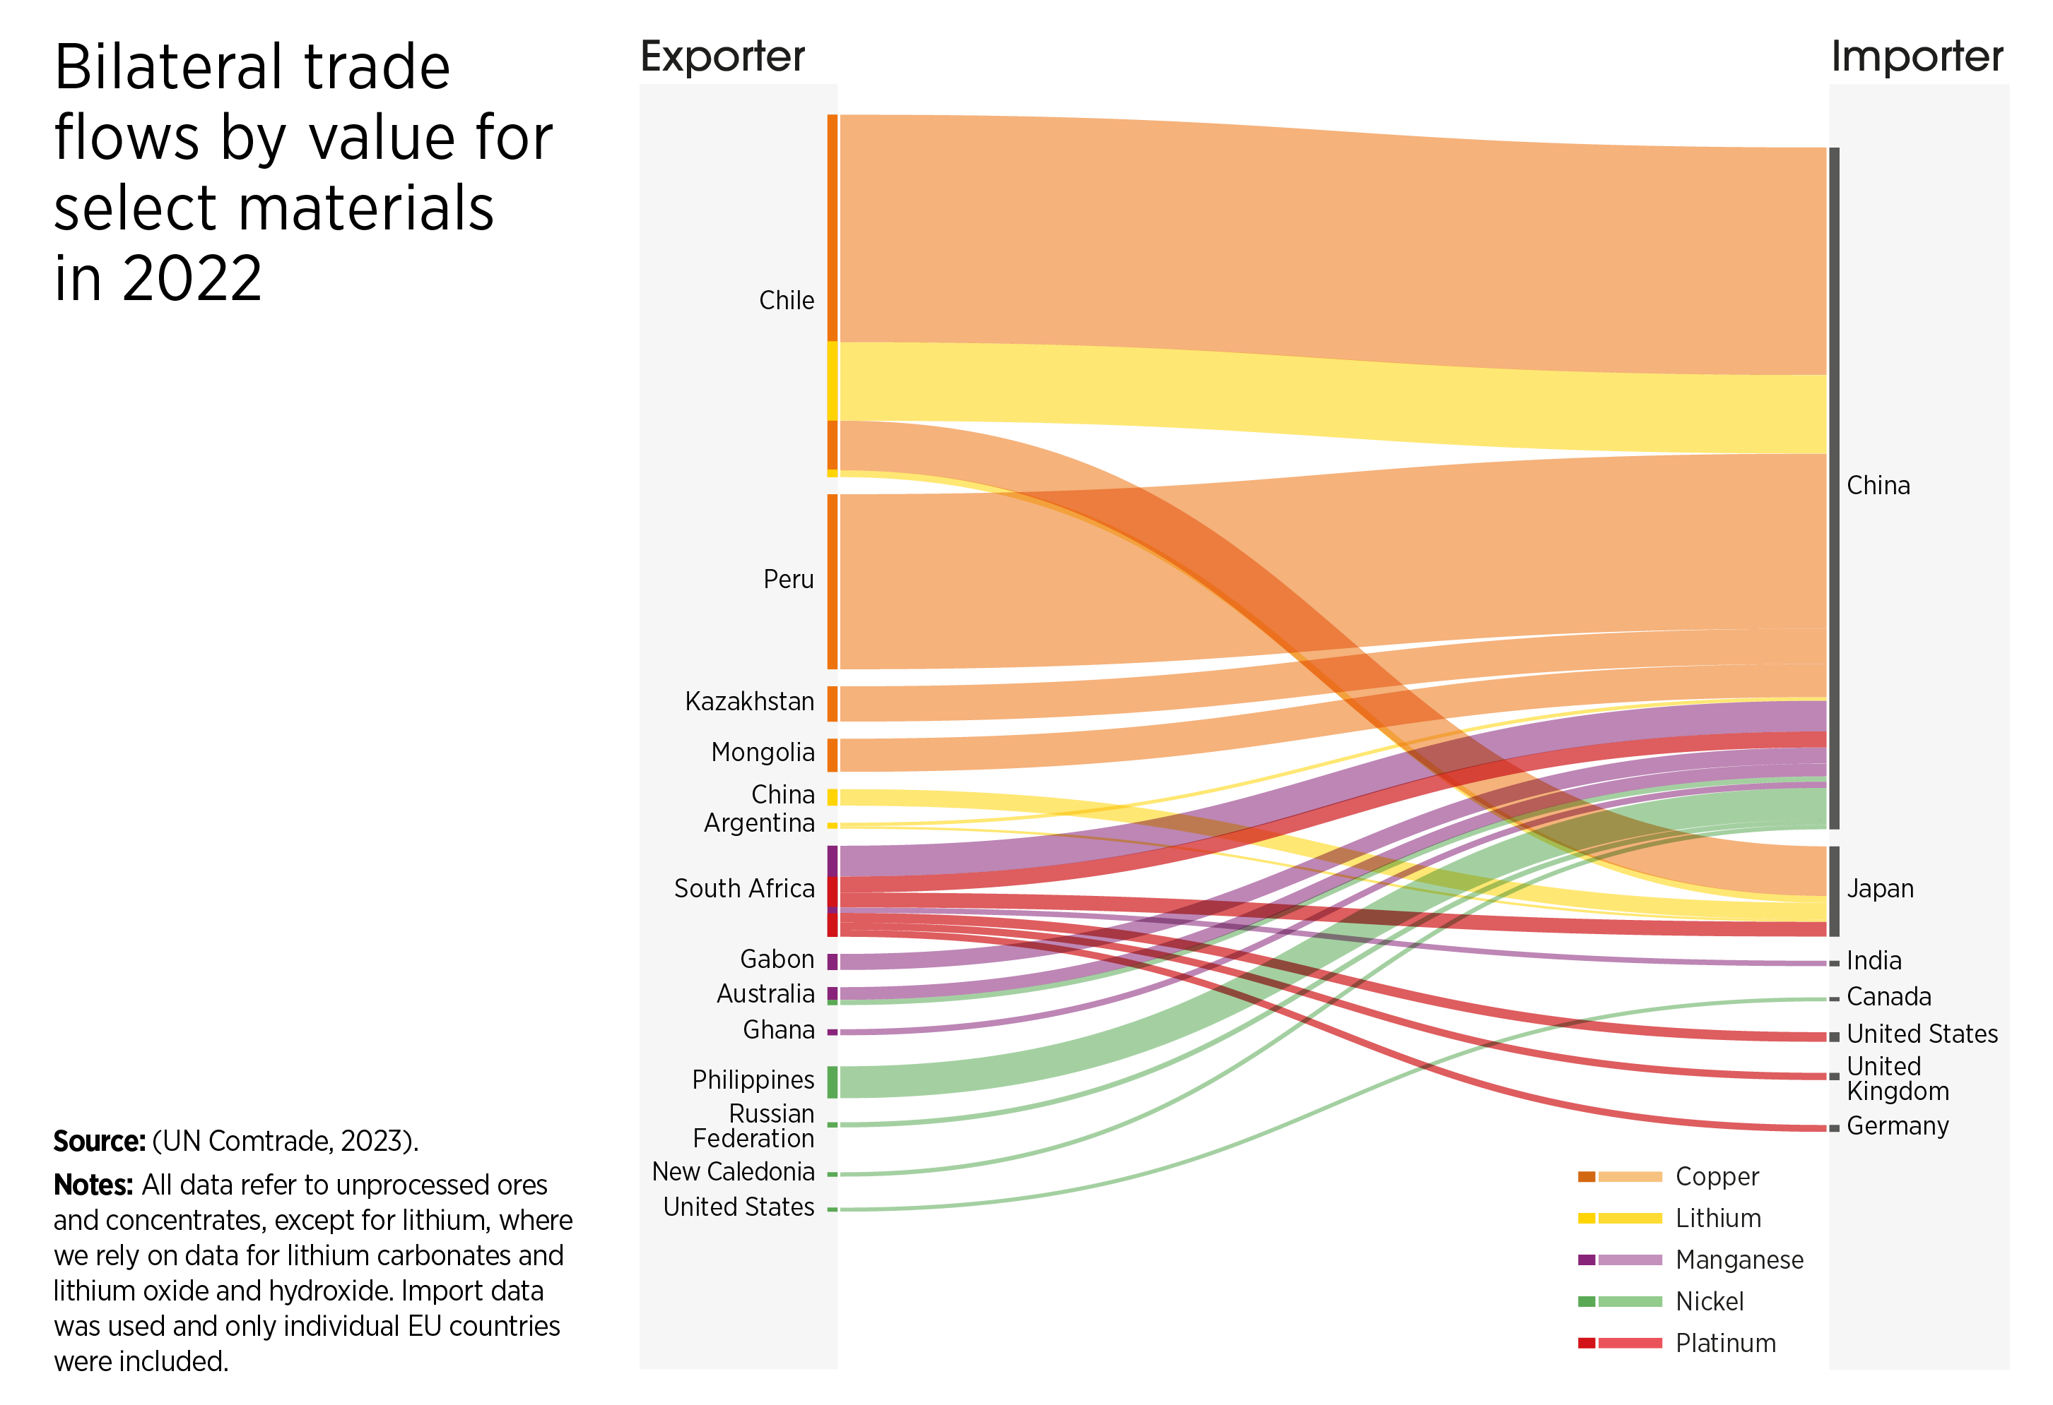
FIGURE 2.9 Bilateral trade flows by value for select materials in 2022
16

Slide 17
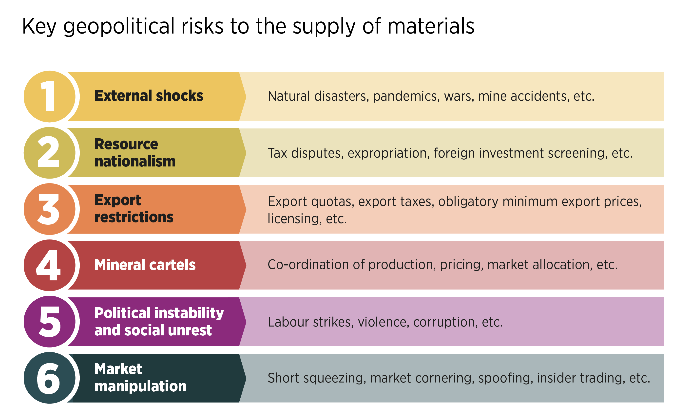
FIGURE 2.10 Key geopolitical risks to the supply of materials
17

Slide 18
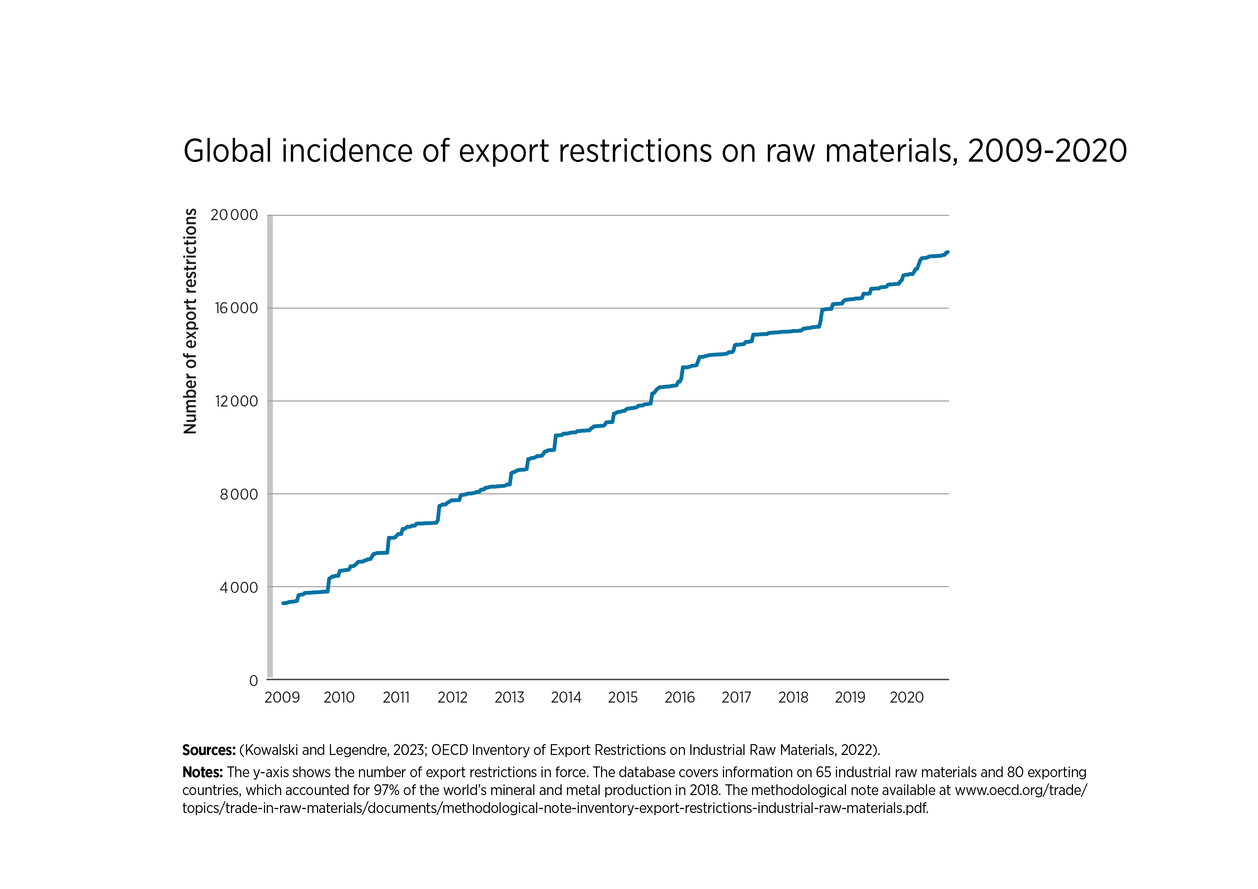
FIGURE 2.11 Global incidence of export restrictions on raw materials, 2009-2020
18

Slide 19
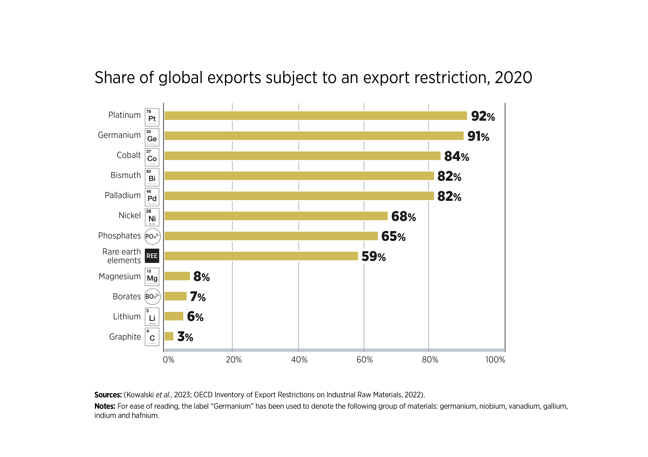
FIGURE 2.12 Share of global exports subject to an export restriction, 2020
19

Slide 20
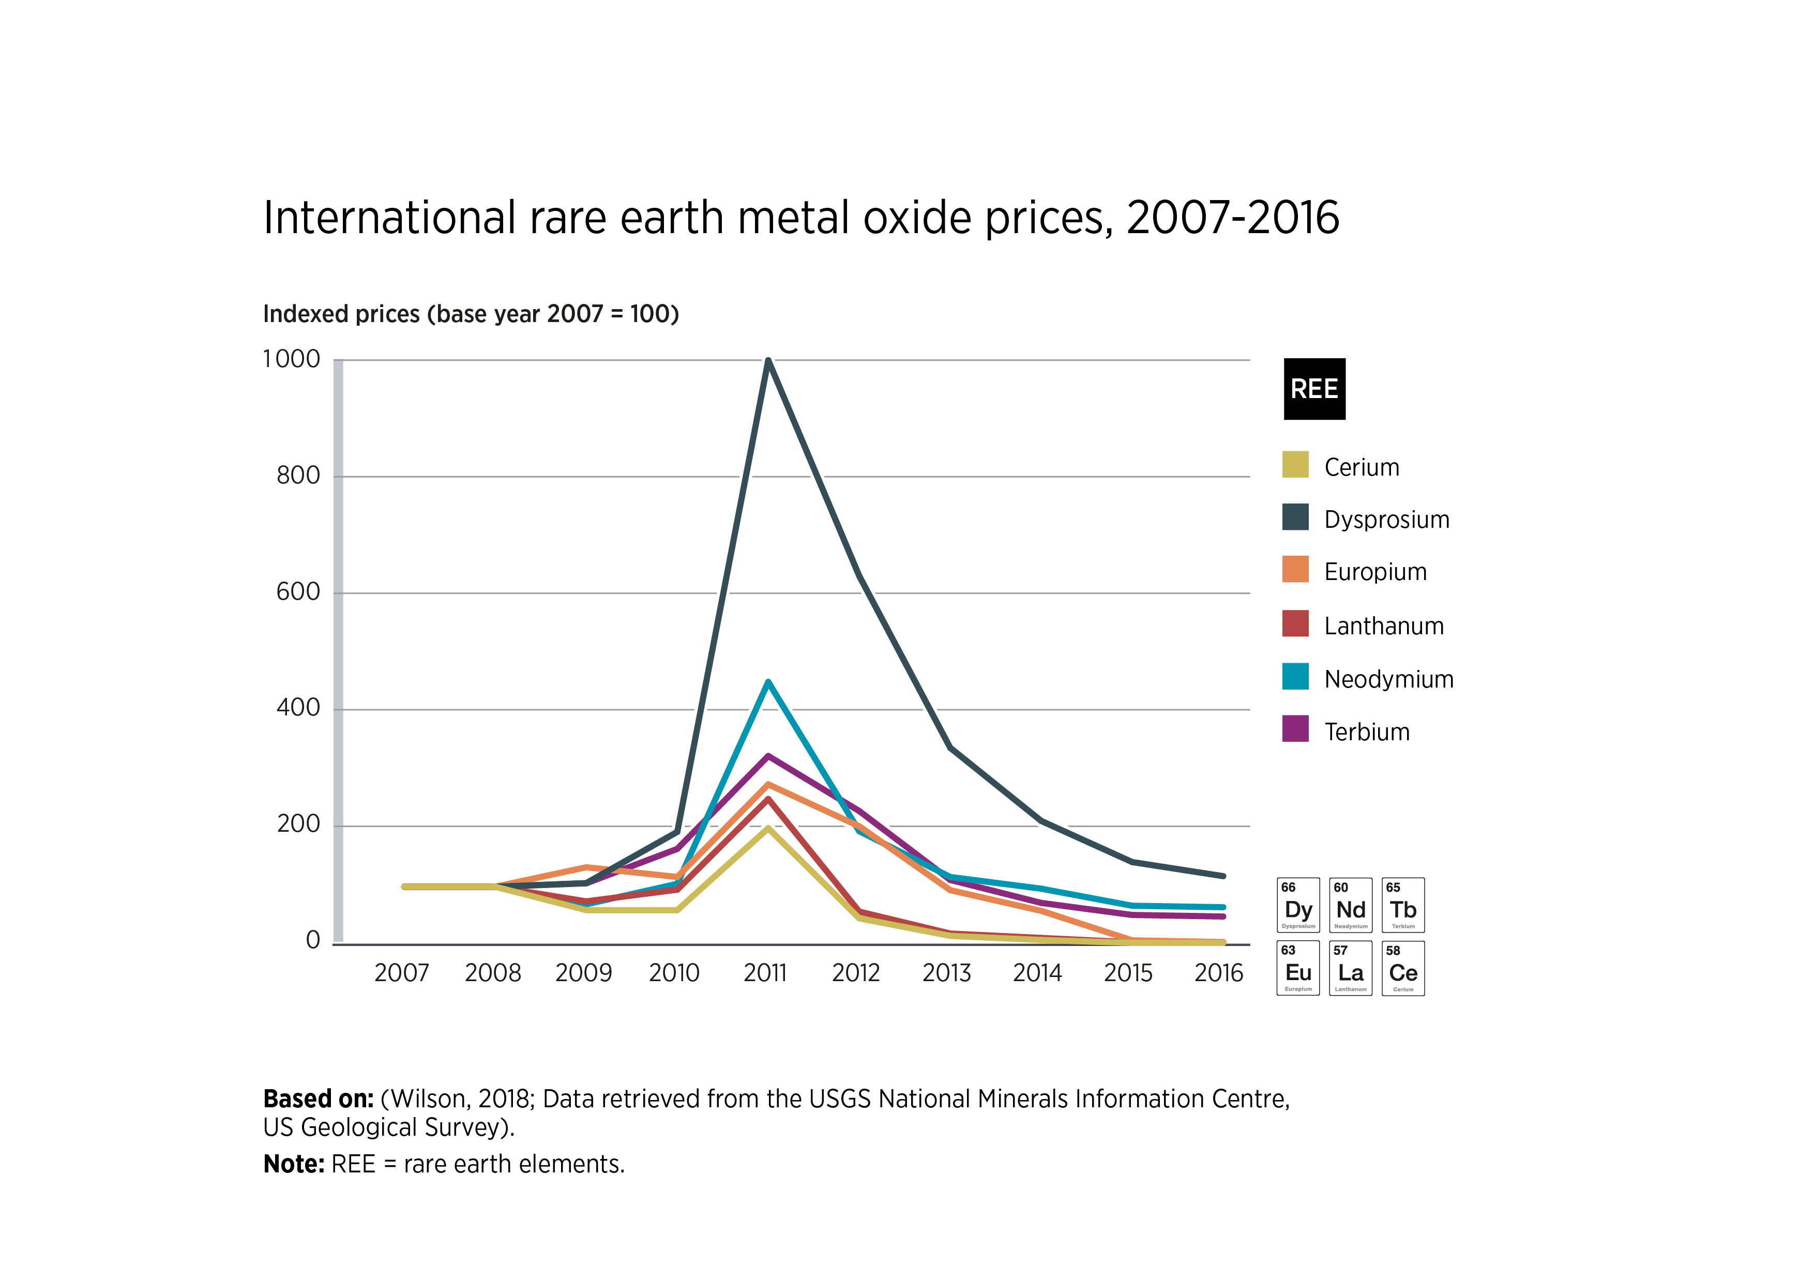
FIGURE 2.13 International rare earth metal oxide prices, 2007-2016
20

Slide 21
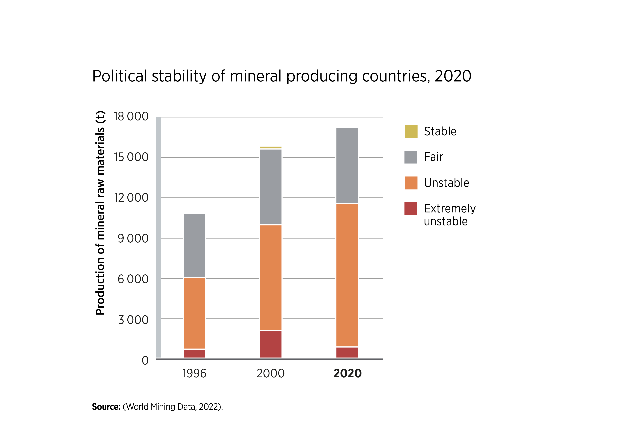
FIGURE 2.14 Political stability of mineral producing countries, 2020
21

Slide 22
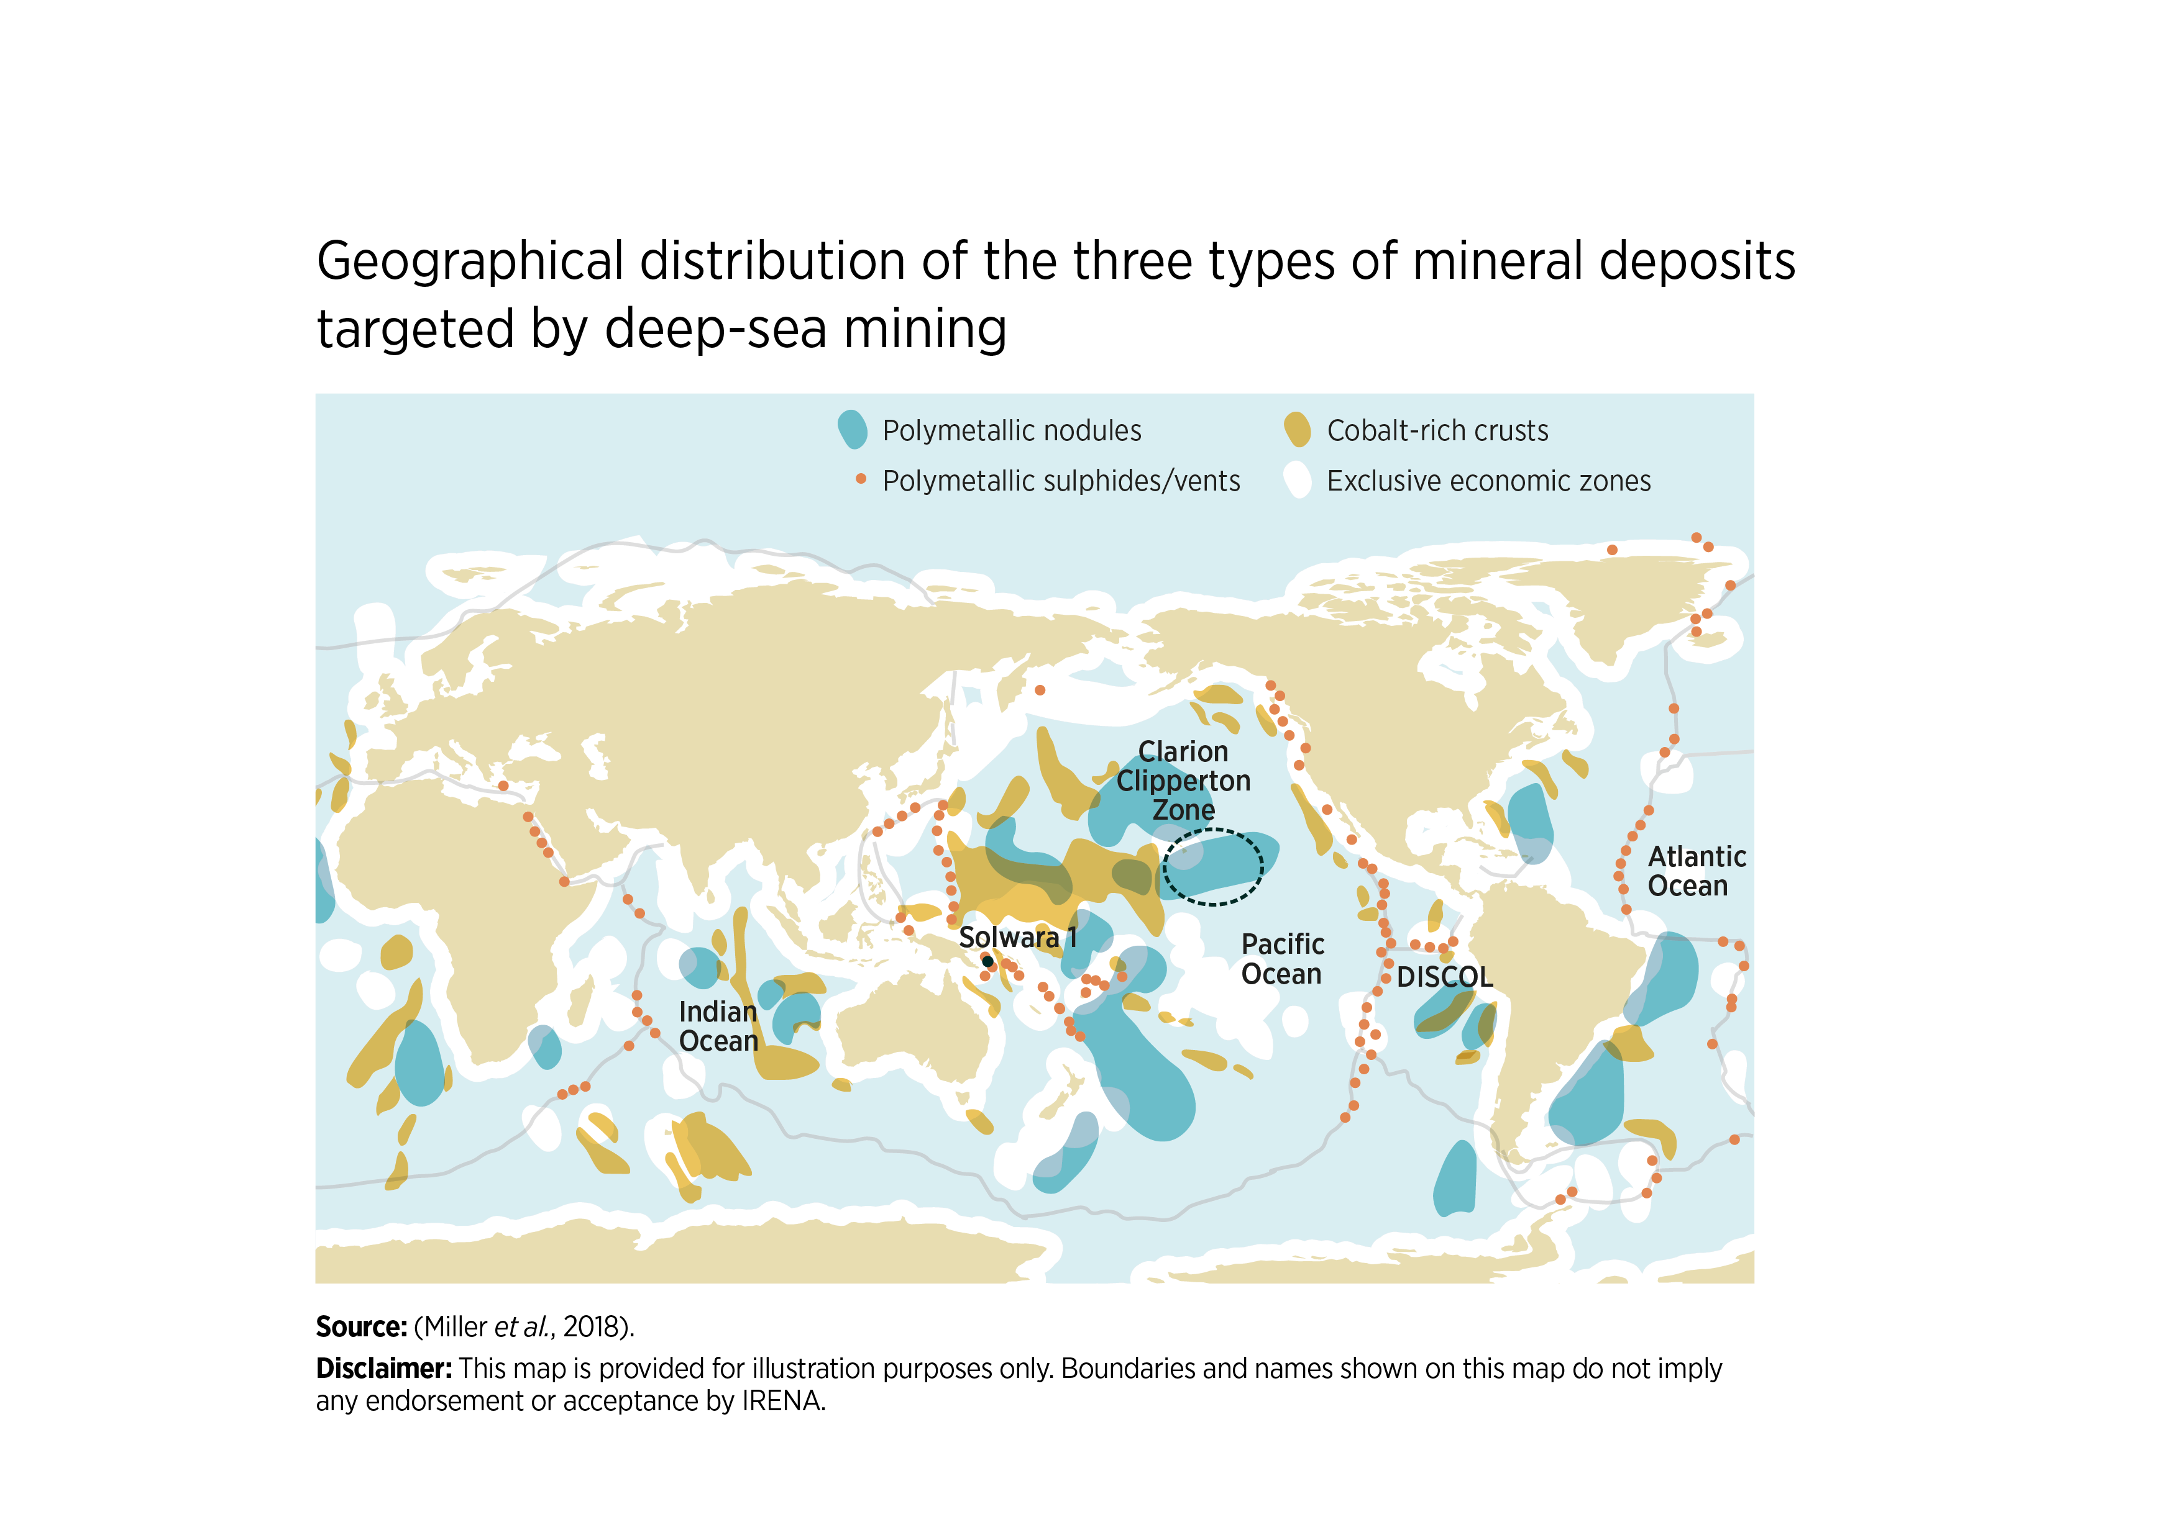
FIGURE 2.15 Geographical distribution of the three types of mineral deposits targeted by deep-sea mining
22

Slide 23
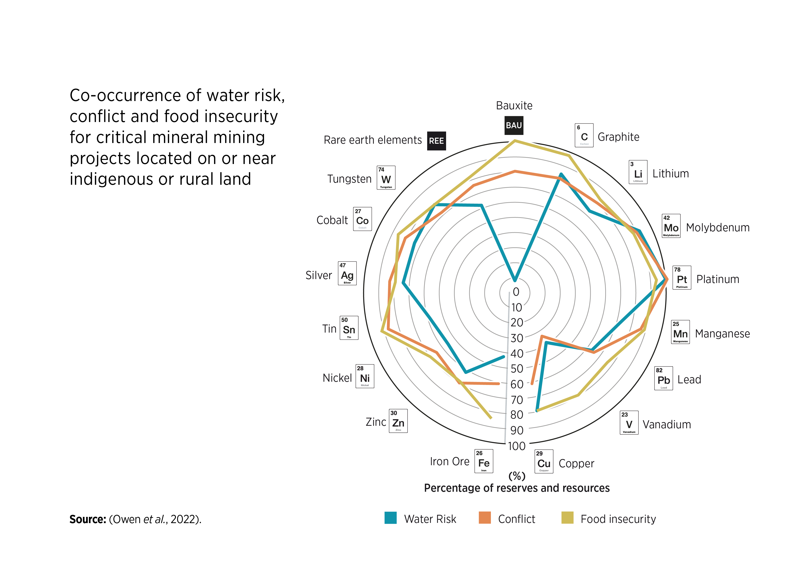
FIGURE 3.1 Co-occurrence of water risk, conflict and food insecurity for critical mineral mining projects located on or near indigenous or rural land
23

Slide 24
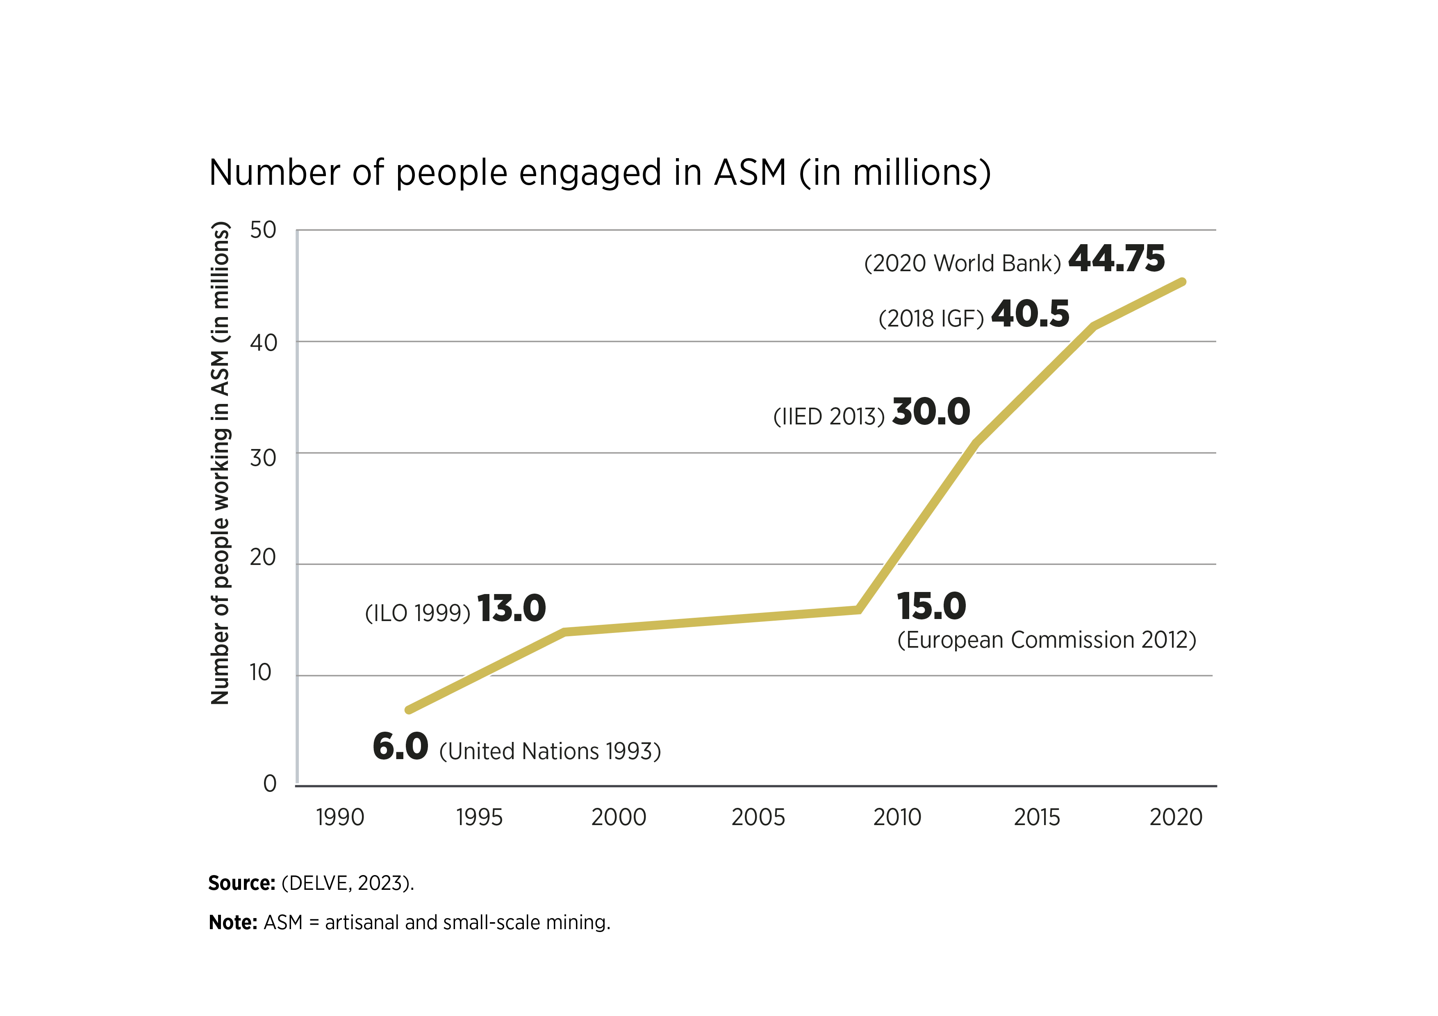
FIGURE 3.2 Number of people engaged in ASM (in millions)
24

Slide 25
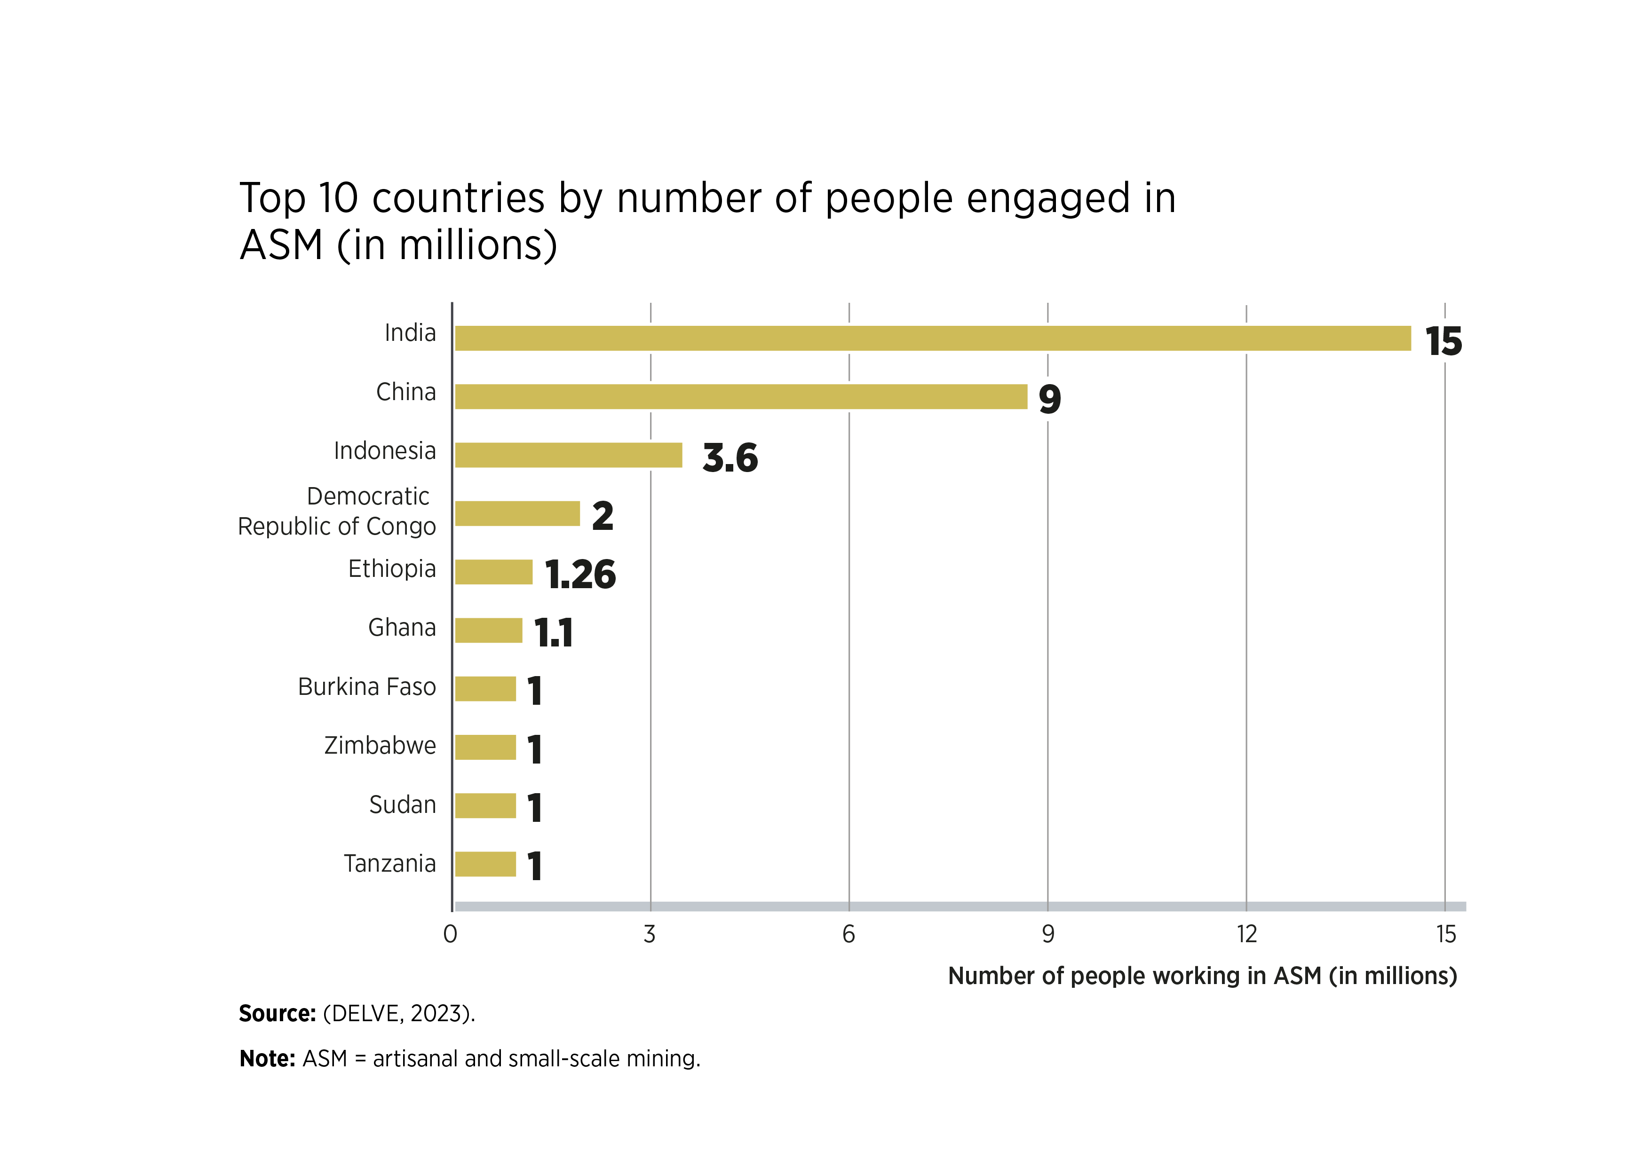
FIGURE 3.3 Top 10 countries by number of people engaged in ASM (in millions)
25

Slide 26
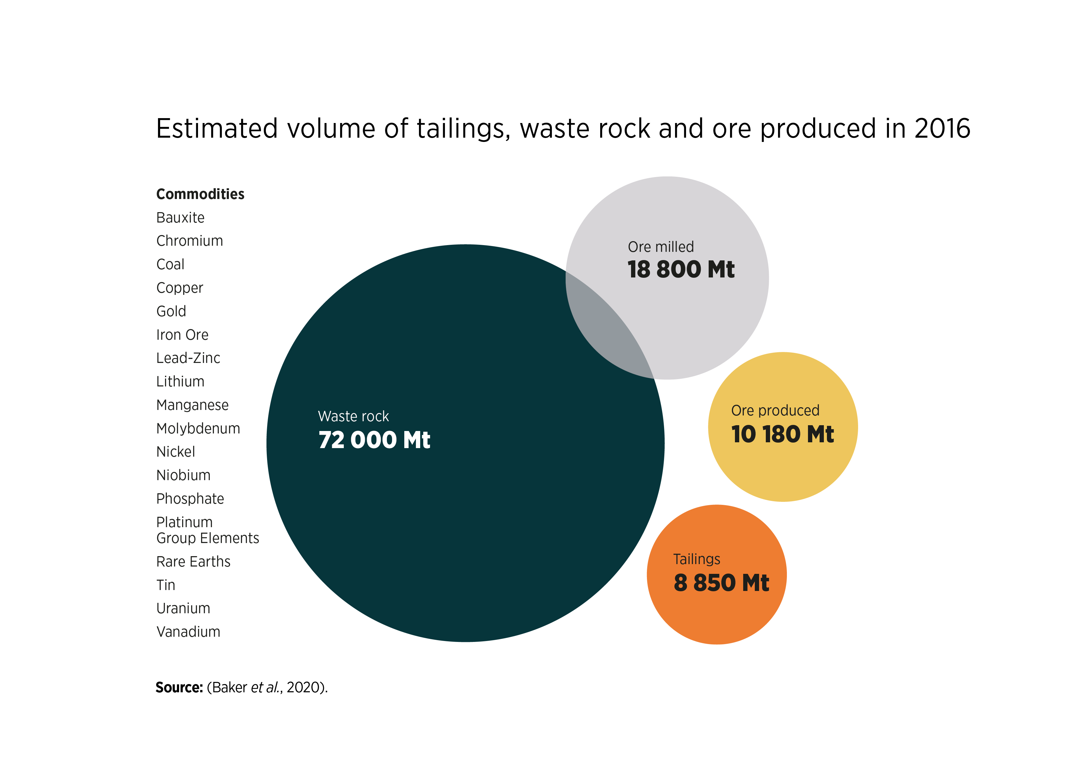
FIGURE 3.4 Estimated volume of tailings, waste rock and ore produced in 2016
26

Slide 27
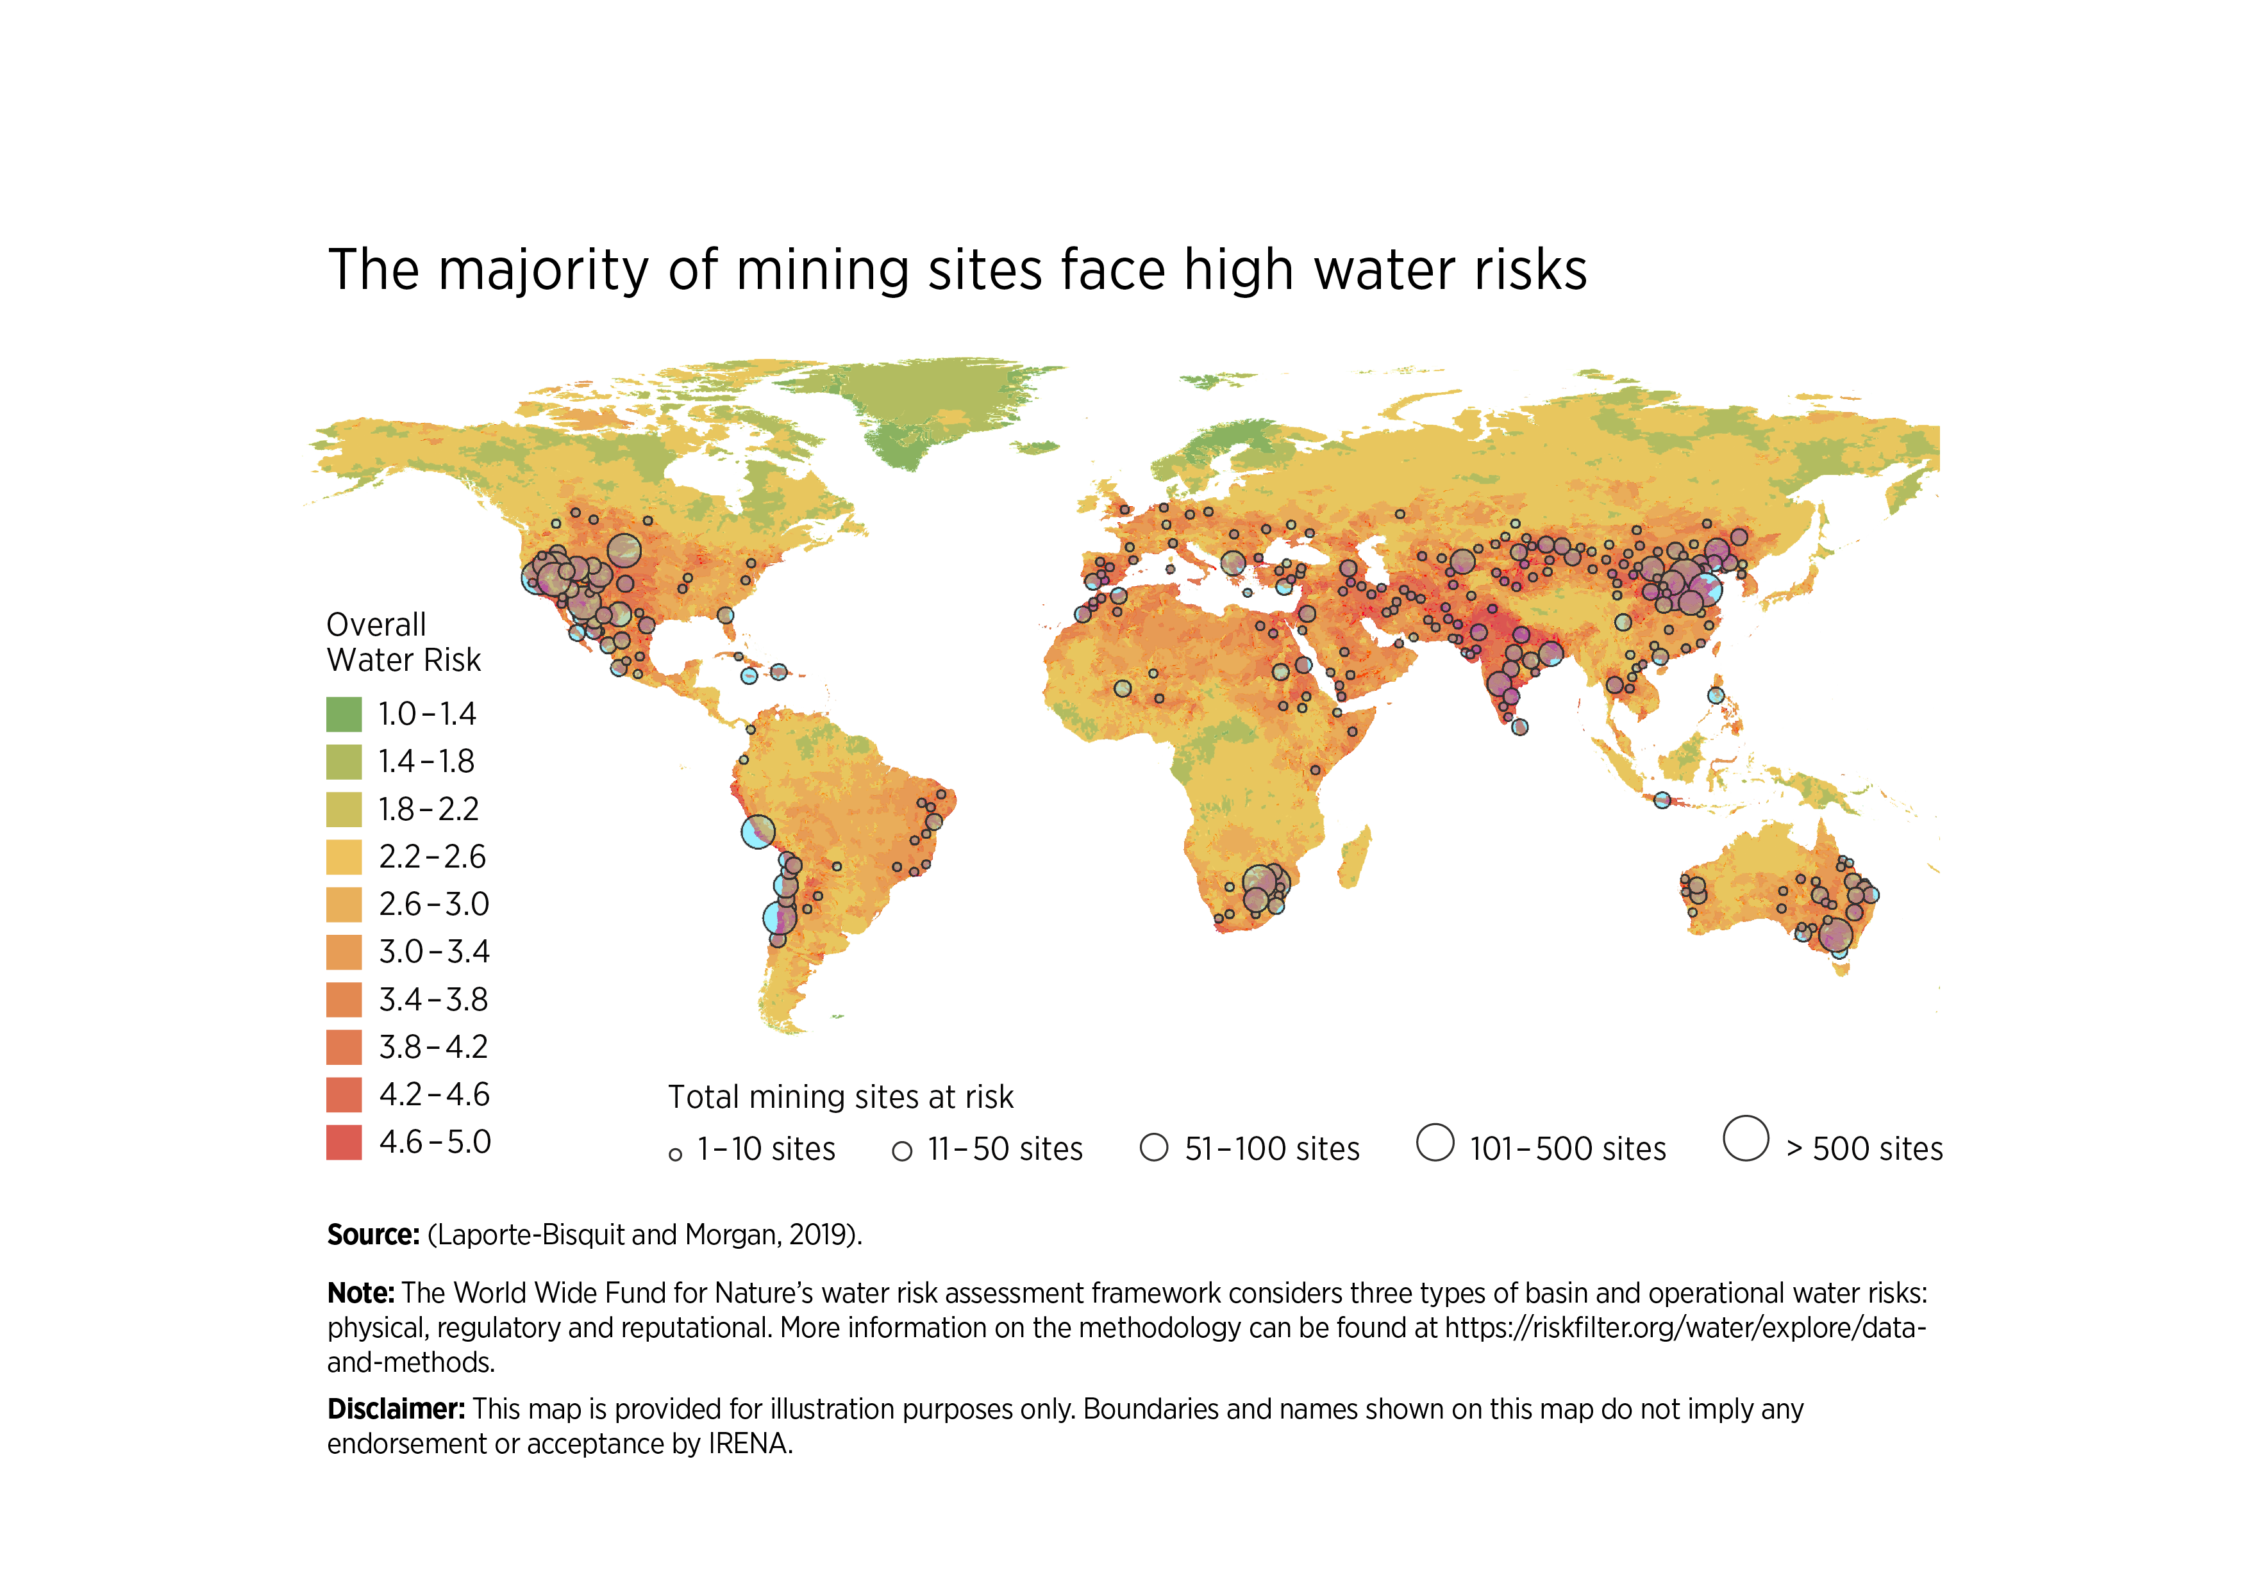
FIGURE 3.5 The majority of mining sites face high water risks
27

Slide 28
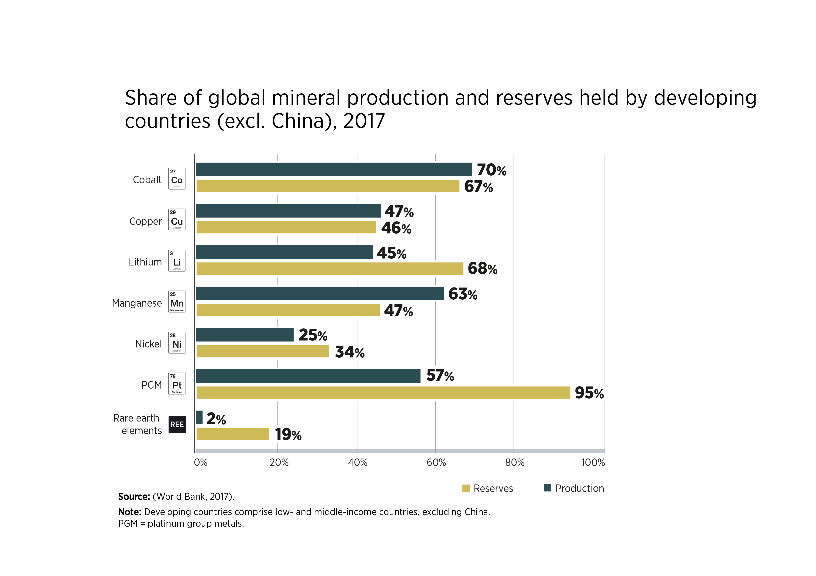
FIGURE 3.6 Share of global mineral production and reserves held by developing countries (excl. China), 2017
28

Slide 29
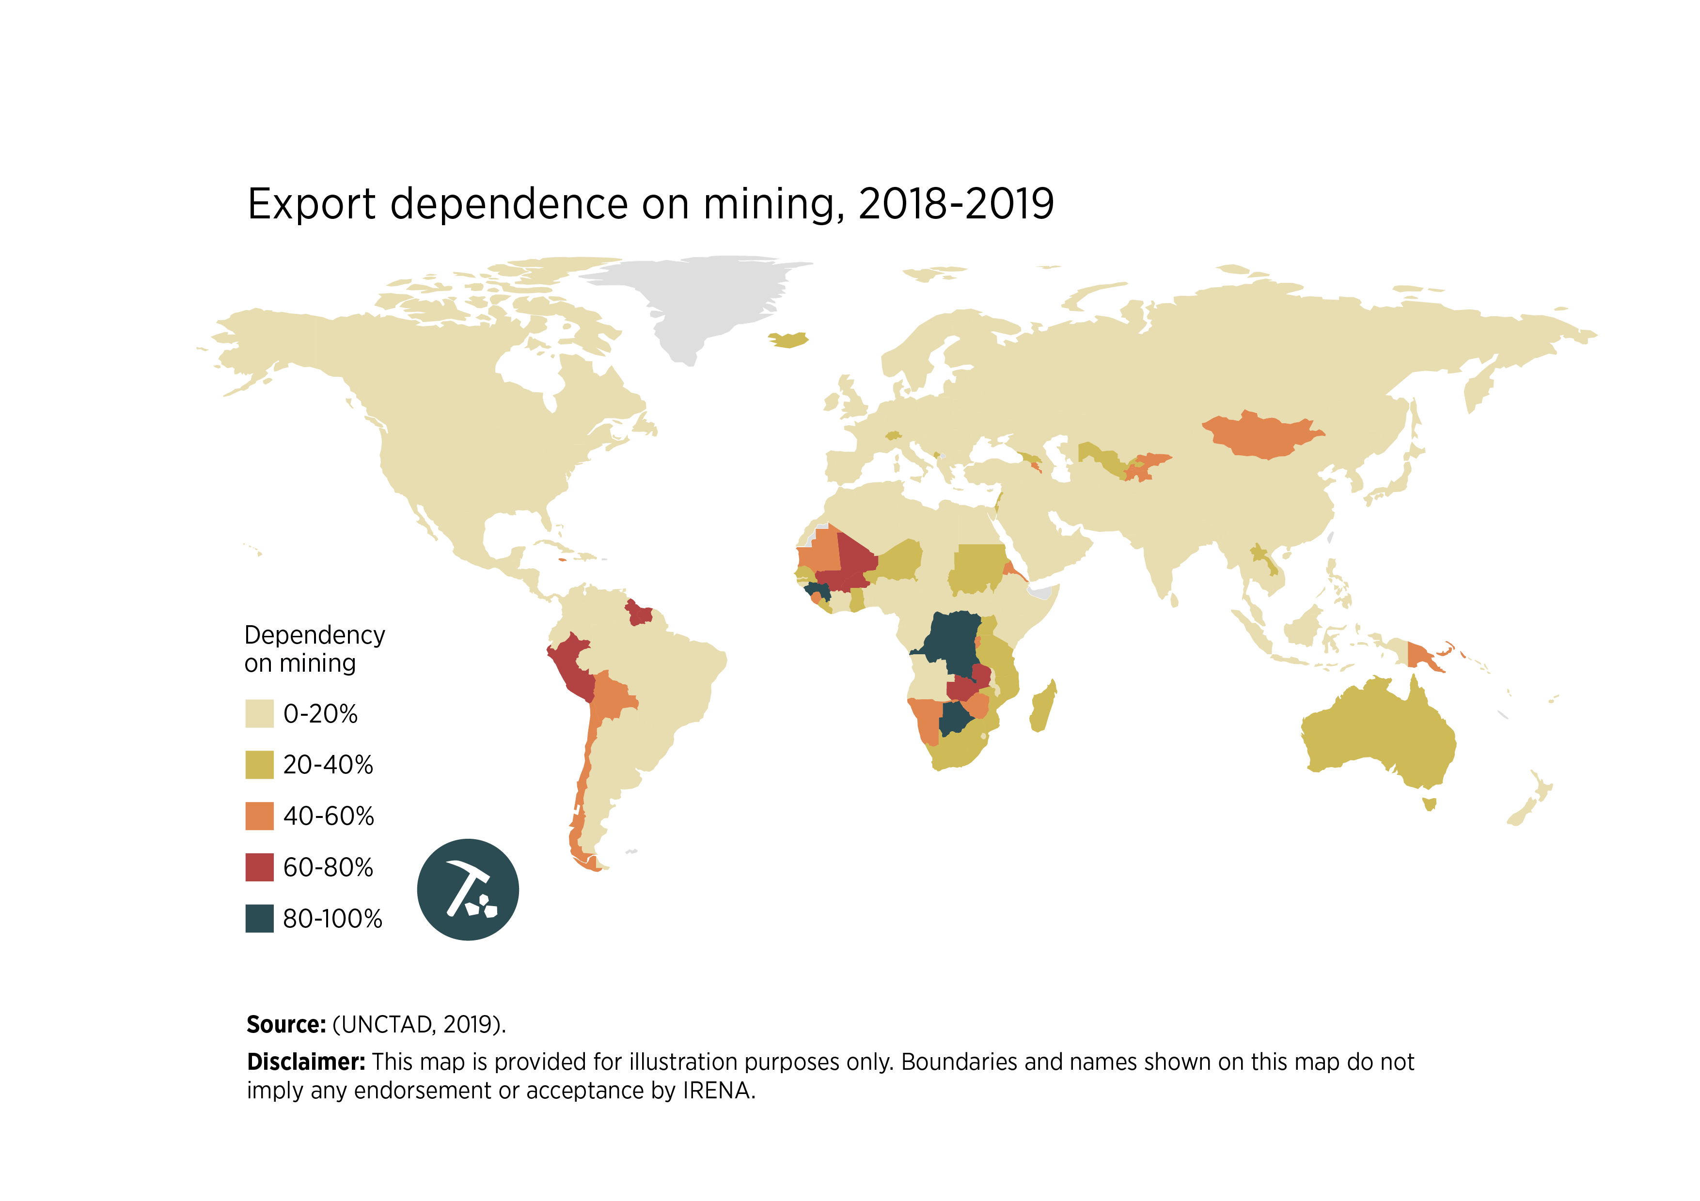
FIGURE 3.7 Export dependence on mining, 2018-2019
29

Slide 30
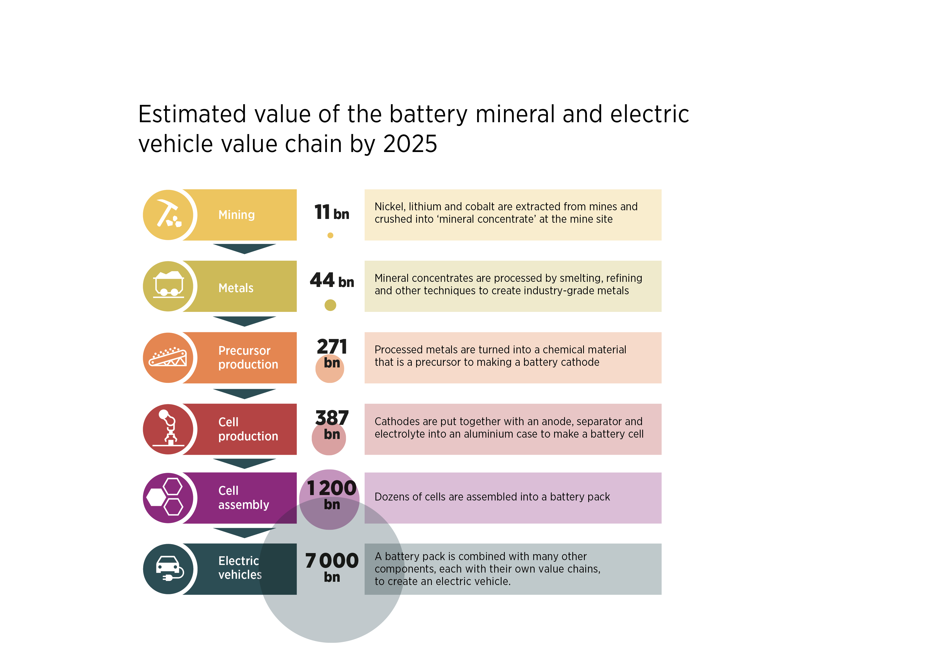
FIGURE 3.8 Estimated value of the battery mineral and electric vehicle value chain by 2025
30

Slide 31
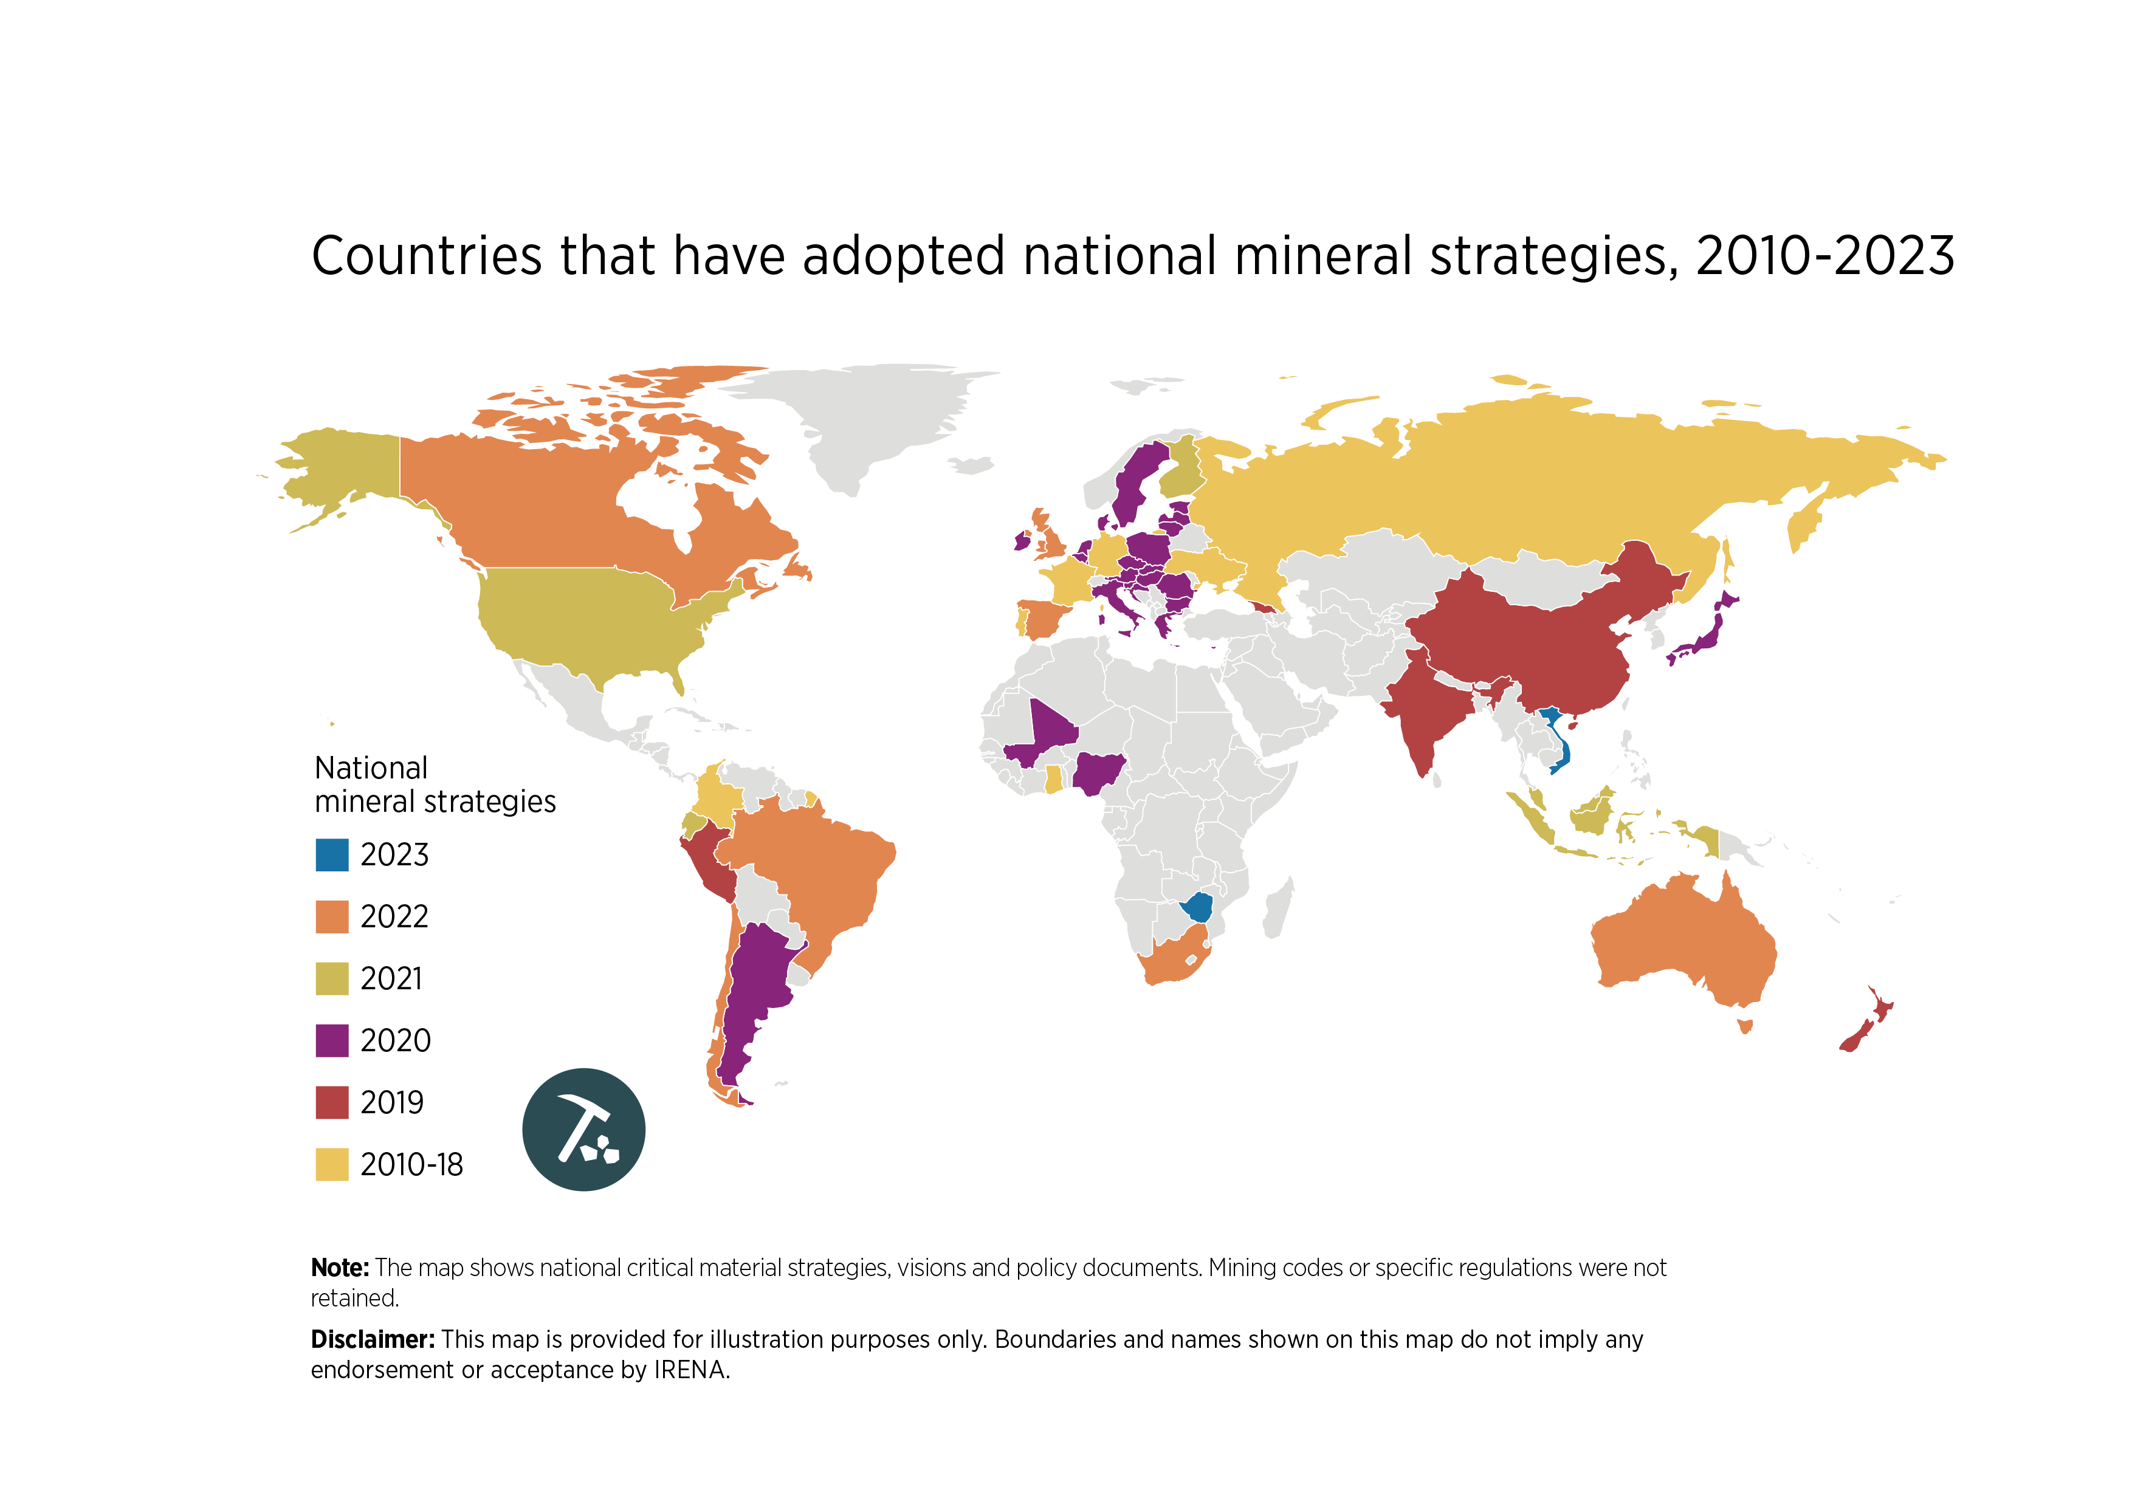
FIGURE 4.1 Countries that have adopted national mineral strategies, 2010 to 2023
31

Slide 32
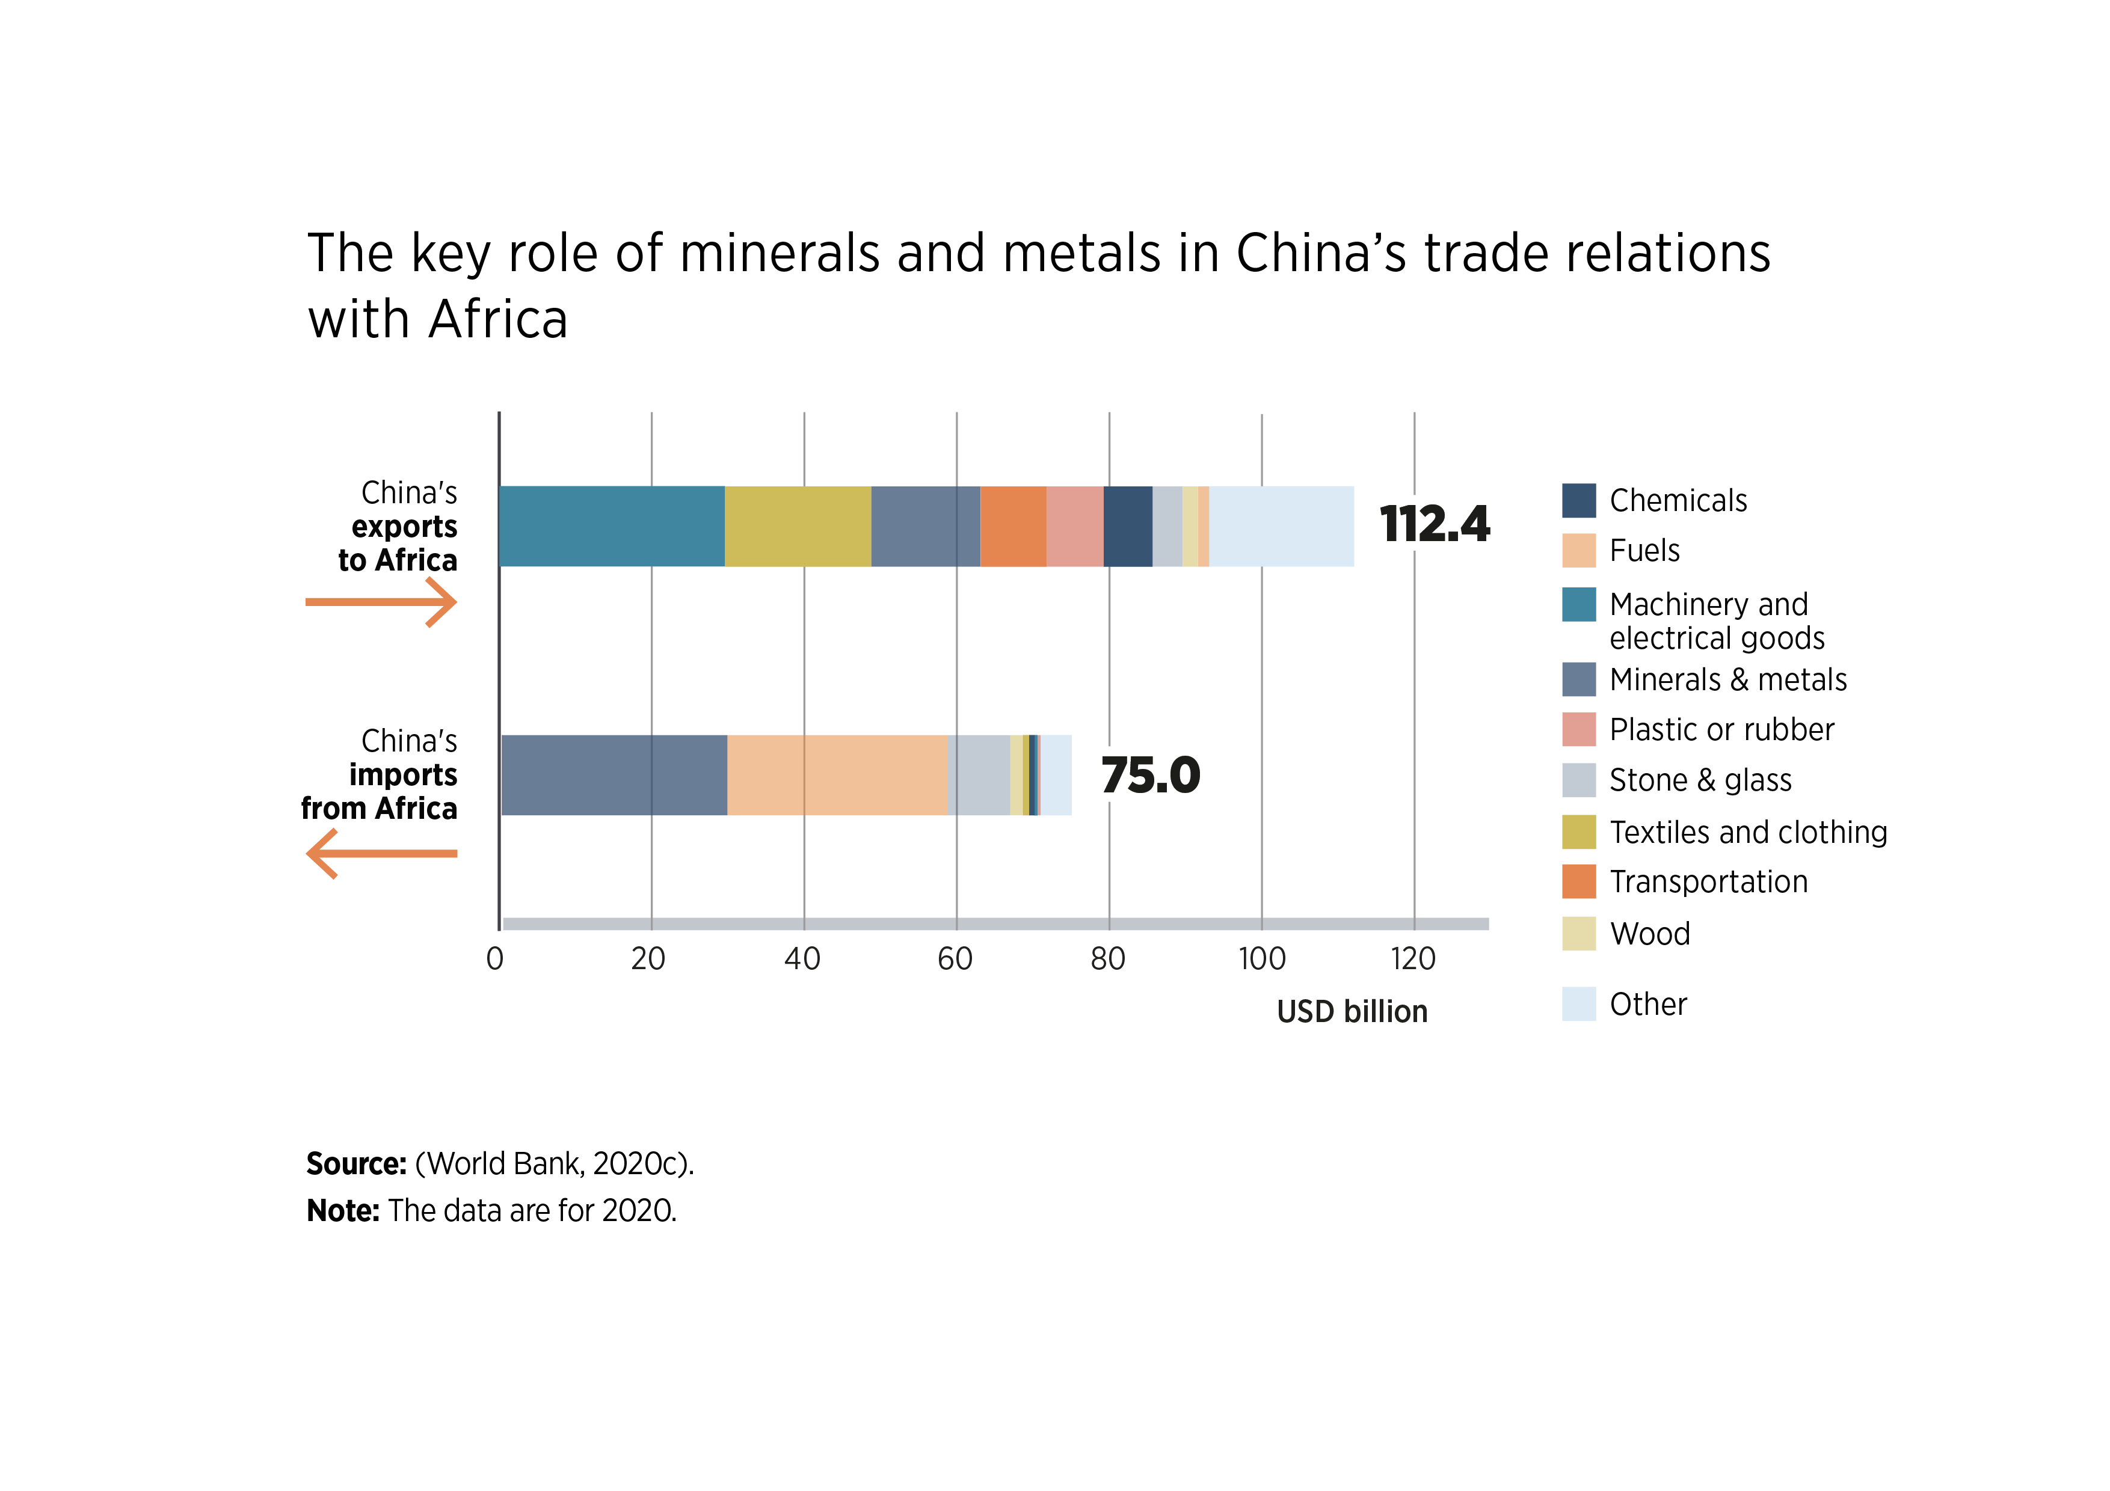
FIGURE 4.2 The key role of minerals and metals in China’s growing trade relations with Africa
32

Slide 33
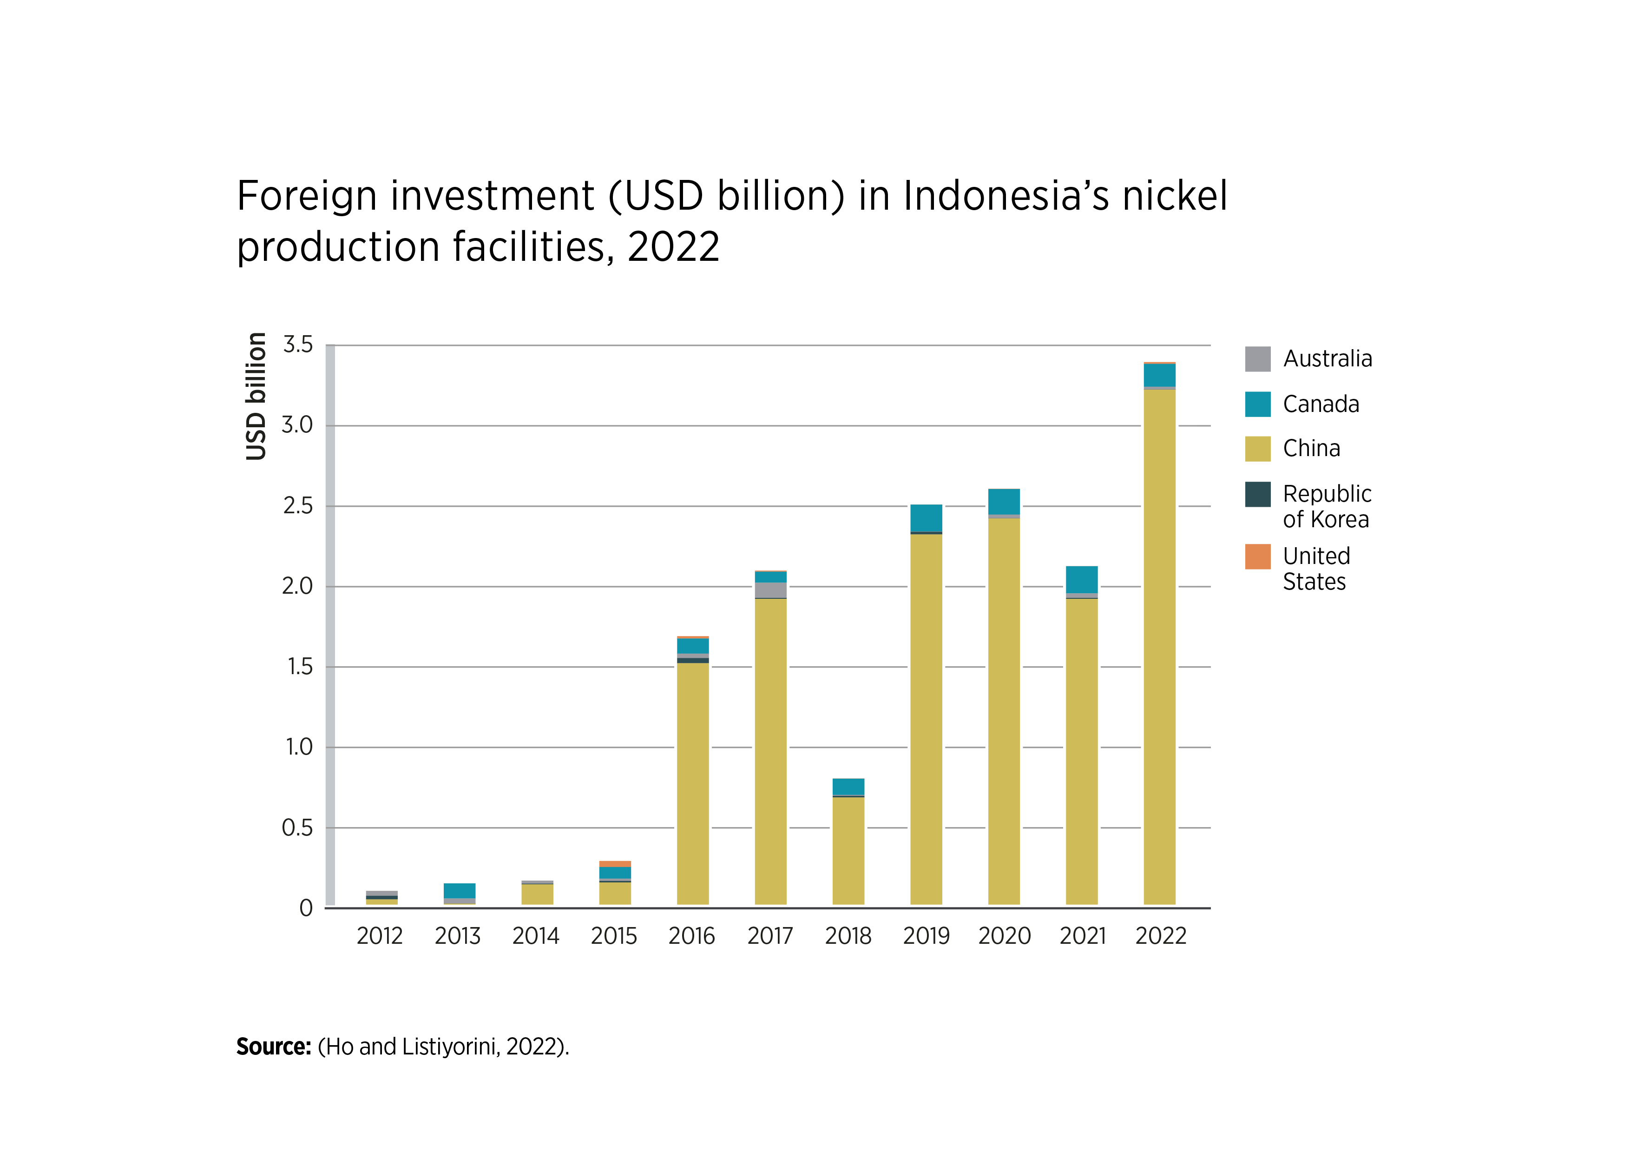
FIGURE 4.3 Foreign investment (USD billion) in Indonesia’s nickel production facilities, 2022
33

Slide 34
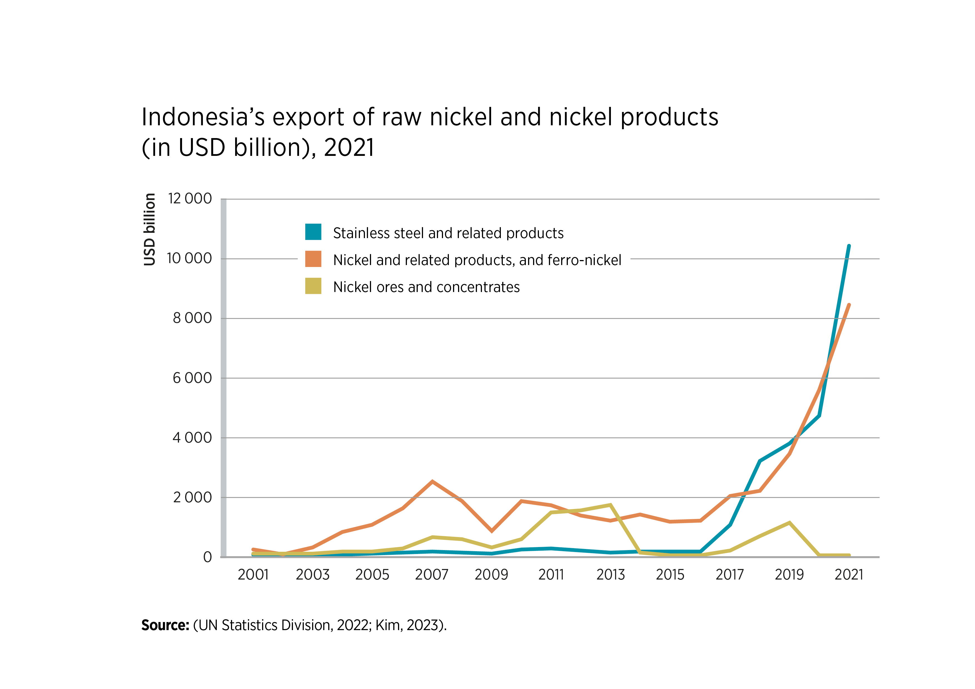
FIGURE 4.4 Indonesia’s export of raw nickel and nickel products (in USD billion, 2021)
34

Slide 35
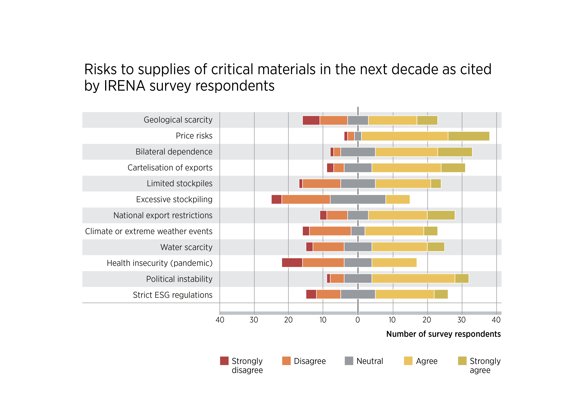
FIGURE A.1 Risks to supplies of critical materials in the next decade as cited by IRENA survey respondents
35

Slide 36
TABLES

Slide 37
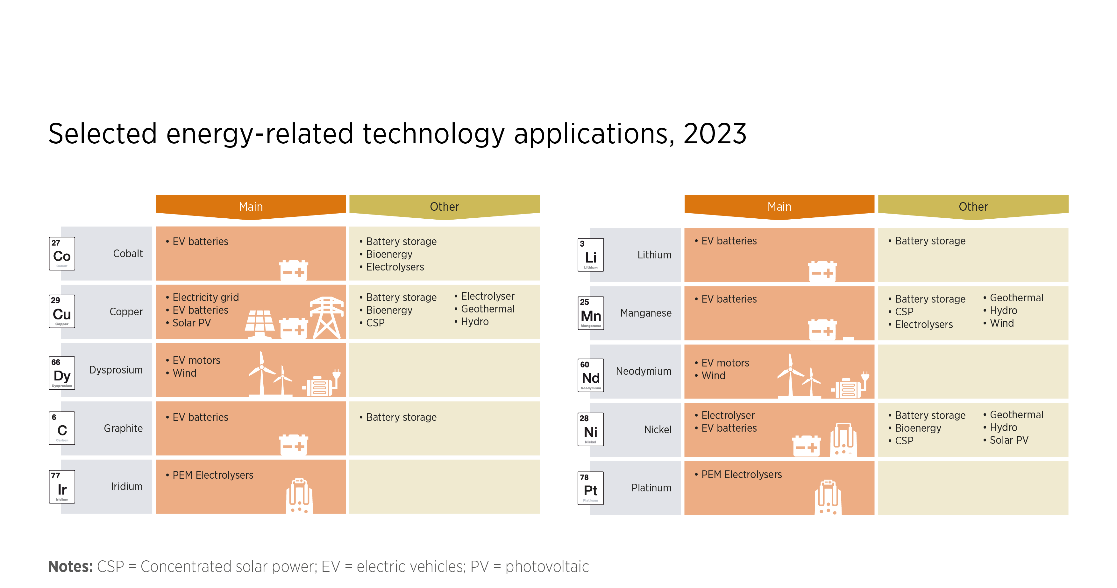
TABLE 1.1 Selected energy-related technology applications, 2023
37

Slide 38
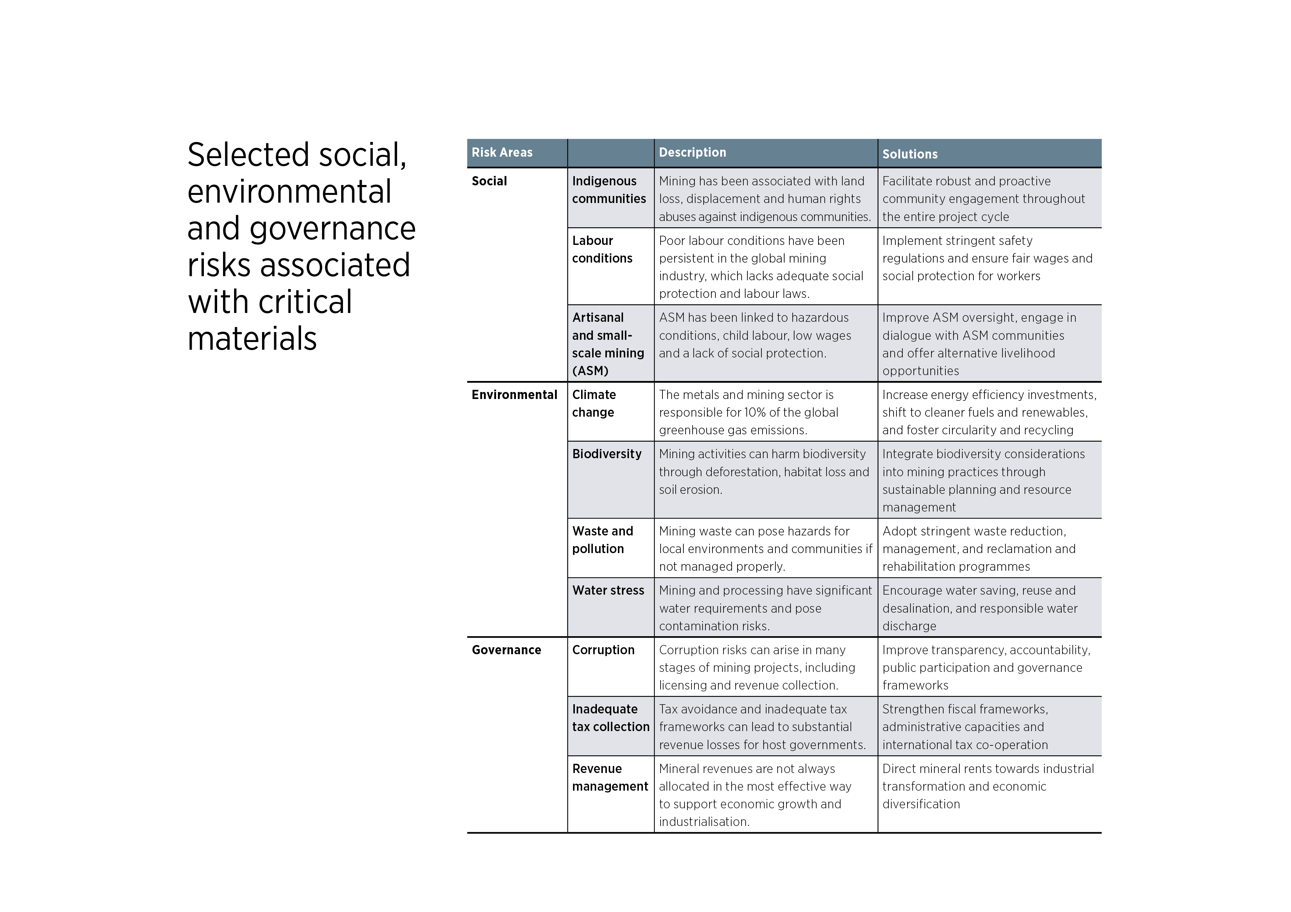
TABLE 3.1 Selected social, environmental and governance risks associated with critical materials
38

Slide 39
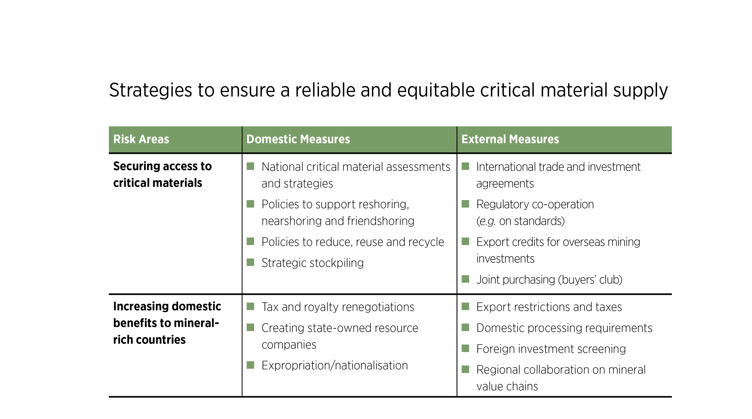
TABLE 4.1 Strategies to ensure a reliable and equitable critical material supply
39

Slide 40
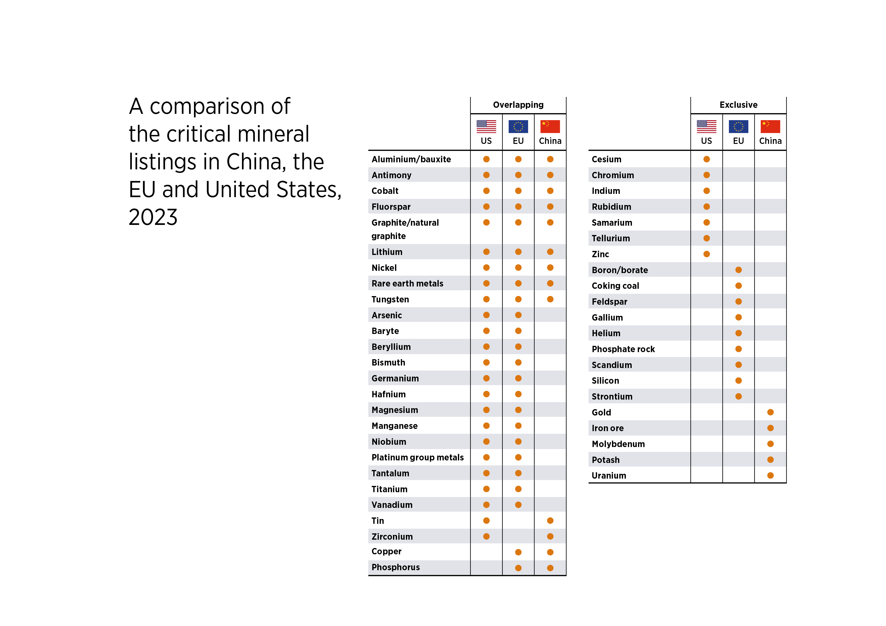
TABLE 4.2 A comparison of the critical mineral listings in China, EU and US, 2023
40

Slide 41
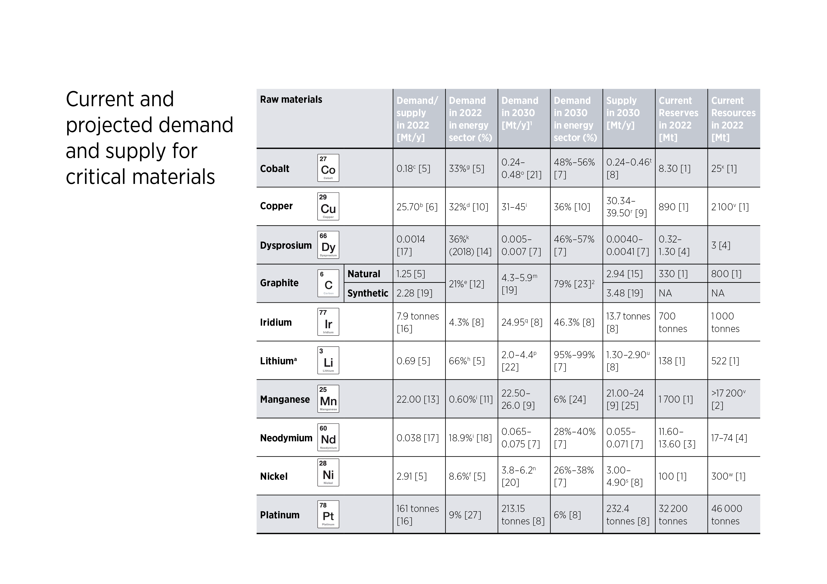
TABLE A1 Current and projected demand and supply for critical materials
41

Slide 42
Thank you!

