Slide 1
Francesco La Camera
Director-General
BETD24 • March 2024

Slide 2
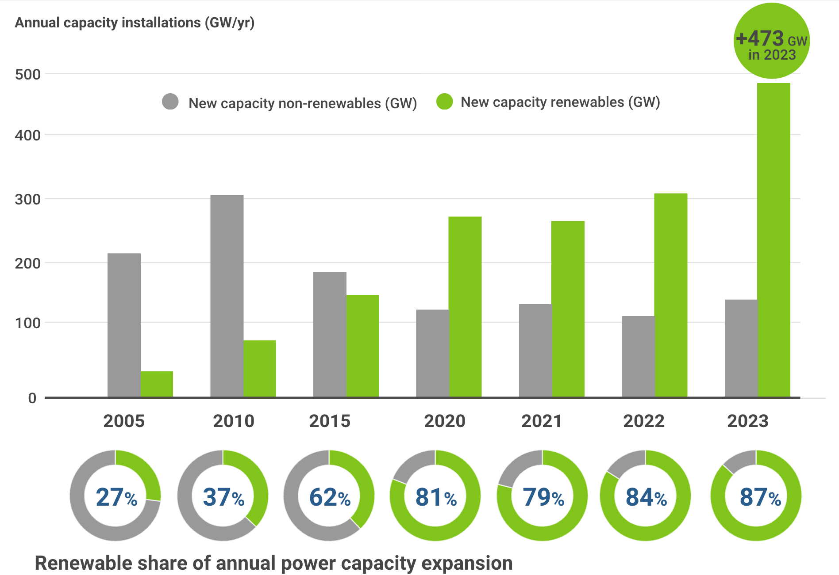
2023 set a new benchmark in renewable power deployment
2
Notes:
[Figure to be updated]
The most recent data highlights that 2023 set a new benchmark in renewable power deployment, adding 473 GW to the global energy mix, with solar accounting for 73 percent of the growth. New capacity was concentrated in China, the European Union, and the United States, collectively accounting for 83 per cent of additions. China reached a new milestone with 85% new capacity originating from renewable sources, driven by the decreasing costs of utility-scale solar and wind power, now competitive against coal and gas power generation.
Policies, together with geopolitical developments and falling costs, have been the critical catalysts in driving the rapid growth of renewable energy in the world's fastest-expanding markets. For instance, the European Union (EU) has experienced an extraordinary surge in renewable energy deployment, driven by enhanced policy focus, heightened energy security concerns, and the increasing cost-competitiveness of renewables compared to fossil fuel alternatives. This has led to a 37% increase in solar PV capacity since 2022, adding 56 GW, and an addition of 17 GW in wind power compared to the previous year.

Slide 3
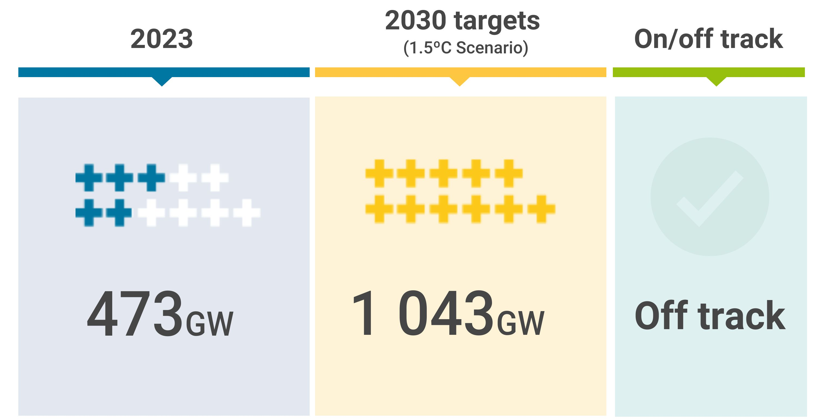
Annual renewable power capacity additions are off track
3

Slide 4
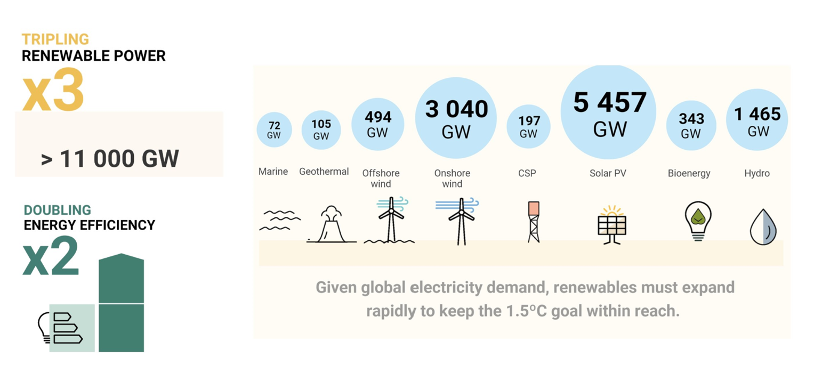
COP28 outcomes: Transitioning away from fossil fuels

Slide 5
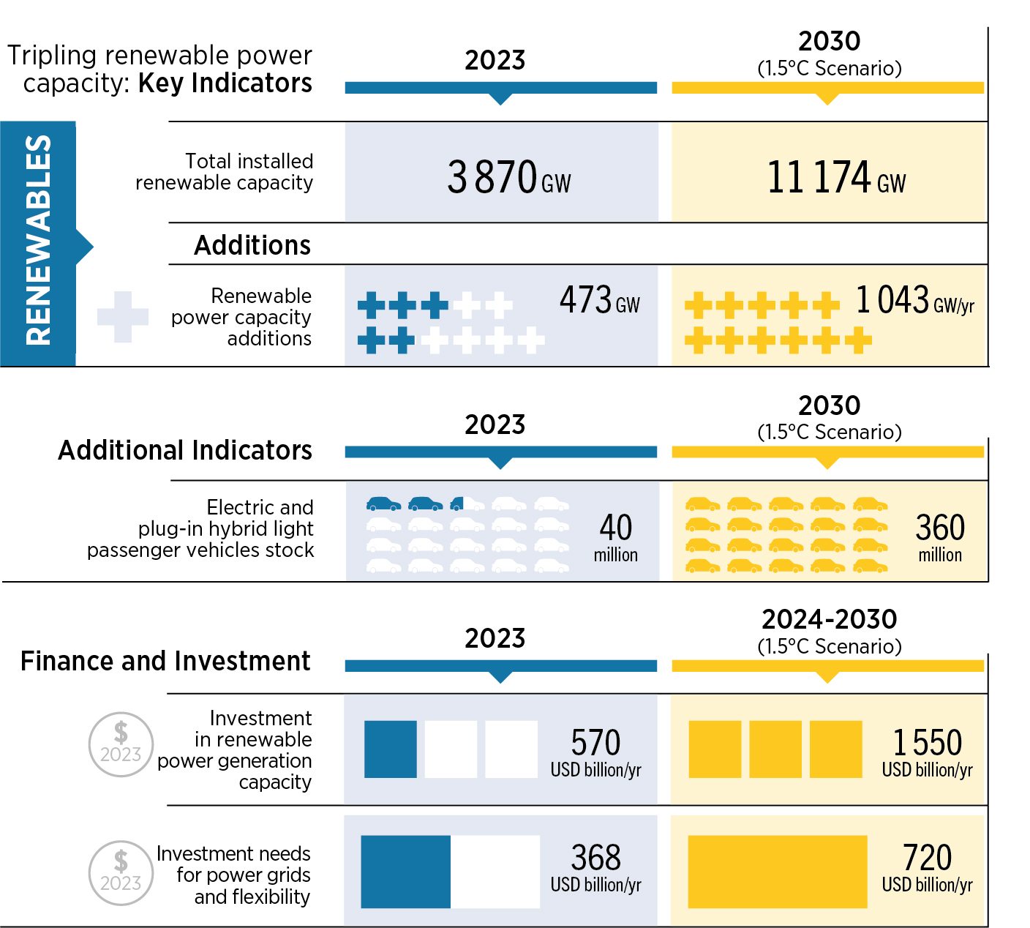
Despite some progress, the tripling renewable power capacity by 2030 is still off track
5
Notes:
[Figure to be re-designed]
The energy transition progress is inadequate and its trajectory is markedly off course. IRENA’s WETO 1.5°C Scenario shows that a systemic, comprehensive transformation of the energy system is required across all sectors. The latest data shows inadequate progress, especially those needed for a tripling of renewables power capacity by 2030 such as development of electric vehicles, electrolyser capacities, scale up of investments in power grids and flexibility as well as renewable energy jobs.
Achieving the tripling target is far from assured as an additional 7.2 TW of renewable power would need to be deployed to reach the required 11 TW by 2030. Global data indicates positive trends in renewable energy expansion and the record annual deployment of 473 GW in 2023 is timely. However, current projections for the coming 7 years suggest we will miss the tripling target without urgent policy interventions.
Progress in electrification of transport in 2023 is falling short of the required pace. According to IRENA's WETO 1.5°C Scenario, the electrification rate in the global transport sector would rise to almost 7% by 2030. Road transport emerges as the subsector with the highest potential for electrification.
Heat pump sales, essential for decarbonisation of the heat sector, are showing signs of slow down.
Achieving tripled commitments in renewable power capacity by 2030 also requires a parallel commitment to significantly increase electricity storage.

Slide 6
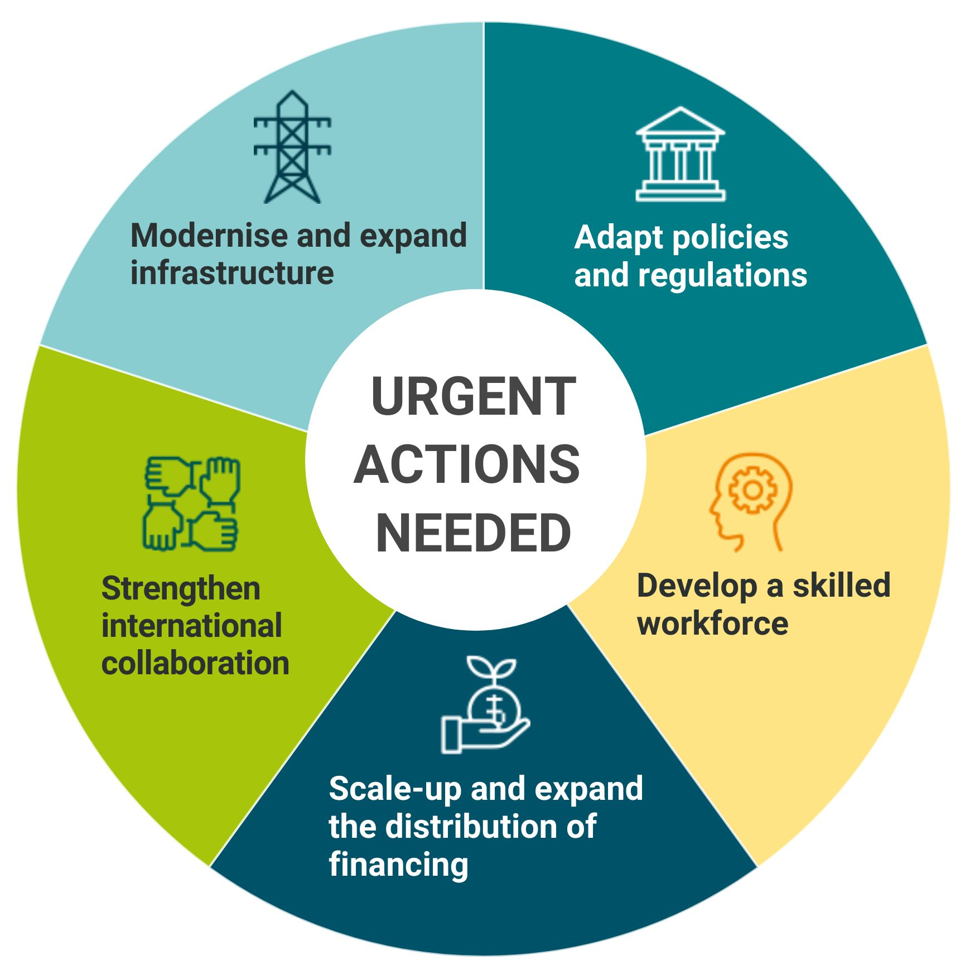
Systemic changes needed to overcome structural barriers impeding progress
6
Notes:
[Figure to be updated]
A systemic energy transition is necessary to overcome structural barriers impeding progress. Key enablers include the establishment of supporting infrastructure, robust policy frameworks, and the development of institutional and human capacities, backed by scaled-up financing and strong international cooperation. Realising the tripling pledge hinges on creating the conditions conducive to accelerated progress as numerous obstacles persist, particularly in the realms of physical infrastructure, policies and regulations, and skills development.
In addition, tripling renewables globally requires a massive scaling up of financing and strong international collaboration.
Scaling up finance for developing countries is a key priority. Despite the significant potential environmental and socioeconomic benefits that the energy transition can bring for emerging market and developing economies (EMDEs), they have received disproportionately low levels of investment. As defined and classified by the International Monetary Fund.
Structural changes, notably a reform of multilateral finance mechanisms, are essential to effectively support energy transition efforts and local value creation in developing countries.
Countries that are considering expanding fossil fuel production or its industrial value must weigh the risks of this strategy in the face of global shifts towards renewable energy sources.
Policymakers play a crucial role in supporting the shift to renewable energy by adapting market structures, reducing fossil fuel subsidies and establishing effective carbon pricing mechanisms.

Slide 7
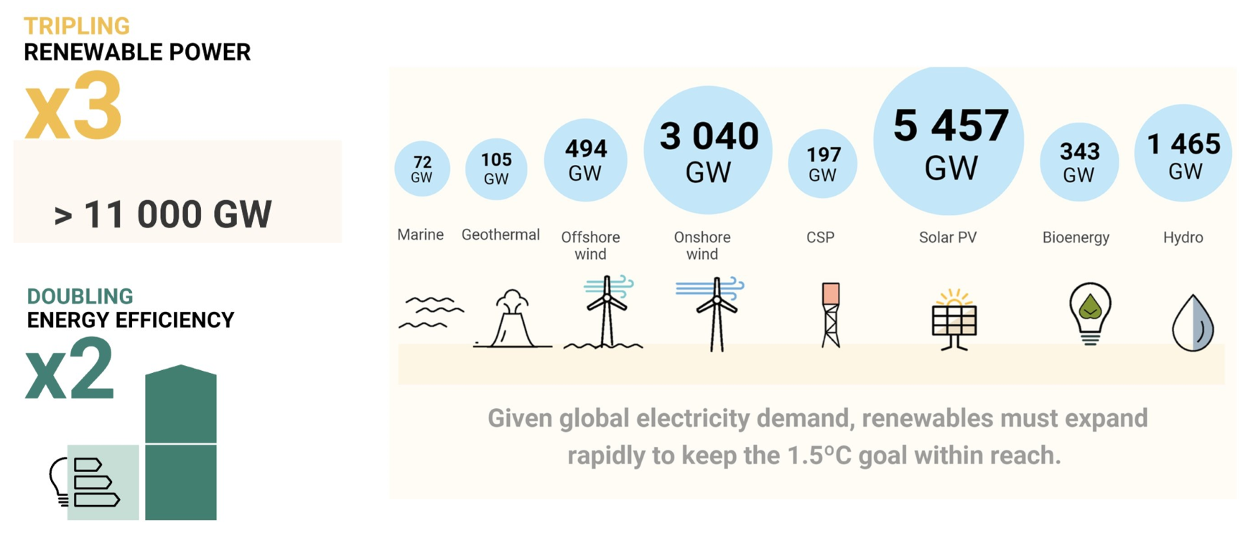
COP28 outcomes: Transitioning away from fossil fuels
7
Notes:
[Figure to be updated]
A systemic energy transition is necessary to overcome structural barriers impeding progress. Key enablers include the establishment of supporting infrastructure, robust policy frameworks, and the development of institutional and human capacities, backed by scaled-up financing and strong international cooperation. Realising the tripling pledge hinges on creating the conditions conducive to accelerated progress as numerous obstacles persist, particularly in the realms of physical infrastructure, policies and regulations, and skills development.
In addition, tripling renewables globally requires a massive scaling up of financing and strong international collaboration.
Scaling up finance for developing countries is a key priority. Despite the significant potential environmental and socioeconomic benefits that the energy transition can bring for emerging market and developing economies (EMDEs), they have received disproportionately low levels of investment. As defined and classified by the International Monetary Fund.
Structural changes, notably a reform of multilateral finance mechanisms, are essential to effectively support energy transition efforts and local value creation in developing countries.
Countries that are considering expanding fossil fuel production or its industrial value must weigh the risks of this strategy in the face of global shifts towards renewable energy sources.
Policymakers play a crucial role in supporting the shift to renewable energy by adapting market structures, reducing fossil fuel subsidies and establishing effective carbon pricing mechanisms.

Slide 8
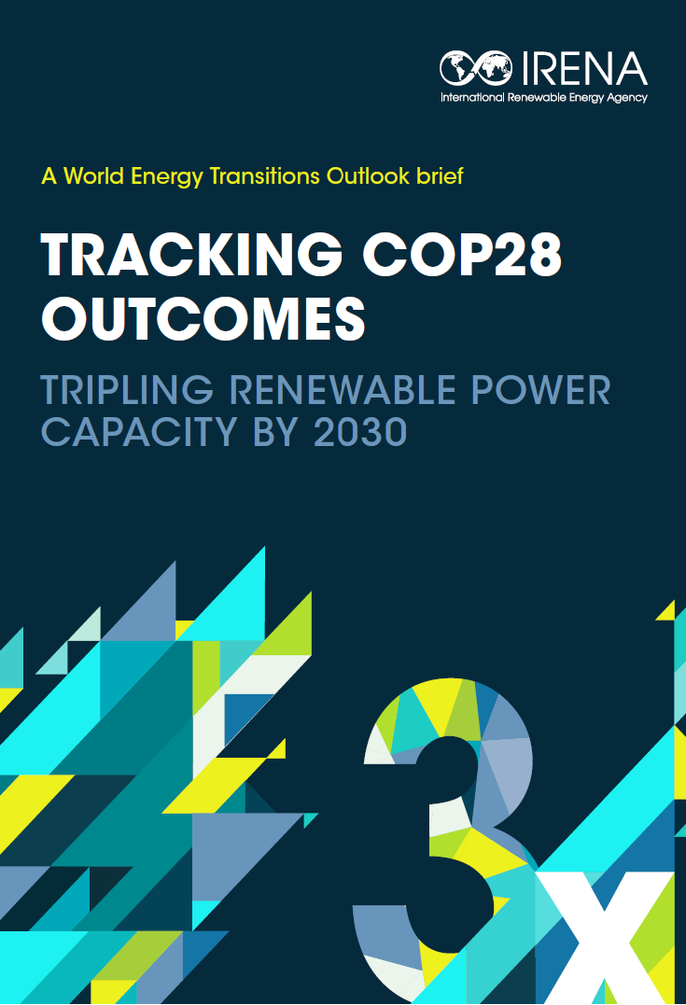

SCAN
TO GET THE BRIEF

Slide 9
Thank you!

