Slide 1
Delivering on the UAE Consensus
TRACKING PROGRESS
Francesco La Camera
IRENA Director-General

Slide 2
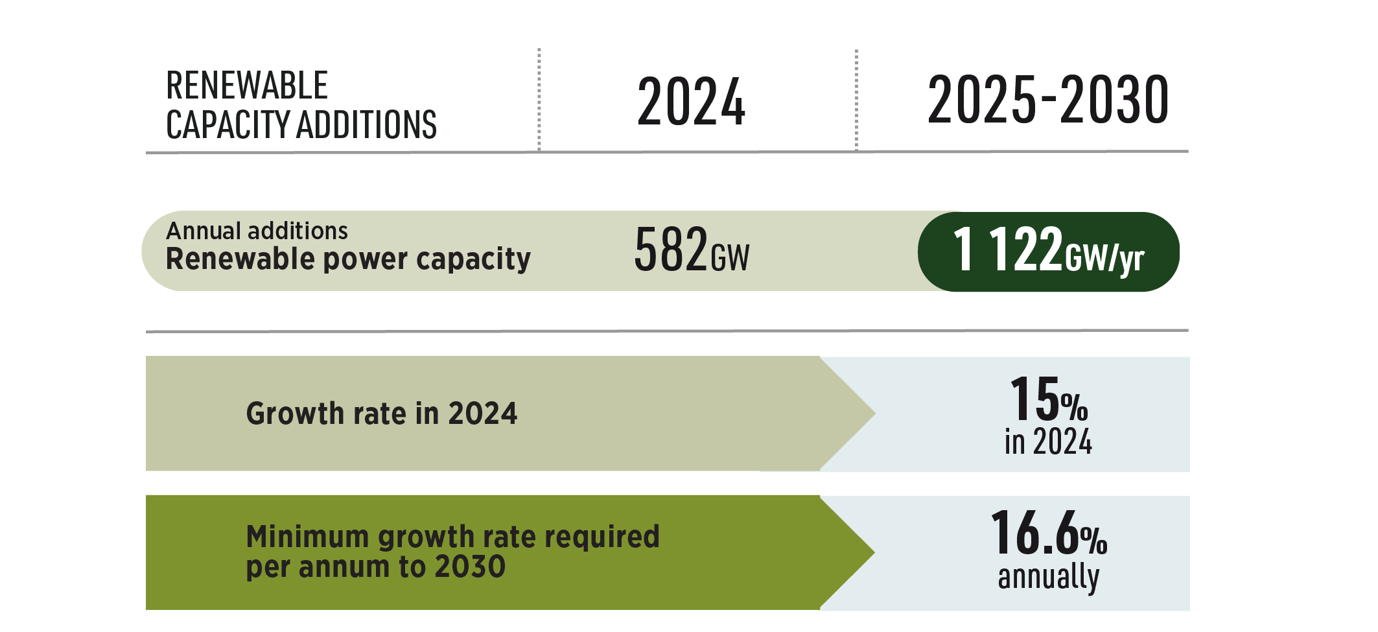
Renewable power growth in 2024
2

Slide 3
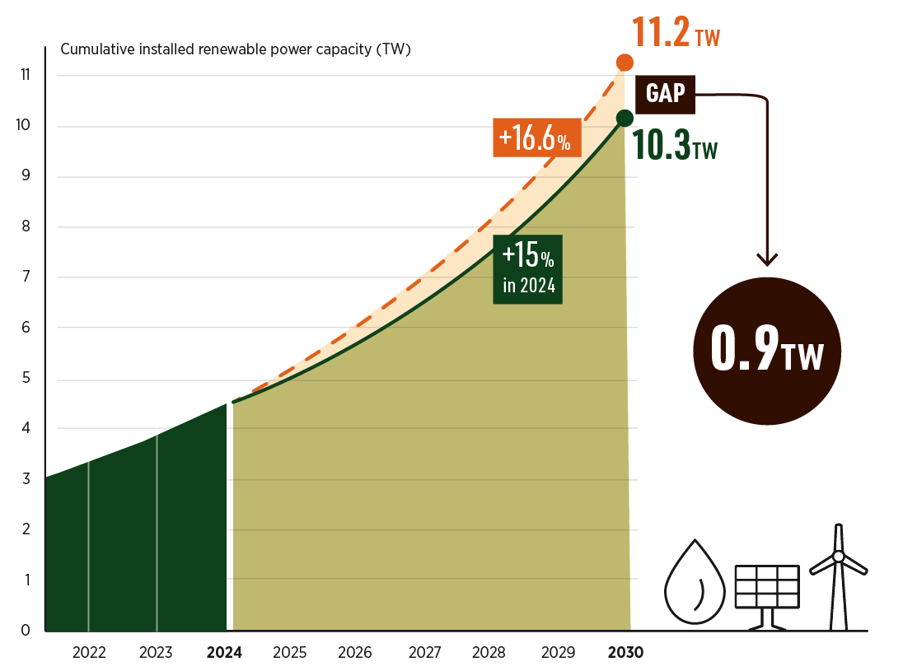
Closing the gap
3

Slide 4
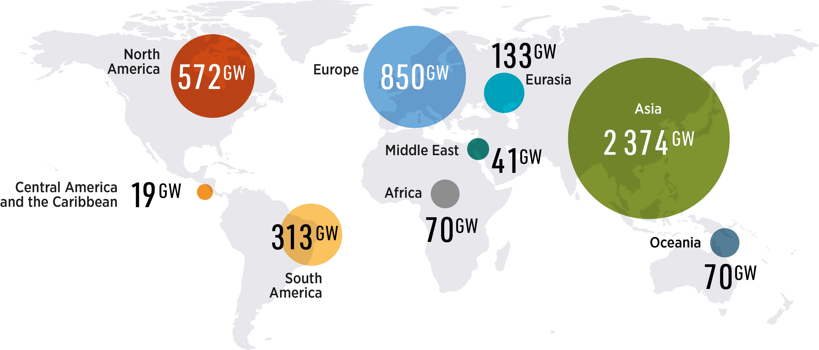
Renewable power capacity by region in 2024
4

Slide 5
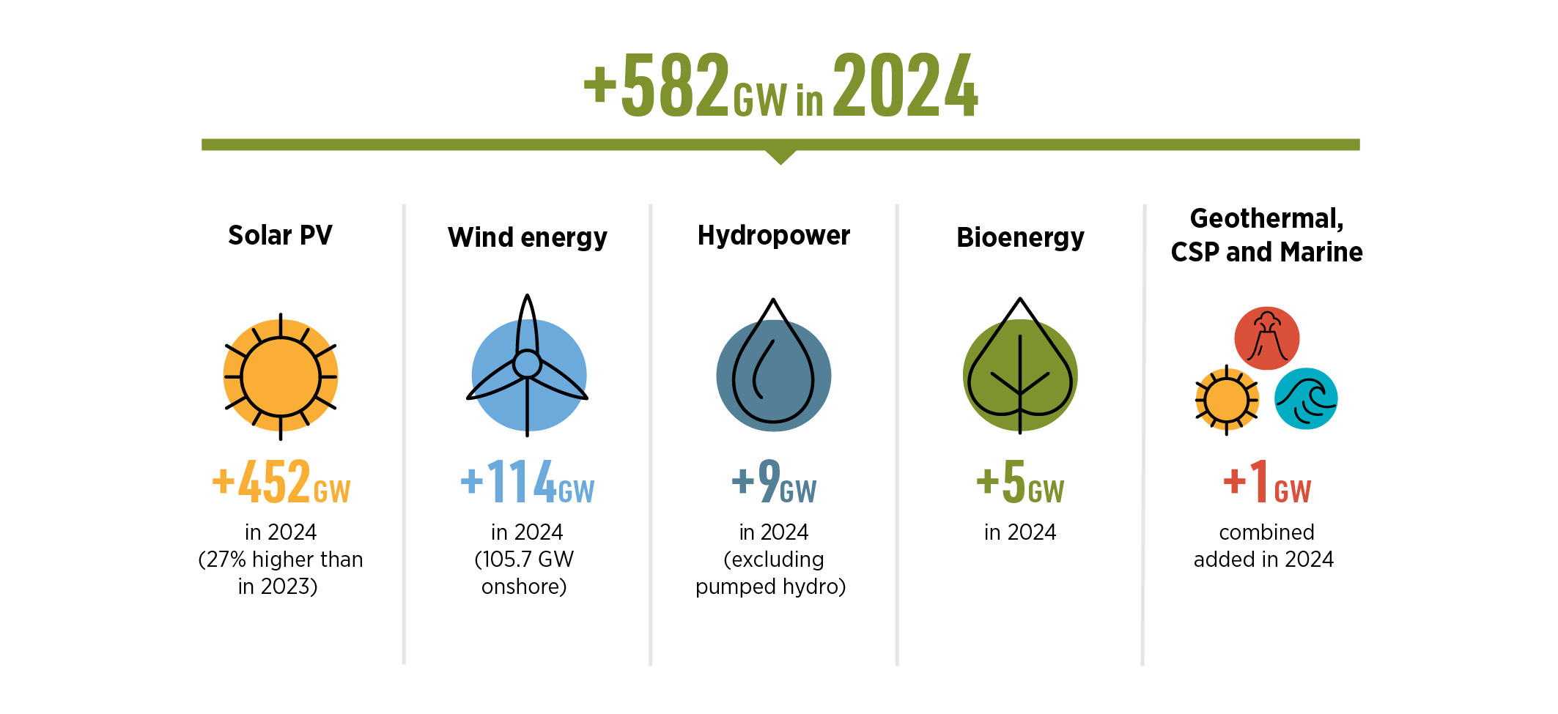
Renewable power capacity by technology in 2024
5

Slide 6
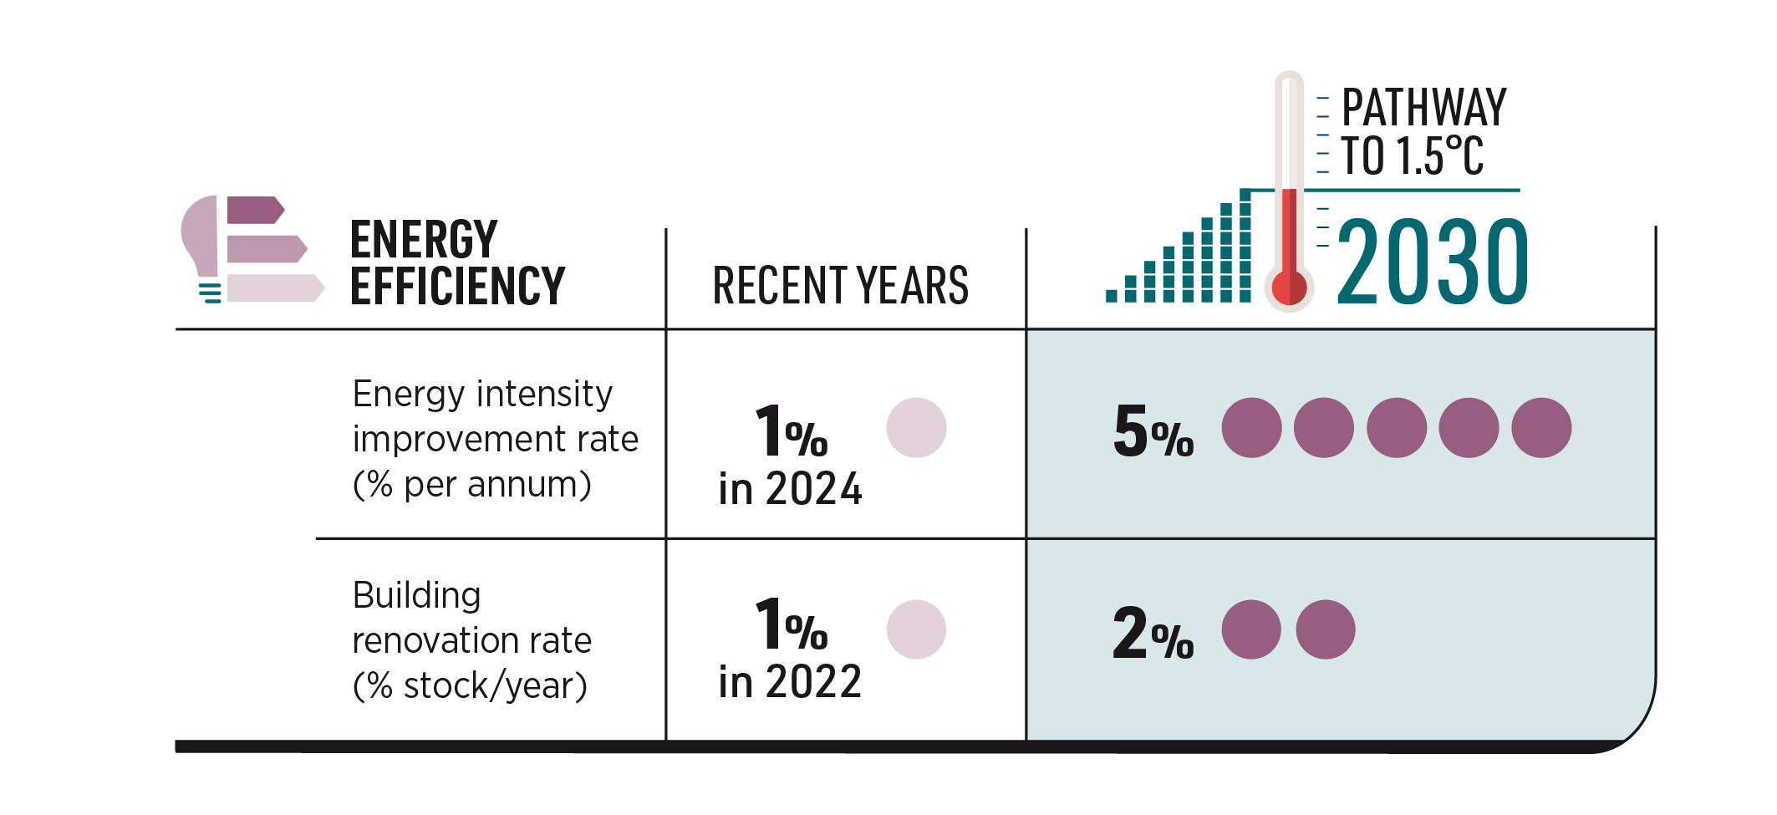
Energy efficiency improvement
6

Slide 7
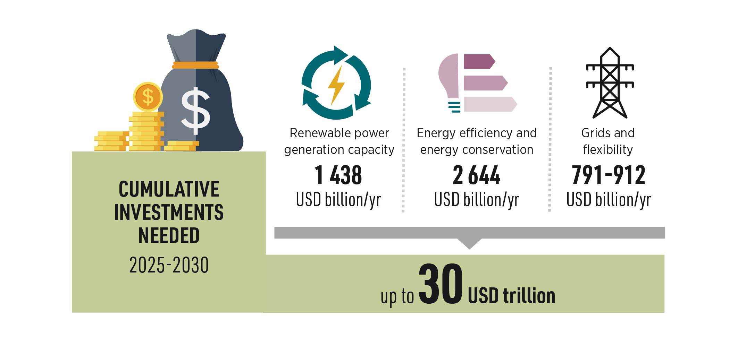
Investment landscape
7

Slide 8
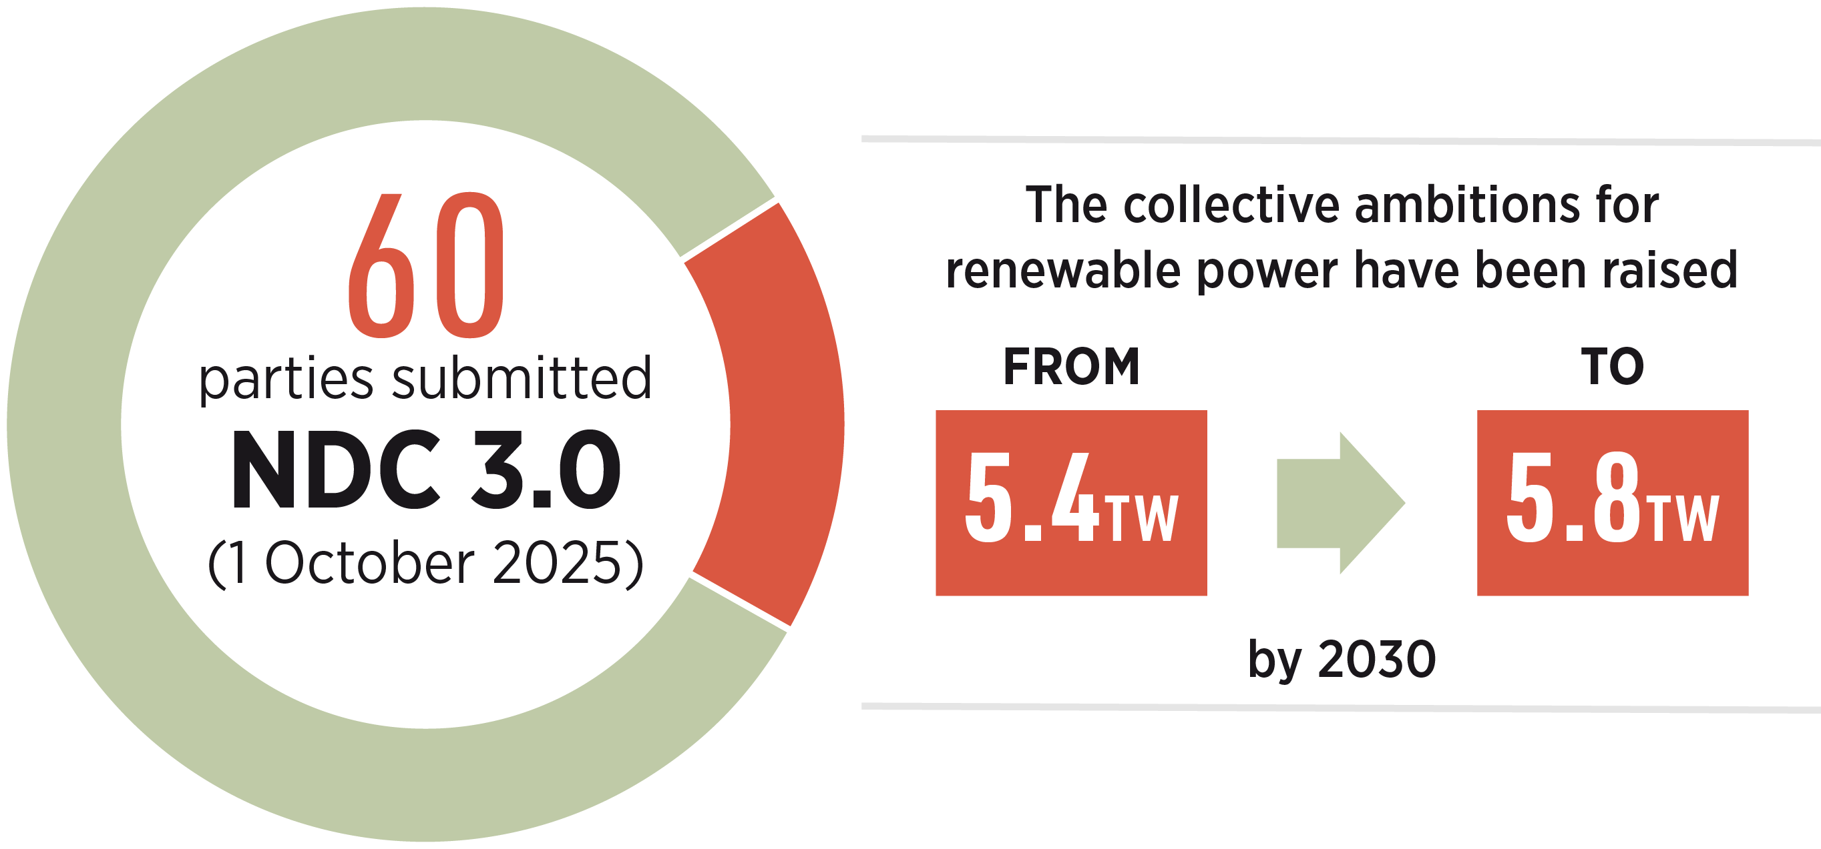
Raising Ambition in NDC 3.0
8

Slide 9
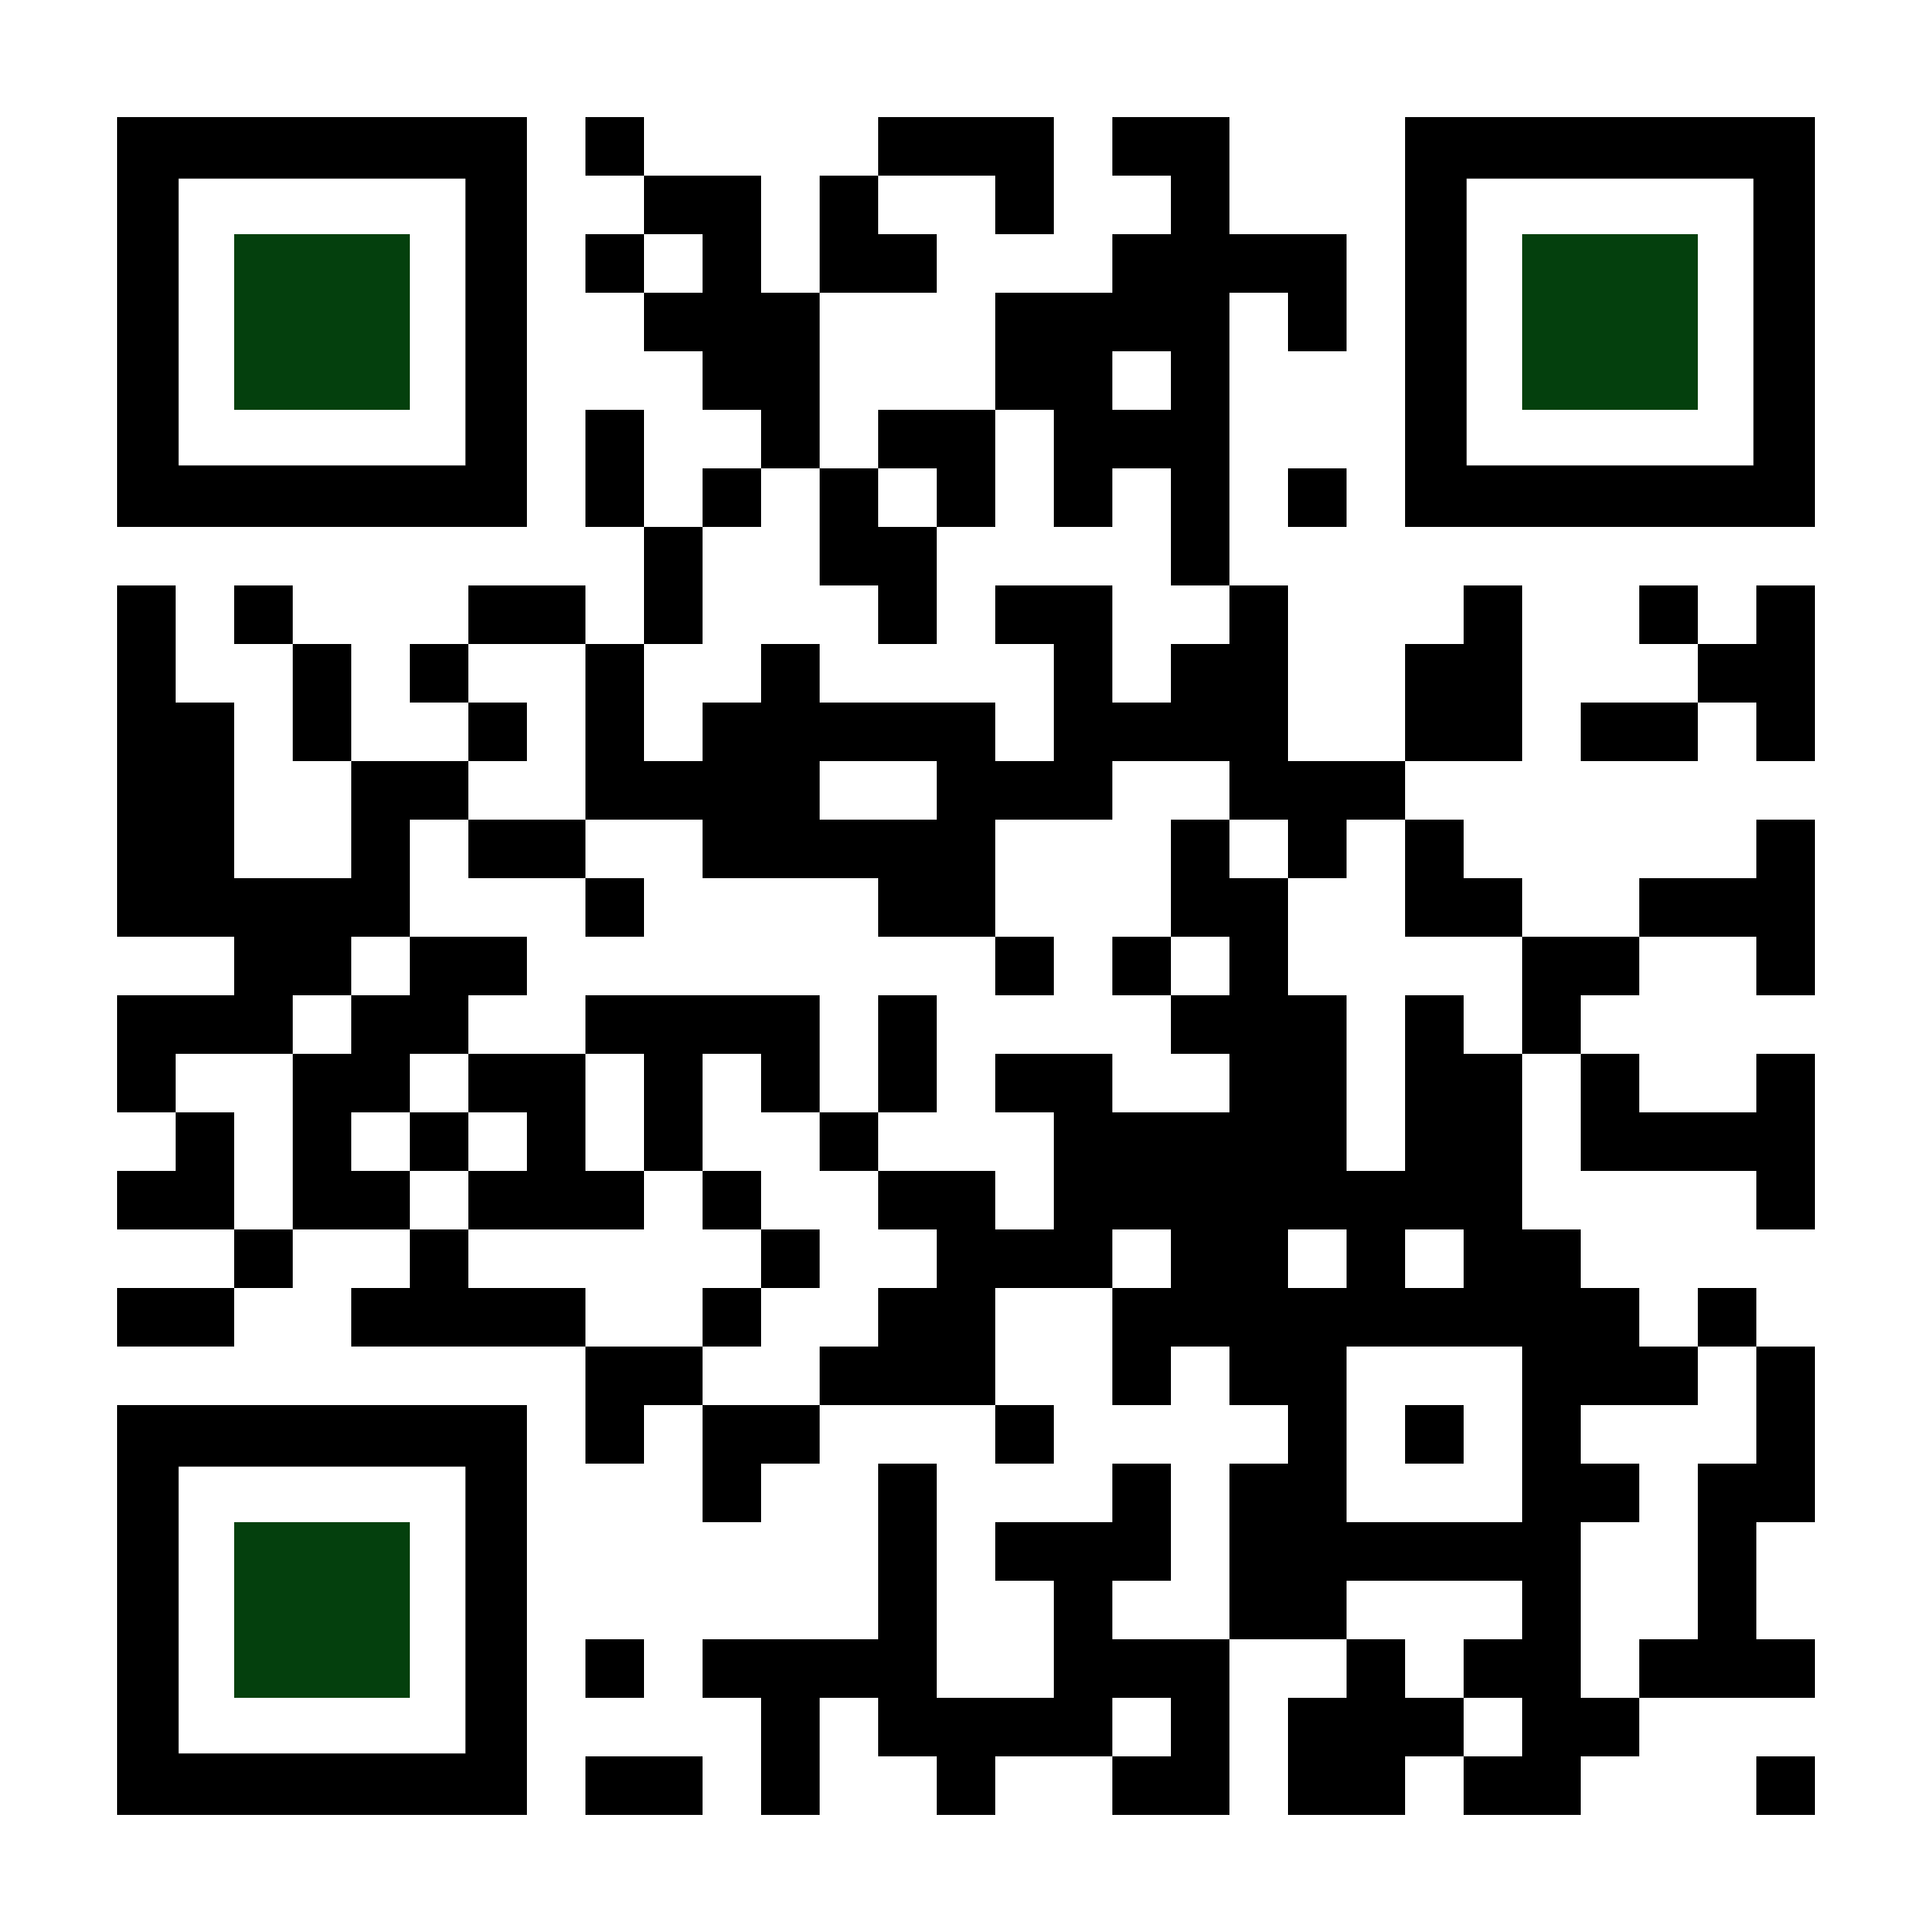
SCAN TO GET THE REPORT

